Slide 1
Protecting the Financial District and Seaport Neighborhoods from Future Sea Level Rise and Storm Surge NJ Coastal Resilience Collaborative 2025 Coastal Flooding Technical Workshop 3/19/2025

Slide 2
Agenda
1 Project Background
2 Wave & Hydrodynamic Modeling
3 Summary

Slide 3
Project Background

Slide 4
Financial District and Seaport Climate Resilience Plan
Notes:
I will be discussing the Fidi and seaport climate resilience plan, which sits between the battery and the Brooklyn bridge. This is a piece of a collection of coastal resilience projects that join together to protect lower Manhattan from future coastal storms and tidal flooding.

Slide 5
Financial District and Seaport Climate Resilience Plan
Conceptual Design Only
Notes:
The Flood protection could be buried within landscapes, incorporated into buildings, or deployed as flood gates before a storm
- Extended Shoreline for additional public space
- Embedded flood defense

Slide 6
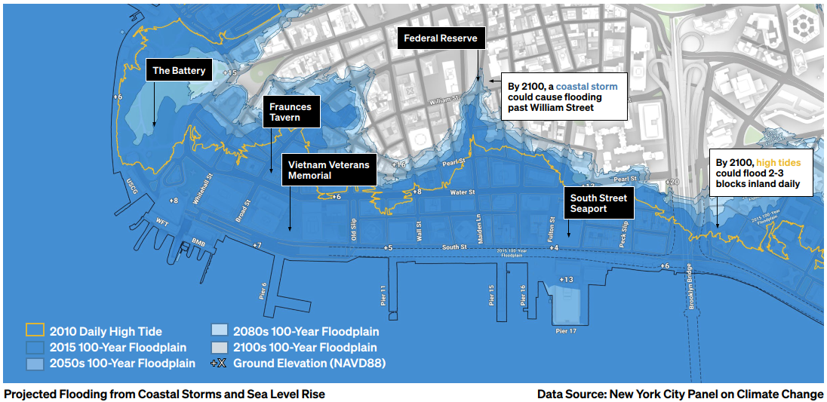
Project Motivation
Notes:
This area is very low lying with the ground elevations around 5-8 ft NAVD88. the projected SLR in 2050 is 2.5 ft and in 2100 6.25 ft, which will result in daily tidal flooding shown in the orange line several city blocks inland
Coastal flooding due to a 100-year storms could result in flood levels as high as 17.5 ft including wind driven wave height in 2100.
The motivation for this project is the projected SLR as well as coastal storm surge which is projected to extend the floodplain several blocks inland as well. This project has a design condition that includes a time horizon of 2100
Storm surge cause is high water levels so to assess future water levels and waves in the future I will be discussing today how climate change is considered in the modeling and therefore is considered in the design

Slide 7
Wave Modeling

Slide 8
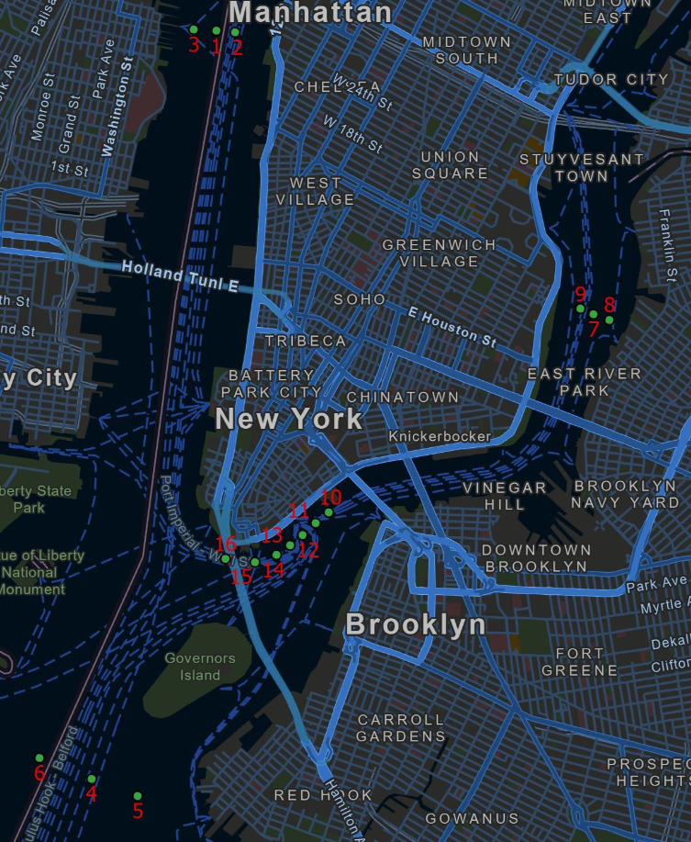
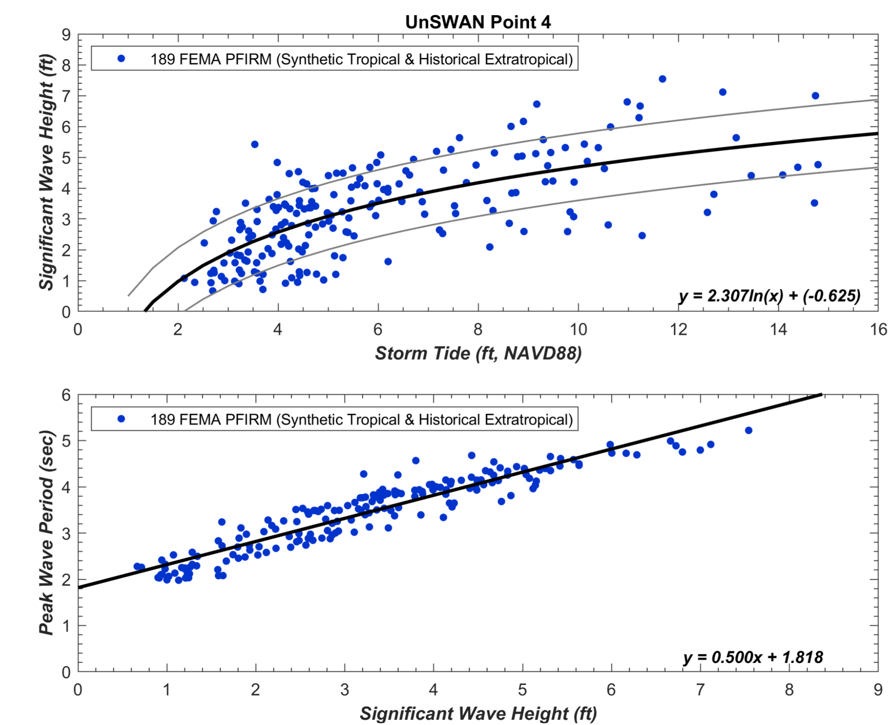
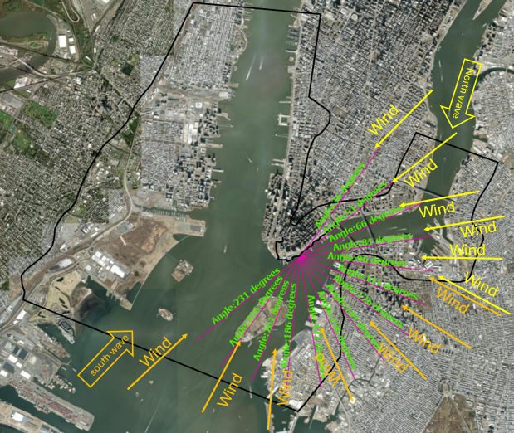
SWAN 2D Model Setup
Wind Direction
FEMA PFIRM Storm Set Regression Analysis
Notes:
Used 189 FEMA storm suite to establish regression relationships at the points shown in map on the right
Entire storm suite to derive a regression correlation between storm tide and wave height as well as between the wave height and mean wave periods. For a given SWEL like for the 1% annual chance storm which is near the battery NY 17 and NY 18 is a SWEL of 11.3 ft
The 3 black curves in the top graph of are simple polylogarithmic functions of the
logarithm of n (which in this case is storm tide), that best fits (in a least-squares sense) the data. The top and
bottom curves are the function plus and minus one standard deviation, which was also estimated from the data.
Using the NPCC SLR projections in 2050 and 2100, we had 3 SWEL to consider including present day , we used the peak wave period, wind speed, and significant wave height from the regression analysis discussed
This would give use future (2050 and 2100) 100 year storm conditions
Established a relationship between storm tide (SWEL) and sig wave ht and wind speed, and then sig wave height and peak period
At the boundary locations in the north of the project which is the east river and the south of the project, toward the Atlantic ocean
Total of 45 simulations:
15 directions x 3 water levels
100-year (+11.3 ft)
100-year + 2050’s SLR (+13.8 ft)
100-year + 2100’s SLR (+17.6 ft)

Slide 9
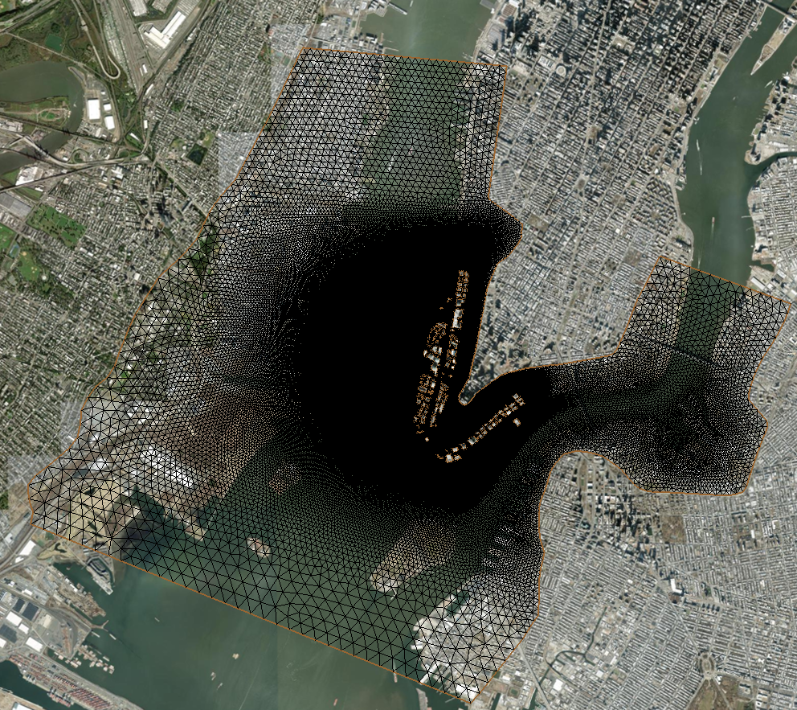
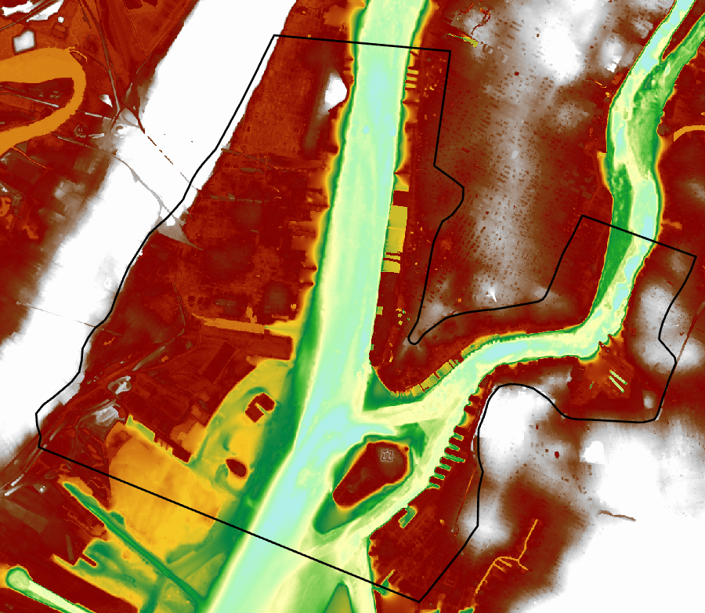
SWAN 2D Model Setup
North Boundary
South Boundary
Notes:
We used SWAN 2D (simulating waves nearshore) model which can output significant wave ht, wave period, spatially across the mesh you see here.
The mesh is more refined around the shoreline extension and floodwall
The bed level elevations of the mesh were created from both project bathymetry survey data and USGS CoNED topography. The topography included the elevations of the extended shoreline of the proposed project

Slide 10
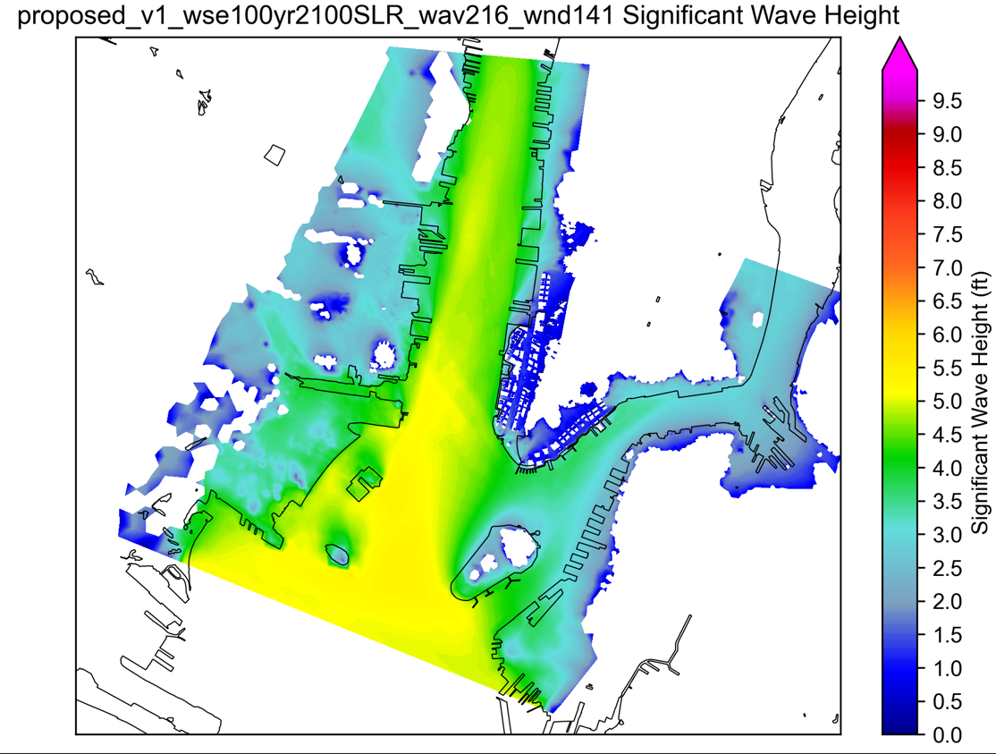
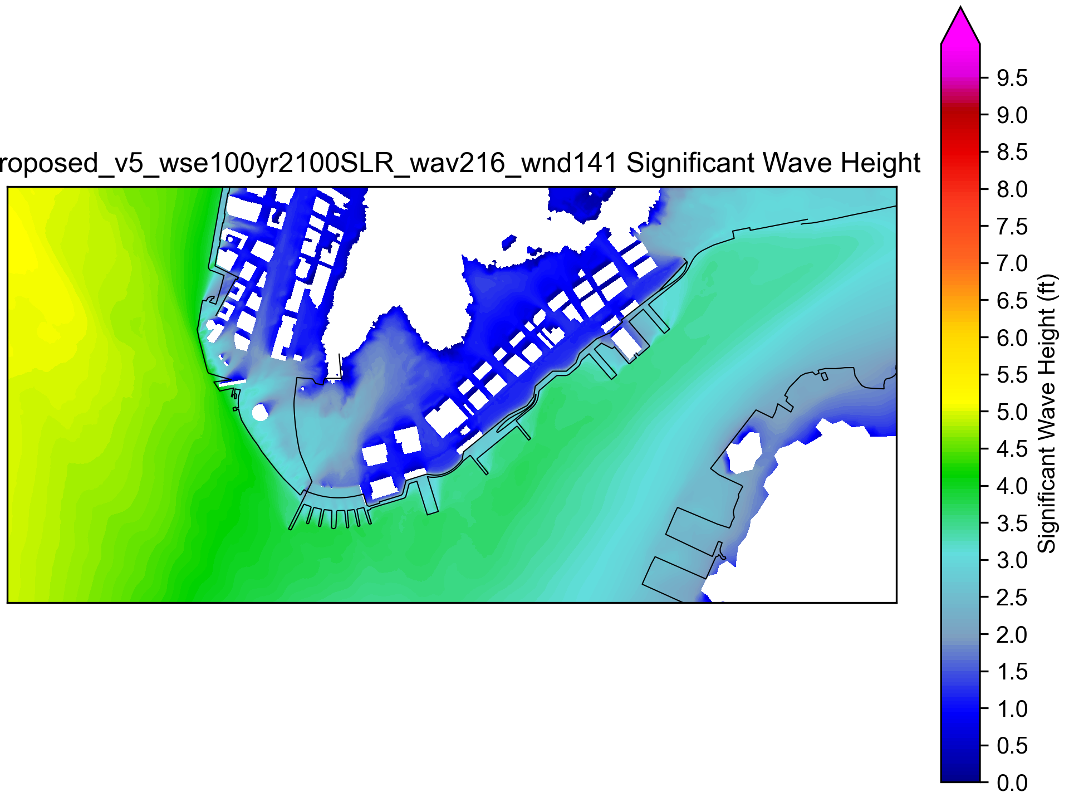
Wave Model Results at Project Location
Proposed Condition at 100-year Water Level with 2100’s SLR
Wave height field map (example shown at right is of wind direction 141 degree with southern incident waves)
Maximum wave heights can be extracted near the FiDi Seaport Climate Resilience Project considering SLR in 2100.
Wind
south wave
Notes:
This approach considers both projected SLR and wave heights expected with the higher water levels

Slide 11
Hydrodynamic Modeling

Slide 12
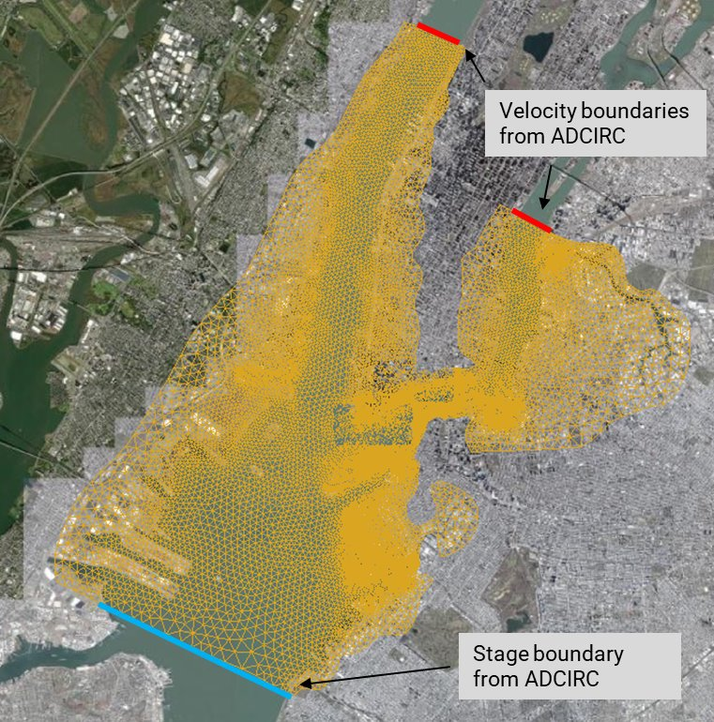
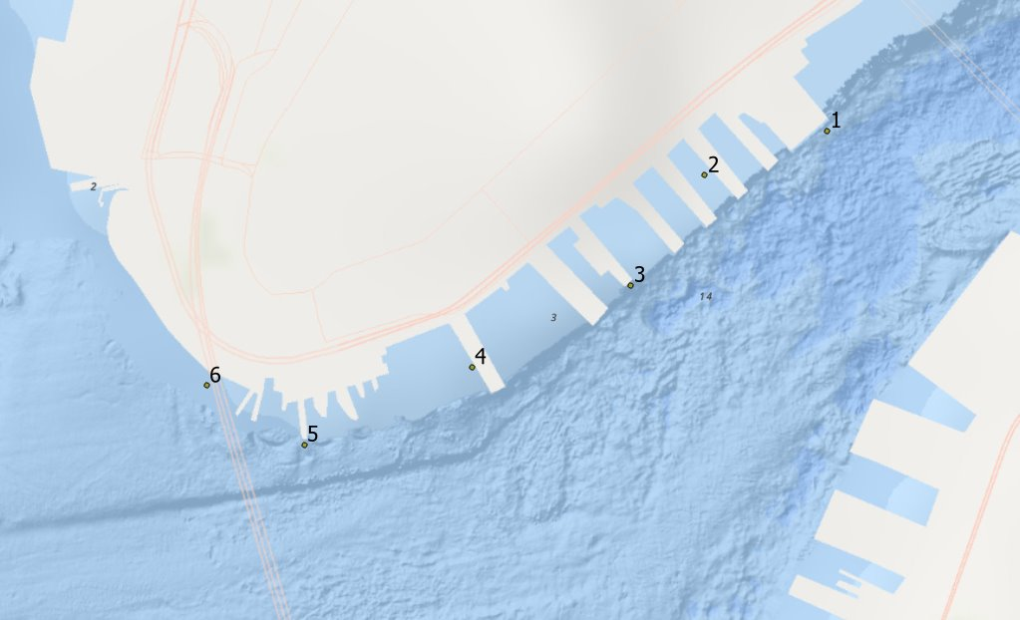
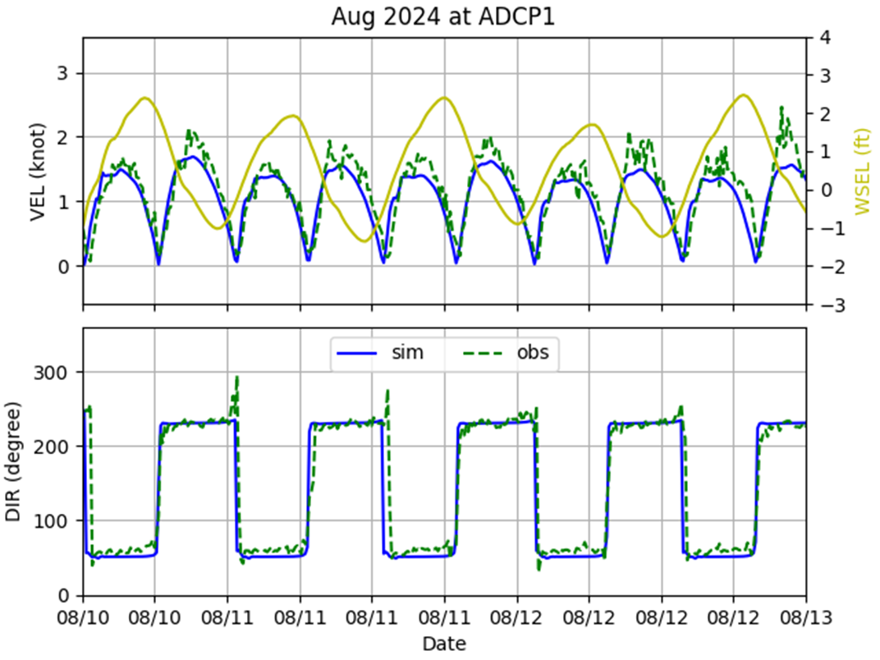
Delft 3D Model Setup & Calibration
ADCP locations
Calibration Results
Notes:
We also did Delft3D modeling for this project to understand how currents in the East River would be impacted by the project. We calibrated our model using ADCP measurements of depth, current velocity, and direction. ​
​
Once we had a calibrated model, we could explore implications of design decisions such as fendering and piers design.

Slide 13
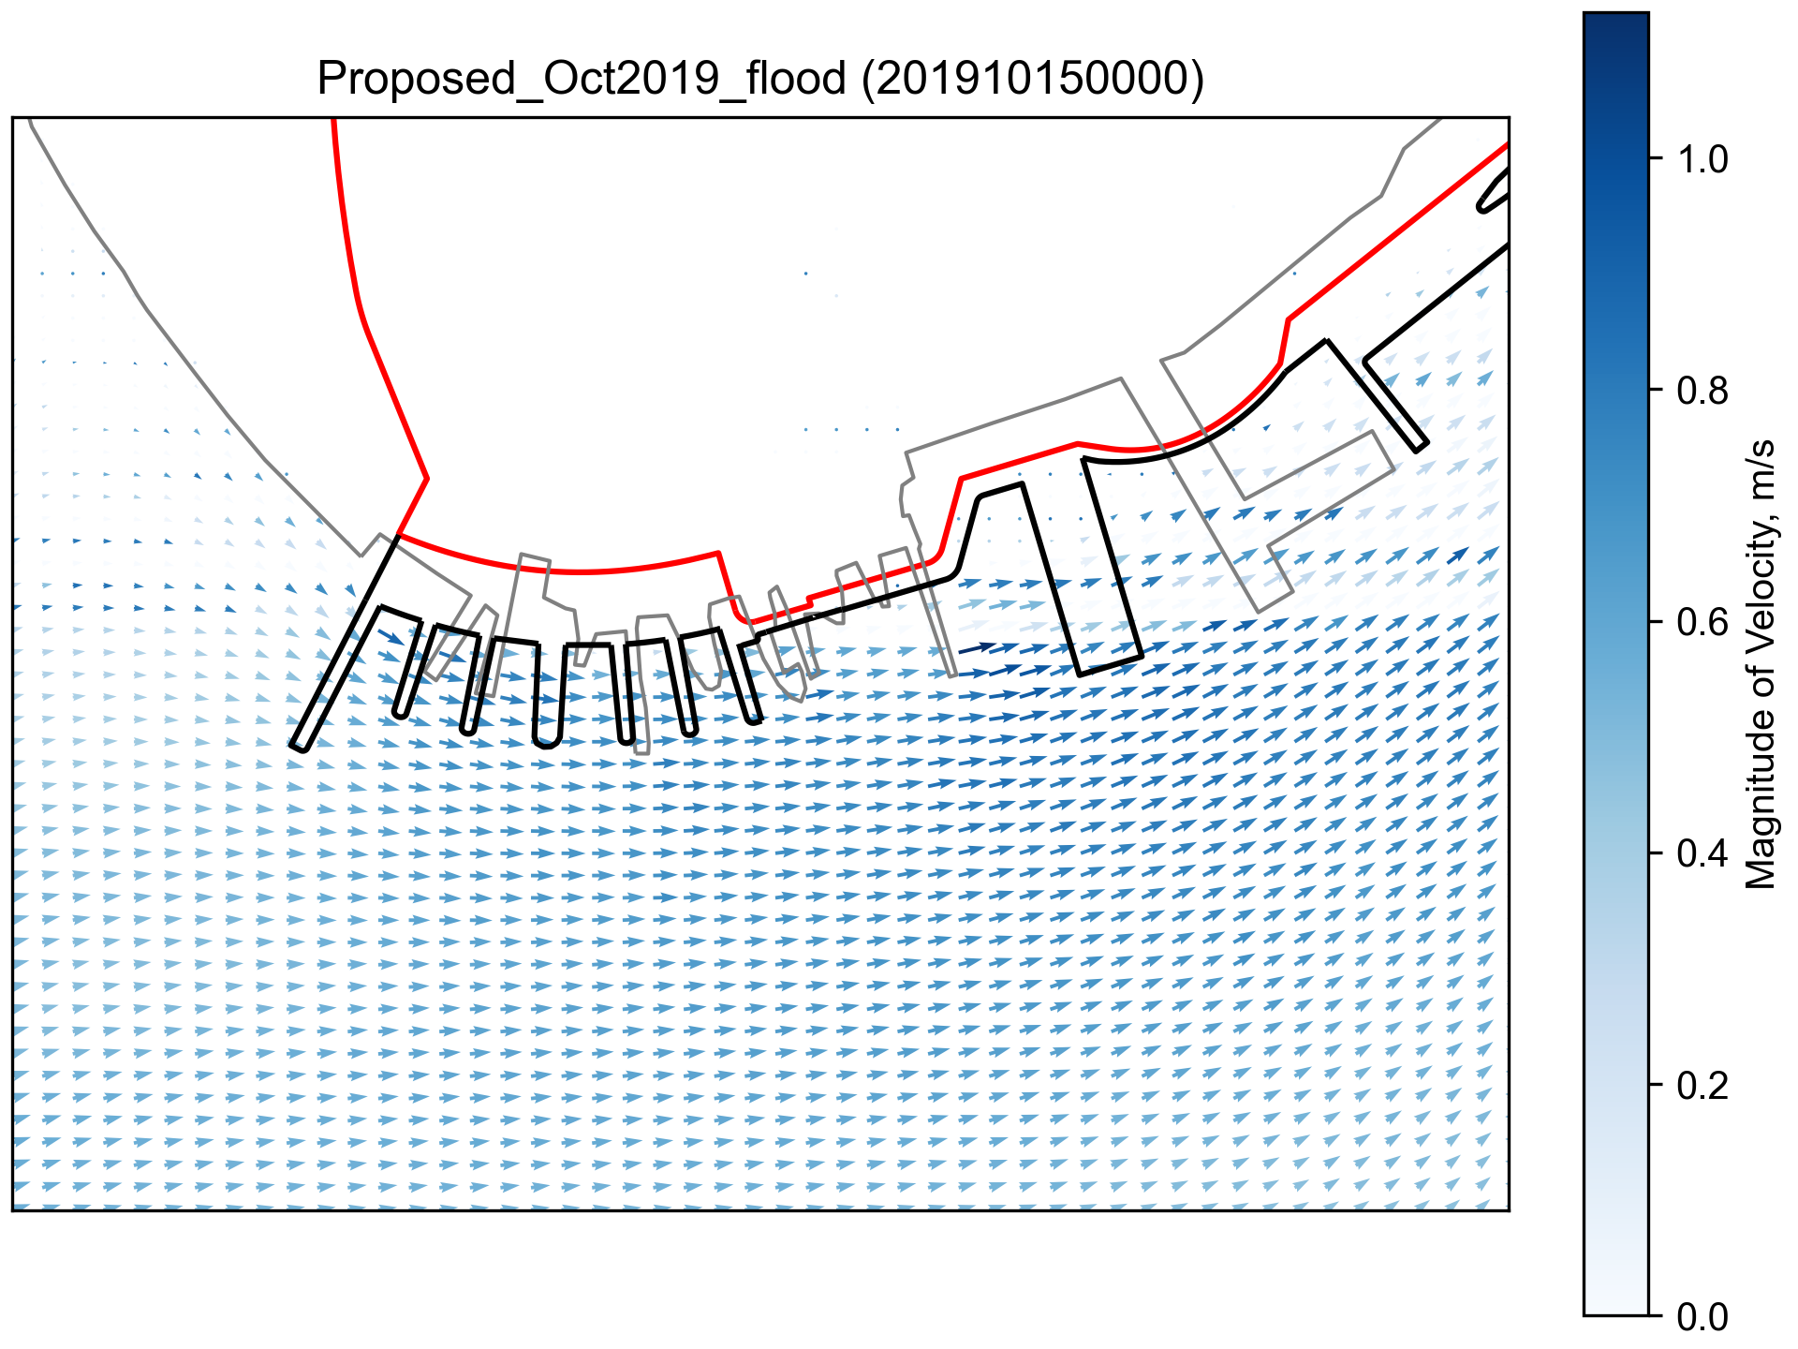
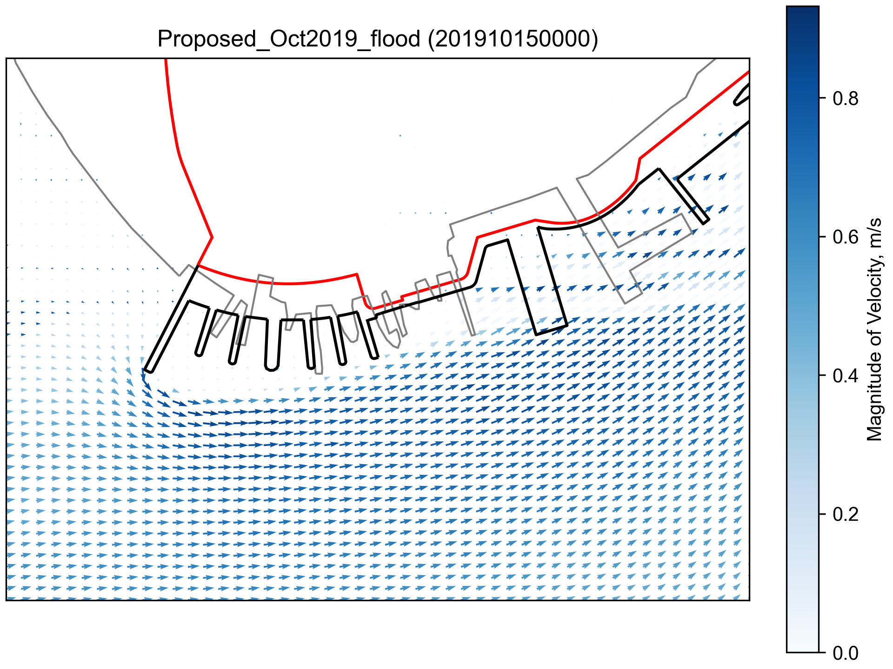
Fender Representation – Velocity Vectors
Fenders & Piers Represented with 0.035 Roughness
Solid Fenders, Piers Represented with 0.035 Roughness
Notes:
This presented an interesting modeling challenge: how we represent the proposed extended shoreline and new fenders and piers in the Delft 3D model. We were evaluating how the velocities in the east river would change given these new structures. This is especially important in this area because there are 3 maritime transportation hubs: USCG, Whitehall Ferry terminal (Staten island ferry), and the battery maritime building (GI ferry) and velocity changes could have rippling effects on ferry operations

Slide 14
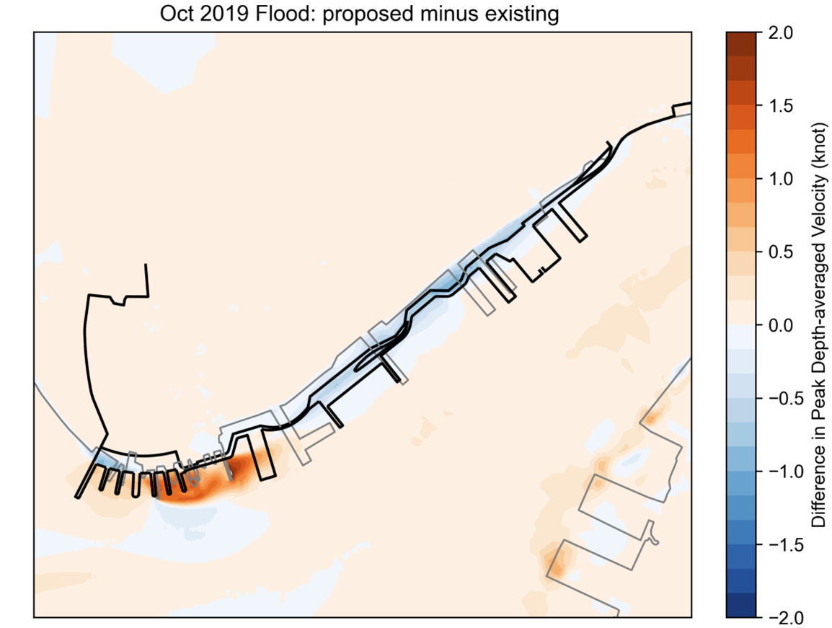
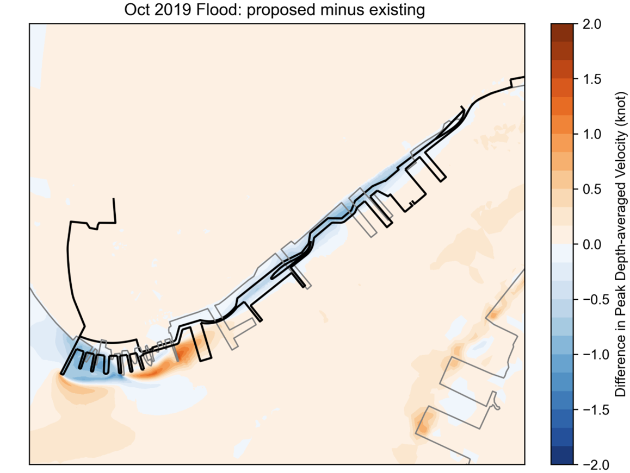
Fender Representation – Peak Depth Averaged Velocity
Fenders & Piers Represented with 0.035 Roughness
Solid Fenders, Piers Represented with 0.035 Roughness
Notes:
We want to minimize velocity changes with the new proposed shoreline/fenders. By having less permeable fender design, the velocities around the piers will be less impacted as seen in the solid piers resulting in lower velocity increases.

Slide 15
Coastal Modeling Summary
Purpose
Project Impact
Establish project design flood elevation, wave loading calculations, overtopping analysis
Wave Modeling
Software: SWAN 2D
Evaluate wave heights under future SLR
Evaluate the project impact to East River velocities
Optimize and refine conceptual fender configuration and design
Hydrodynamic Modeling
Software: Delft3D

Slide 16
Questions & Answers
Please reach out to the FiDi-Seaport Climate Resilience team with additional questions & comments at FiDiSeaportClimate@edc.nyc.
Thank you!
16

