Slide 1
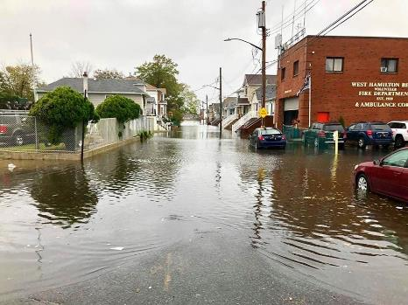
The Challenges of Managing Coastal Storm Risk in a Low-Lying Area Impacted by Frequent Flooding
March 19, 2025
DanaRose Brown - Coastal Engineer
Reegan McCaulley - Planner
Karen Baumert - Planner
Notes:
Photo Sources: Saturday flood hits in Howard Beach | | qchron.com
Howard Beach | Queens, NY August 9, 2015 | Keith Michael | Flickr

Slide 2
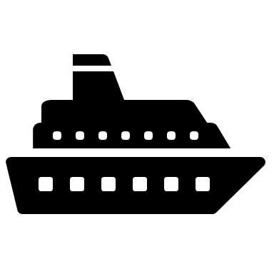
U.S. Army Corps of Engineers
Civil Works Missions
Coastal Storm Risk Management
Flood Risk Management
Navigation
Ecosystem Restoration
Partnership, Authorization, and Appropriation
Partner with local and state governments
Authorization and Appropriation from Congress
Notes:
Reegan
We are the U.S. Army Corps of Engineers, we are a federal agency, we have military and civil works missions, today we will be talking about the civil works mission of coastal storm risk management, but we also do FRM, Navigation and Ecosystem restoration. We do all work in partnership and typically cost share with state and local governments to study, design, and construct projects, we get all authorization and appropriation directly from Congress.

Slide 3
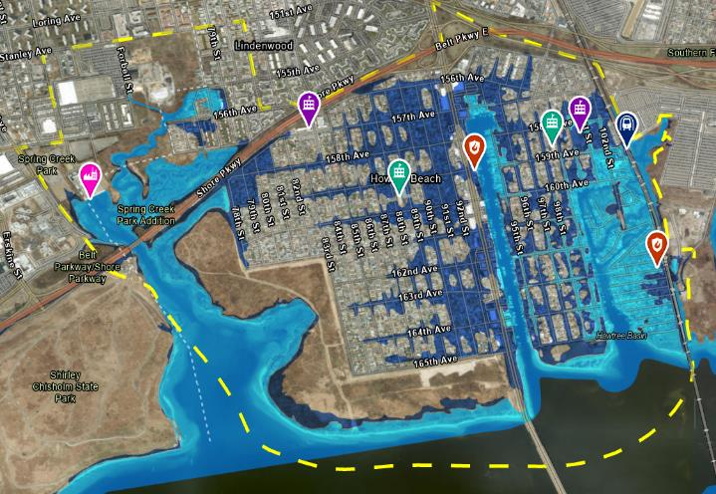
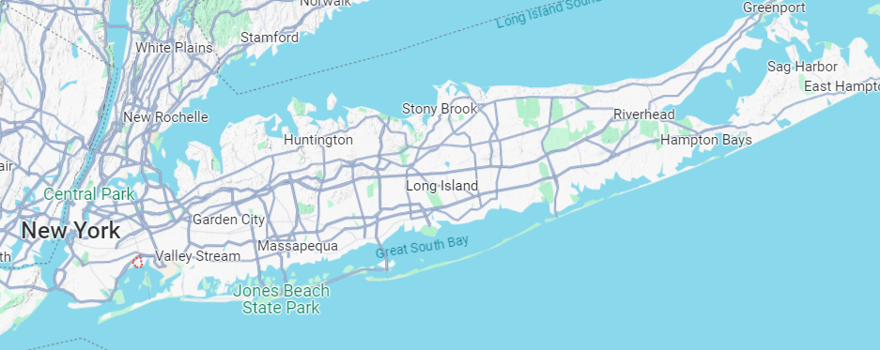
STUDY AREA
The Spring Creek South study area is location on the northern shore of Jamaica Bay. The Study Area includes the vulnerable communities of Old Howard Beach, Howard Beach, Hamilton Beach, and Lindenwood. The study area includes National Park Service Property and borders John F. Kennedy International Airport.
St. Helen Catholic Academy
Our Lady Grace Howard Beach
Study Area
Boundary
FDNY
Engine 331 & Ladder 173
Spring Creek Auxiliary Water Pollution Control Plant
PS 146
Howard Beach
Howard Beach – JFK Airport (MTA)
FEMA
1% Annual Flood Hazard
PS 207
Rockwood Park
West Hamilton Beach Fire Department
0.2% Annual Flood Hazard
Spring Creek South Park - NPS
Cross Bay Boulevard
A Line Subway Tracks
Notes:
Reegan
The Study area we are talking about today is located in the State of New York, Borough of Queens, New York City. More specifically we are on the northern shore of the Jamaica Bay. The Study area shown in yellow here encompasses all identified areas subject to risk by the FEMA 500-year floodplain. It includes the communities of Howard Beach, Old Howard Beach, Lindenwood, and Hamilton Beach. This figure also outlines some of the critical infrastructure in the area which includes a WWTP, Fire Depts, Schools, and an MTA Subway Station. John F Kennedy International Airport is also located directly East of our study area. HTRW is a major concern as we know there is an ongoing CERCLA investigation in the large undeveloped area shown here, Spring Creek Park, that is owned and operated by the National Park Service.

Slide 4
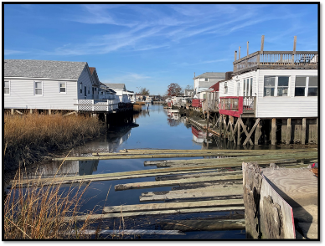
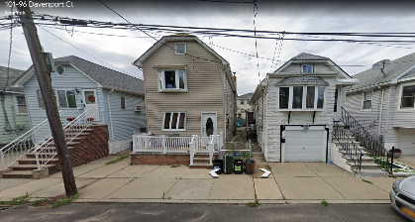
Structures in the Study Area
~200
~20
~30
~5000
Notes:
Reegan
This map is to show the land use of the study area, as you can see its densely populated, the green shows that it is mostly residential, some pockets of commercial structures shown in red , and some industrial and public facilities throughout shown in blue and yellow. The photos on the right hand side are to highlight that some residential structures are raised to varying heights in the study area, and there is development directly on the waterways.

Slide 5
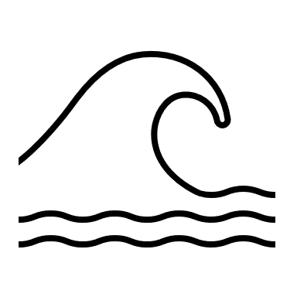
CONSIDERATIONS and constraints
VARIOUS PROJECTIONS OF SLC
EXISTING HTRW
LOW LYING DEVELOPMENT
TIE-IN AVAILABILITY
WATER LEVELS
TRANSPORTATION IMPACTS
VIABILITY AND ACCESSIBILITY OF STRUCTURES:
Assumption: Structures that are inaccessible at Mean Higher High Water (MHHW) in the future are not eligible for elevations nor floodproofing.
INACCESSIBILITY = 6” OF WATER DEPTH AT MHHW IN IMMEDIATE VICINITY IN 30 YEARS
Notes:
Reegan
There are many considerations and constraints within this study area. DR will touch more on these throughout her slides but to name a few, we have rising water levels with various projections of SLR, we know there will be impacts to transportation including major evacuation routes, there is existing and known hazardous toxic and radioactive waste that we are actively avoiding, there is low lying development and space and elevation constraints on available tie-ins for coastal storm risk management features.
We have to take viability and accessibility of structures in the future into consideration as we typically assume that structures that will be inaccessible at MHHW in the future would not be eligible for elevations or floodproofing. Therefore, this category of structures would likely result is buyouts. Inaccessibility it this case has been defined as structures with 6 inches of water on the ground in their immediate vicinity at MHHW in 30 years (so in this case 2055).

Slide 6
Preliminary Strategies used for scoping
STRATEGY | DEFINITION | MEASURES TO BE CONSIDERED | ALTERNATIVE ITERATIONS TO BE DEVELOPED ACROSS
DEFEND | Keep coastal waters out and stay in place | Structural measures such as floodwalls, levees, vegetated berms, storm surge barriers, and road raisings | Lower frequency / higher intensity Higher frequency / lower intensity
ACCOMMODATE | Let coastal waters in, stay in place | Nonstructural measures such as floodproofing, and elevations, and structural measures such as road raisings and ringwalls | Lower frequency / higher intensity Higher frequency / lower intensity
RETREAT | Let coastal waters in, move out over time | Nonstructural measures such as relocation or acquisitions of structures at high risk | Lower frequency / higher intensity Higher frequency / lower intensity
HYBRID | Combination of the above strategies | Relocate or acquire structures at highest frequency risk, setback structural measures | Lower frequency / higher intensity Higher frequency / lower intensity
Notes:
Reegan

Slide 7
Current water levels
The majority of the study area would currently be inundated by a 1% (100-yr) annual exceedance probability (AEP) event
Hamilton Beach is the most vulnerable section of the study area and is expected to currently experience some inundation during a 100%
(1-year) AEP event
Current MHHW is not high enough to cause consistent inundation in the study area
Old Howard Beach
Hamilton Beach
MHHW (current) | ~40 Structures
100% AEP (current) | ~290 Structures
1% AEP (current) | ~4,730 Structures
Notes:
DR
To help us better understand the existing conditions, this figure shows the current water levels in the project area - the purple shows the current inundation during MHHW, the blue line shows the current inundation during a 1-year event, and the green shows the current inundation during a 100 year event. As you can see, even at current sea level conditions we expect significant flooding at the 100-year event with inundation through the majority of the study area. Portions of Hamilton Beach are also vulnerable during a 1-year event and some even see inundation at high tide.

Slide 8
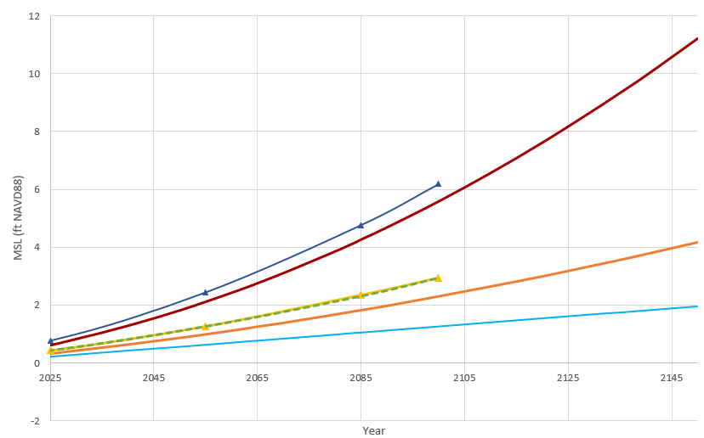
PROJECTED SEA LEVEL CHANGE SCENARIOS
~ Planning Horizon
USACE High
~ Period of Analysis
USACE Intermediate
USACE Low
Notes:
DR
Here you can see the projected sea level change scenarios for our project area, including the USACE low, intermediate, and high projections, as well as the NY state intermediate and high and NYC high. There is a lot of uncertainty about what the future holds, and as shown here there is a wide range of possibilities. Historically, the average sea level trend has been tracking between the intermediate and high USACE projections, so we will be focusing on both of these in the coming slides.

Slide 9
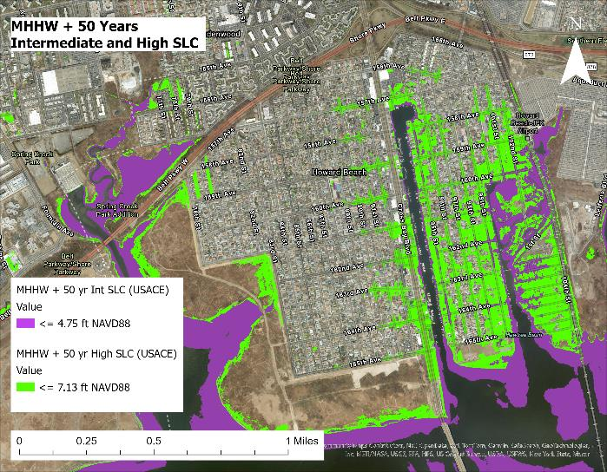
Mean higher high water with 50-Year sea level rise - retreat
Lindenwood
Howard Beach
Old Howard Beach
Hamilton Beach
Notes:
Looking at a frequently occurring scenario, the figure on the left shows future high tide flooding at MHHW with 50 years of intermediate and high sea level rise for our USACE SLR projections. Looking at the intermediate SLC scenario, we can expect future high tide flooding to impact parts of Hamilton Beach on a daily basis, while under the high SLC scenario it is anticipated that Hamilton Beach would be almost completely inundated at high tide daily, and a large portion of Old Howard Beach would be affected on a daily basis from high tide flooding as well. The figure on the right shows the number of structures in the study area that are expected to become inaccessible due to high tide flooding with incorporated SLC in ten year intervals throughout our projected period of analysis. You can see here that the number of structures increases steadily, but in 2075 and then in 2085, there are pretty significant jumps in the total number of structures. The biggest takeaway here is that it is projected that inundation in portions of Hamilton Beach and some road flooding in other parts of the study area will happen very frequently. Our "retreat" strategy is considered for our formulation in this area, as we expect many structures to be inaccessible at high tide in the future.
~270 Structures

Slide 10
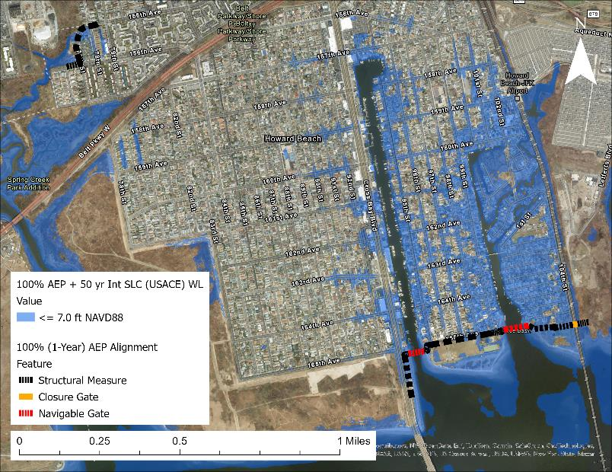
Future Coastal Storm Water Levels - DEFEND
100% AEP (1 yr) + 50 yr Intermediate Sea Level Change (USACE)
Design Water Level: +7.0 ft NAVD88
Crest elevation and tie-ins at approximately +10 ft NAVD88
Considerations
Greater availability of tie-ins
Closure gate on MTA A-line subway tracks
Frequent gate closure, high O&M costs
Lindenwood
N
Old Howard Beach
Howard Beach
Hamilton Beach
DRAFT ALIGNMENT FOR DISCUSSION PURPOSES ONLY.
Base year: 2034
Notes:
DR
The low lying topography of the study area makes it exceptionally difficult to formulate solutions for CSRM using our "defend" strategy. The alignment shown here was designed to +7ft NAVD88 with tie-ins around 10 feet, assuming approximately 3 ft of freeboard. It is consistent with the proposed alignment for the NYNJ Harbors and Tributaries Study (HFFRRS) High Frequency Flooding Risk Reduction Features, which includes structural measures such as navigable gates, floodwalls, and vegetated berms. The 7ft elevation coincides with the 100% Annual Exceedance Probability event with 50 years of SLC, so this alignment is only designed to reduce risk from high frequency, lower intensity flooding. Despite this being the lowest exceedance probability event we looked at, this alignment would require a closure gate across the MTA A-line subway track at the far eastern boundary of the study area in order to tie into high ground. To reduce risk for the 1 year event, this alternative would require the gates to be operated frequently, contributing to high O&M costs and possibly water quality concerns. Nonstructural measures (accommodating strategy?) may need to be considered as well for flooding that occurs more frequently than the gates are closed.

Slide 11
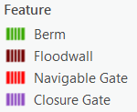
Future Coastal Storm Water Levels - DEFEND
5% AEP (20 yr) + 50 yr Intermediate Sea Level Change (USACE)
Design Water Level: +10.0ft NAVD88
Crest elevation and tie-ins at approximately +13 ft NAVD88
Considerations
Low availability of tie-ins
Closure gate on MTA A-line subway tracks
Frequent gate closure, high O&M costs
Need to avoid HTRW
Lindenwood
Old Howard Beach
Howard Beach
Hamilton Beach
DRAFT ALIGNMENT FOR DISCUSSION PURPOSES ONLY.
Base year: 2034
Notes:
DR
When we reduce the frequency but increase the intensity of a storm event, the required alignment expands greatly. We can see this even when comparing the 20 year event with 50 years of intermediate SLC to the previous 1 year event. During the 20 year event, the design water level increases to 10 ft NAVD88, with tie-ins at an elevation of approximately 13 ft NAVD88. This alignment also includes storm surge barriers on the mouths of Hawtree and Shellbank basins, and requires extensive stuctural measures such as floodwalls or vegetated berms in order to meet the necessary high ground tie-in elevation. In developing this alignment, we also needed to avoid the adjacent HTRW area to the west of the alignment, reducing the possible measures and eliminating the use of high ground tie-ins that lie within it. We anticipate a lot difficulties with implementing this amount of structural measures and the required closure gate over the MTA tracks.
It is important to note that this would not address frequently flooded structures nor roads, unless the gates were operated on a frequent basis, and nonstructural measures may need to be considered as well. This would result in exceptionally high O&M costs, and may have negative water quality impacts.

Slide 12
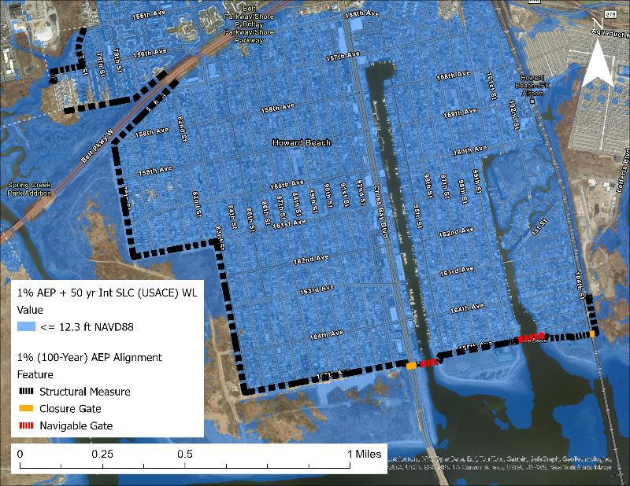
Future Coastal Storm Water Levels - Defend
1% AEP (100 yr) + 50 yr Intermediate Sea Level Change (USACE)
Design water level +12.3ft NAVD88
Crest elevation and tie-ins at approximately +15ft NAVD88
Considerations
Lowest availability of tie-ins
Closure gates on Cross Bay Boulevard
Closure gate on MTA A-line subway tracks
Need to avoid HTRW
Lengthy floodwalls with big footprints
To address frequently flooded structures, gates would need to be closed frequently; exceptionally high O&M costs for this
Lindenwood
Old Howard Beach
Howard Beach
Hamilton Beach
DRAFT ALIGNMENT FOR DISCUSSION PURPOSES ONLY.
Base year: 2034
Notes:
Looking at an even higher intensity event, we can see that almost the entirety of the project area could be inundation in the future under a 100 year event with 50 years of intermediate SLC. The proposed alignment for this condition is similar to the alignment shown for the 20 year storm, but includes higher tie-in elevations, and adds a closure gate across Cross Bay Boulevard. Formulating a solution for a storm of this intensity and magnitude of inundation only exacerbates the constraints present in this area.

Slide 13
Consideration of metrics
Economic benefits
- Contribution to national economic development
- Contribution to regional economic development
Costs
- Construction costs
- Real estate costs
Environmental impacts
- Impacts to threatened and endangered species
- Impacts to critical habitat
- Water quality
Social impacts
- Benefits and impacts to disadvantaged communities
- Life safety
- Critical infrastructure and transportation
Congressional and Public Support
Notes:
These are the different categories of metrics that we will use to evaluate, compare, and eventually select an alternative. Its important to note that traditionally, the Corps has focused on a Benefit-Cost ratio, but we do recognize the importance of considering environmental and social impacts as well as the acceptability of a plan by congress and the public.

Slide 14
Continued work
Continued coordination with our study partners and community stakeholders on how to best manage flood risk in the area.
Development of alternatives in alignment of different strategies.
Evaluation of the alternatives across sea level change scenarios.
Comparison and tradeoff analysis.
Public and agency review of alternative analyses and proposed plan.
Incorporate feedback of proposed plan.
Notes:
We want to highlight that this is just the beginning of our study, as we move forward through iteration of plans, and evaluation and comparison of alternatives, we will solicit feedback from our study partners, community stakeholders, and resource agencies, and incorporate it into our plan development and selection.

Slide 15
THANK YOU – QUESTIONS OR COMMENTS?
DanaRose Brown
Coastal Engineer
DanaRose.Brown@usace.army.mil
Reegan McCaulley
Plan Formulator
Reegan.A.McCaulley@usace.army.mil
Karen Baumert
Plan Formulator
Karen.L.Baumert@usace.army.mil
Notes:
This concludes our presentation. We will open it up for questions now.

Slide 16
STRUCTURES EXPERIENCING IMMEDIATE VICINITY FLOODING AT HIGH TIDE with Intermediate slc
Year | # of structures experiencing flooding at high tide with USACE Intermediate SLC
2035 | 50 Structures
2045 | 52 Structures
2055 | 60 Structures
2065 | 65 Structures
2075 | 95 Structures
2085 | 130 Structures
~ Period of Analysis
Notes:
This slide shows the number of structures in the study area that are expected to become inaccessible due to high tide flooding with incorporated SLC in ten year intervals throughout our projected period of analysis. You can see here that the number of structures increases steadily, but in 2075 and then in 2085, there are pretty significant jumps in the total number of structures.
VIABILITY OF STRUCTURES Assume structures that are inaccessible at MHHW in the future are not eligible for elevations Nor floodproofing. Inaccessibility defined as structures with 6” of water on the ground in their vicinity at MHHW in 30 years at the various SLC scenarios.

Slide 17
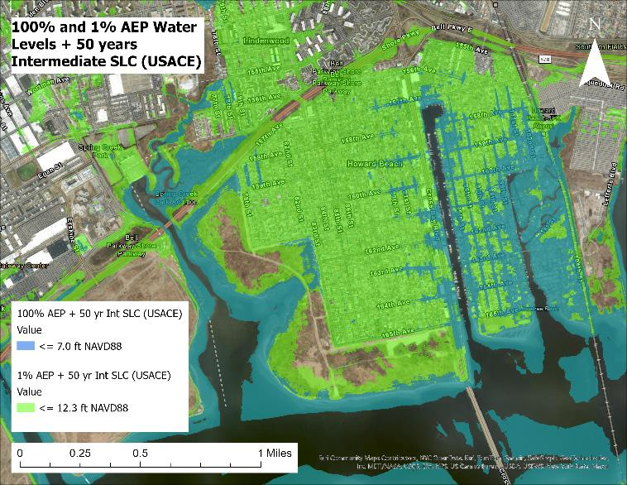
100% and 1% AEP with 50-years of intermediate slc
By 2085, the majority of Hamilton Beach is expected to be inundated during a 100% (1-year) event
By 2085, the majority of the study area is expected to be inundated during a 1% (100-yr) AEP event
Notes:
This figure is showing us the 100% storm in the dark turquoise color, and the 1% storm in green, but this map takes into account 50 years of intermediate LSR, so you can see that the 1% storm becomes very problematic in Hamilton Beach and parts of Old Howard Beach. A 1% AEP event under this scenario looks to be catastroprhic for the area.

Slide 18
Existing and Future Water Levels
SCENARIO | CURRENT MHHW (ft NAVD88) | FUTURE MHHW USACE | FUTURE MHHW CITY | FUTURE MHHW STATE
Intermediate | 3.27 | 4.75 | 5.22 | 5.26
High | N/A | 7.13 | N/A | 7.68
% EVENT​ | ‘YEAR’ STORM​ | CURRENT WSEL [ft]​ | FUTURE WSEL USACE INTERMEDIATE SLC​ | FUTURE WSEL CITY INTERMEDIATE SLC | FUTURE WSEL STATE INTERMEDIATE SLC​​
1%​ | 100​ | 10.9 | 12.3​ | 12.8​ | 12.8​
2%​ | 50​ | 9.6 | 11.1​ | 11.6​ | 11.6​
5%​ | 20​ | 8.5 | 10​ | 10.4​ | 10.5​
10%​ | 10​ | 7.7 | 9.2​ | 9.7​ | 9.7​
20%​ | 5​ | 7.0 | 8.5​ | 9.0​ | 9.0​
50%​ | 2​ | 6.1 | 7.6​ | 8.1​ | 8.1​
100%​ | 1​ | 5.4​ | 6.9​ | 7.4​ | 7.4​
*future represents 50 years
Notes:
This table just outlines all of the storm events with current WSEL with the intermediate SLR we would be seeing about an additional 2 feet of water, while the USACE projections are lower than the city's, theyre not that far off, and the city and state projections are almost identical

Slide 19
Measures
Structural Measures
Levees
Floodwalls
Vegetated berms
Sand berms ×
Dunes ×
Tide gates and associated tie ins
Road raising
Bulkheads
Groins ×
Seawalls ×
Flap gates
Storm sewer / drainage upgrades (pump stations)
Nonstructural Measures
Acquisition
Relocation
Elevation
Floodproofing (wet or dry)
Flood warning systems
NATURE BASED SOLUTIONS (NBS)
Living shorelines × *
Wetlands × *
Breakwaters × *
Submerged Aquatic Vegetation × *
Reefs × *
Floodplain Restoration following Acquisitions/Relocations of Structures
‘Greening the grey’
*not being considered as a primary feature
Notes:
Here are the measures that the team considered and some that were screened due to being not applicable, or space constraints, and the coastal environment is not conducive to the coastal environment and would not, as primary features, provide the risk reduction that is needed in this area, are shown with red –xs here

Slide 20
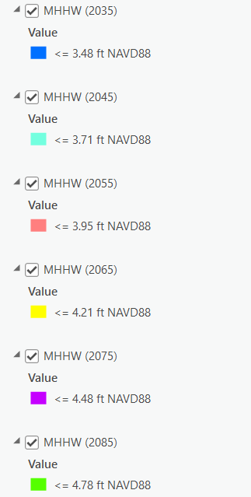
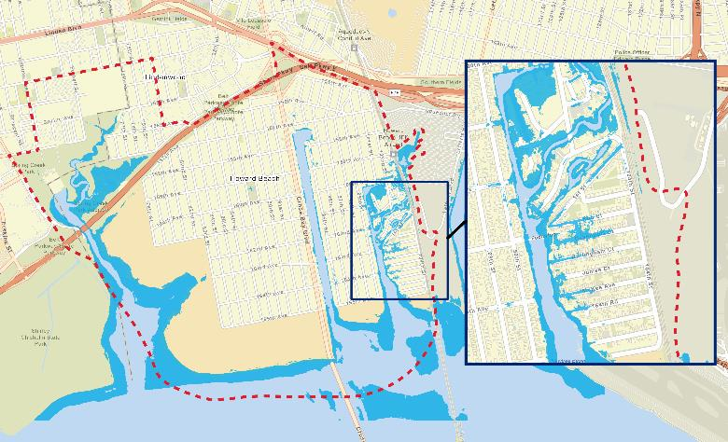
STRUCTURES at risk of being inaccessible AT HIGH TIDE with Intermediate slc in the future
Year | # of structures experiencing 6 inches of flooding or more at high tide with SLR*
2035 | 50
2045 | 52
2055 | 60
2065 | 65
2075 | 95
2085 | 130
*Intermediate USACE SLC curve in 2085
Notes:
For the chart on the left: Filtered DEM to only show ground level that is at .5 or below MHHW value at each 10-year increment
Figure on the right: Since MHHW + 50ft INT SLC identifies the water level hits 4.75ft NAVD88 – I filtered the DEM to only show where the ground elevation was at or below 4.25ft since anything at or below that elevation would experience inundation at 0.5ft or more.

Slide 21
Abstract
The Challenges of Managing Coastal Storm Risk in a Low-Lying Area Impacted by Frequent Flooding
The USACE New York District is currently undertaking the Spring Creek South (SCS), New York, Coastal Storm Risk Management Feasibility Study to manage coastal storm risk in the communities of Hamilton Beach, Howard Beach, Old Howard Beach, and Lindenwood on the northern shore of Jamaica Bay. This area has been studied extensively in the past by State, City, and Federal agencies; however, features from these studies have not been implemented. These communities are densely populated and low-lying, especially Hamilton Beach, which contains many structures located at or below +5 ft NAVD88. Considering future sea level change (SLC), the possibility of daily high tide flooding in this area exists under the USACE High SLC scenario by 2085. The study area is also highly vulnerable to low-frequency, high intensity storm events, with inundation expected to occur throughout the majority of the study area during a 2% (50-year) annual exceedance probability (AEP) event.
This presentation will discuss the considerations for managing flood risk in a low-lying area, including the challenges of designing structures to combat high water levels during low-frequency events in an area with limited availability of high ground tie-ins, and managing property accessibility for high-frequency events throughout the period of analysis. Tools and approaches to be discussed include water level mapping for various AEP events and SLC; the metrics to evaluate the feasibility of measures such as flood gates, flood walls, elevations, and buyouts to manage the risk of coastal flooding; and the implications of these defending, accommodating, and retreating strategies.

