Slide 1
Prevent Secondary Disasters: Substantial Damage Planning
Chris Huch, CFM
Black & Veatch Corporation

Slide 2
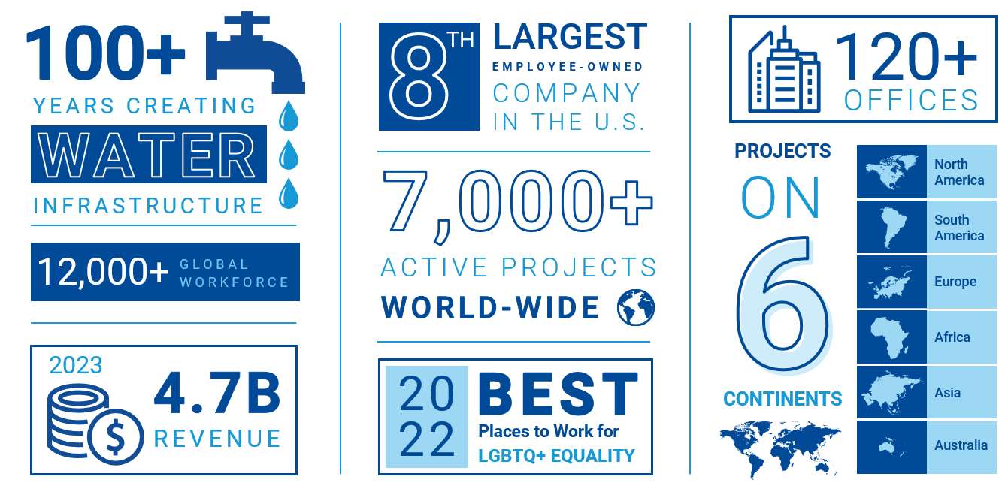
About Black & Veatch
Notes:
Black & Veatch has been providing resilience and sustainability solutions for over 100 years. We have been working to modernize energy, water, and telecommunications infrastructure, protect and restore ecosystems, meet performance and resilience goals, and reduce costs and save lives to mitigate hazard and climate risk.

Slide 3
The National Flood Insurance Program (NFIP) provides affordable insurance to property owners and encourages communities to adopt and enforce floodplain management regulations.
The Community Rating System (CRS) rewards communities that go above and beyond NFIP requirements with flood insurance premium reductions.
5% discount per class rating increase
Class 10 – entry level, 0% discount
Class 5 – 25% discount
Class 1- 45% discount
Notes:
At this point in the conference, you should have a pretty good handle on hazard mitigation but as a refresher….

Slide 4
Substantial Damage - Who Cares?
Substantial Damage Definition: Whenever a building in a mapped special flood hazard area is damaged from ANY source (flood, fire or wind), the community must determine whether that structure has been “substantially damaged.” Substantial damage means that the cost of repairs equals or exceeds 50 percent of the structure’s market value prior to damage.
It is a minimum NFIP requirement
Failure to enforce = non-compliance
Non-compliance = reduced post-disaster assistance
When can you be sure compliance will be audited?
After a declared disaster when “red tape” is rolled back to get people home!
Notes:
Most communities can handle the small events
It’s the large-scale events that really catch communities off guard
Lack of established procedures and the push to return people to their homes and cut red tape results in non-compliance issues later

Slide 5
Case Study: Hurricane Ian - 2022
Greg Lovett, Palm Beach Post, 2022
Hurricane Ian caused an estimated $112.9 billion in damage, making it the costliest hurricane in Florida's history and the third-costliest in U.S. history
Notes:
Substantial Damage non-compliance has come up numerous times across the U.S. in recent years, including Whatcom County, WA after major floods and areas impacted by Hurricane Harvey in Texas.
Most recent notable recent example is the SW cost of Florida from Hurricane Ian.

Slide 6
Hurricane Ian Substantial Damage Fallout
FEMA conducted audits of Hurricane Ian impacted communities.
FEMA notified Lee County, Bonita Springs, Cape Coral, Estero, and Fort Myers Beach in March 2024 that they would be dropped in the CRS due to "the large amount of unpermitted work, lack of documentation, and failure to properly monitor activity in special flood hazard areas, including substantial damage compliance.”
Rollback would have affected more that 115,000 policy holders with an average increase of $300 per year.
Al Diaz, Miami Herald
Notes:
Fort Myers ultimately was kicked out of CRS, has to wait 2 years to rejoin.

Slide 7
Substantial Damage Planning
Notes:
How do we get in front of the problem? We plan.
Development and use of a Substantial Damage Response Plan can make sure that communities are prepared and compliant.

Slide 8
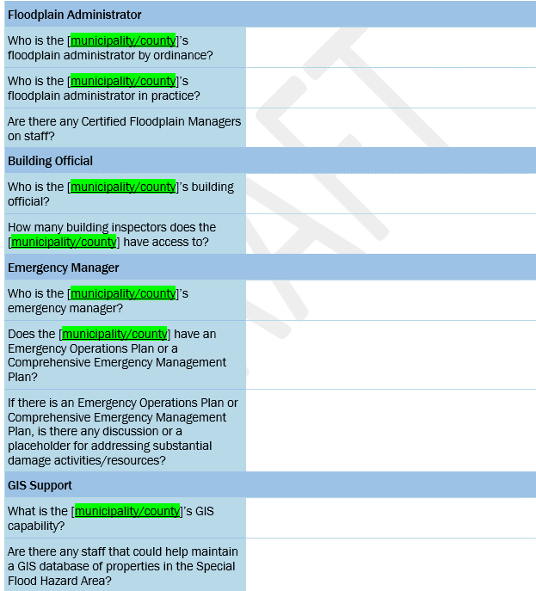
SDRP Components: Assess
The Community Assessment
What are the community’s capabilities and capacities to implement SDE?
Identifies resources to be leveraged
Conducted with key community officials:
Floodplain Manager
Building Code Official
Planning/Zoning/Permitting
Public Information Official
Community EM/EOC (looking for coordination)
GIS (capabilities)
Understand the community’s capacity to implement it the SDRP or where outside help may be needed.

Slide 9
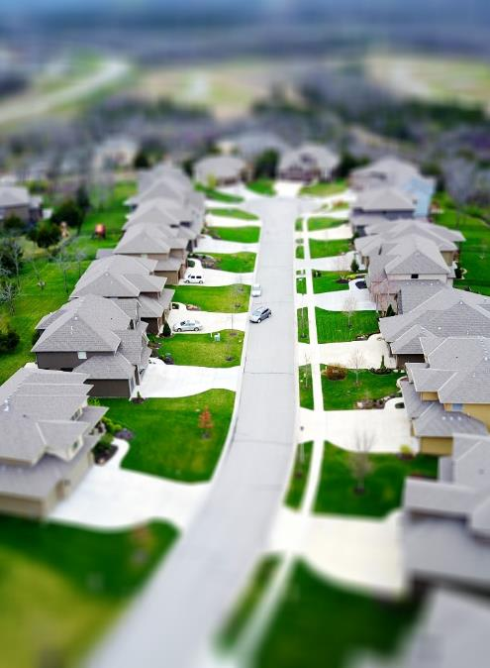
SDRP Component: Inventory
The Structure Inventory Database (SID)
Determine where SDE would have to be applied
Identifies key structure attributes vital to SD determination
Occupancy
Date of Construction
Foundation type
Finished Floor Elevation
# of stories
Square footage
Structure replacement Costs
Repetitive Loss Property
Past substantial damages
Identify what is prone to SD, what level events cause damages, how many inspections are needed.

Slide 10
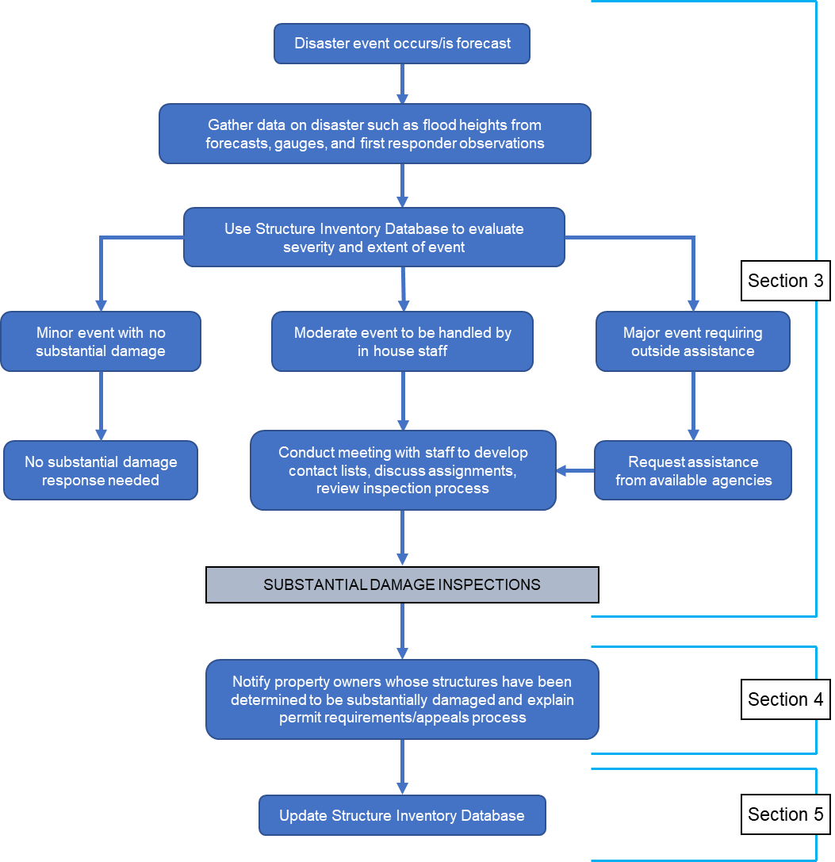
SDRP Component: Establish Procedures
Procedures
Identify and evaluate scale of event
Mobilize staff/request support
Conduct inspections
Notify property owners
Establish process for appeals
Track repairs/rebuilding through permit process
Public outreach is important throughout the process

Slide 11
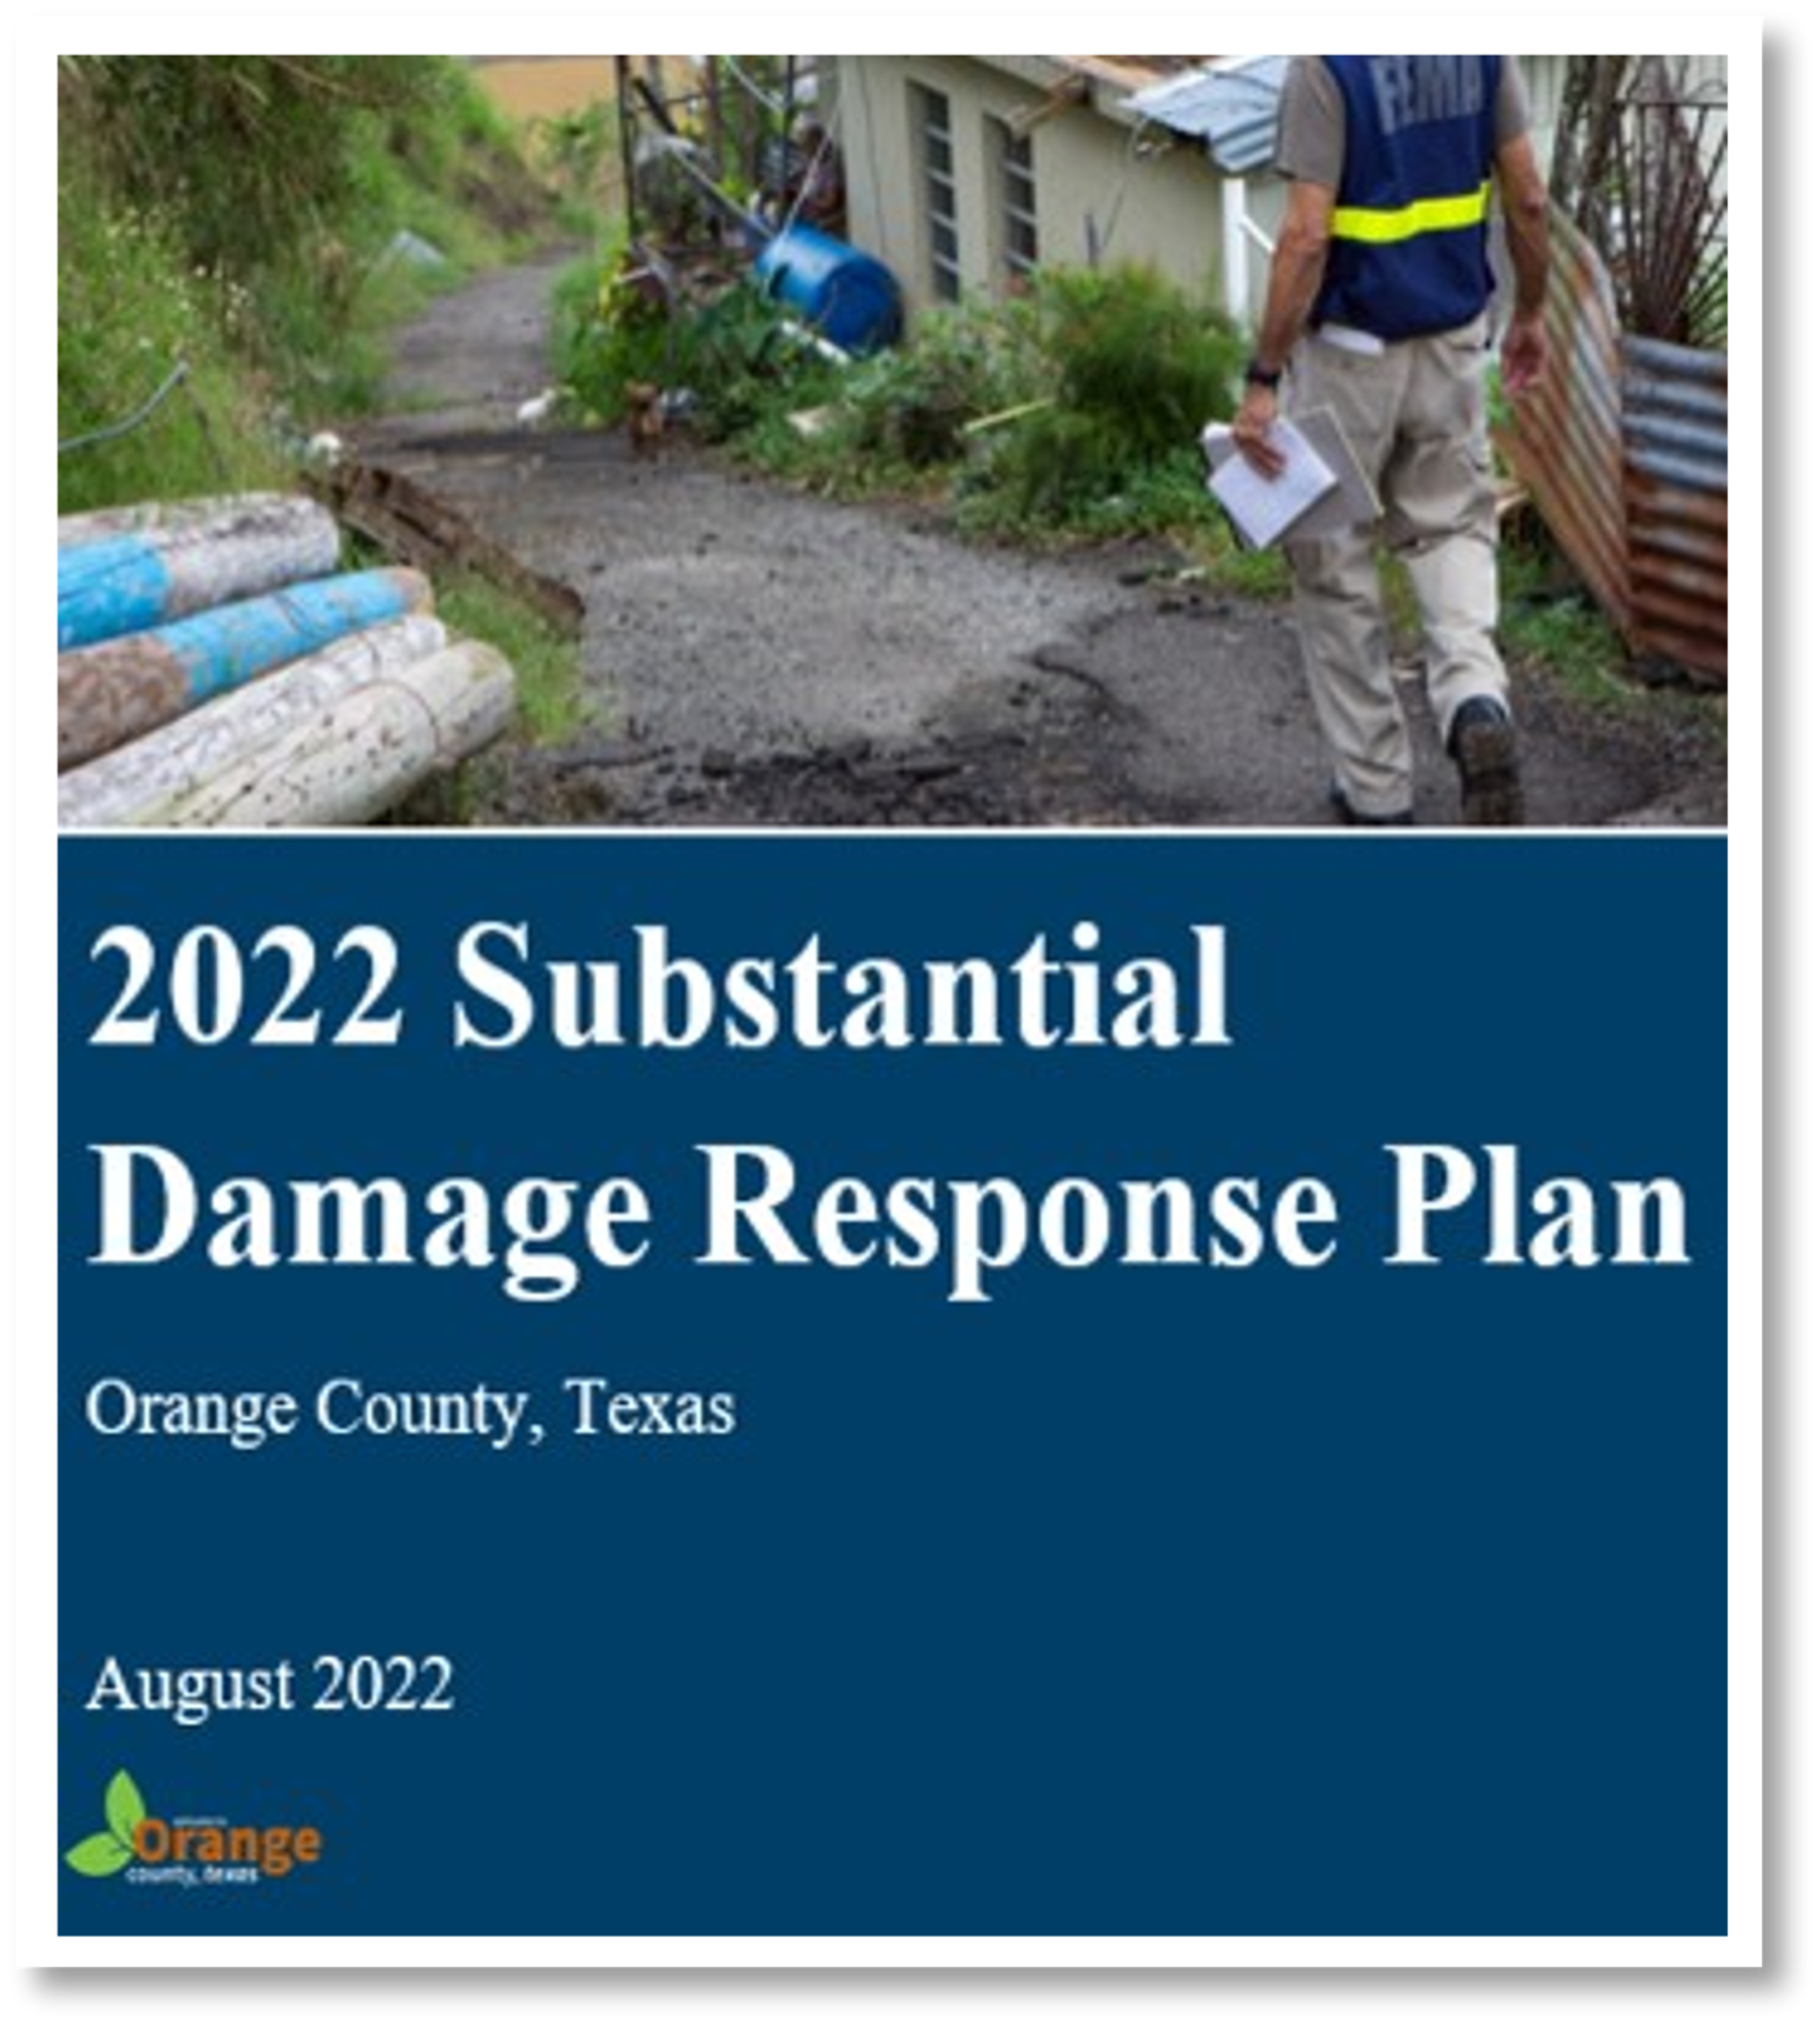
SDRP Component: Exercise and Update
Exercising the Plan
This step is important to keep your SDRP current and up to date.
Consider regular table-top exercises with emergency management or post-event reviews.
Update the Structure Inventory Database as necessary.
Integrate with the emergency plan!
To keep the plan current, it needs to be exercised, just like an emergency plan

Slide 12
For more information contact:
Black & Veatch Corporation
+1 913 458 2000
info@bv.com
Chris Huch
Hazard Mitigation Planning Specialist
+1 201 225 8077
HuchJrC@bv.com

