Slide 1
Application of a coupled modeling framework to simulate urban coastal-pluvial flooding
Shima Kasaei¹, Philip Orton¹, David Ralston², John Warner³, Thomas Wahl⁴
Research funded by US. Geological Survey
1 Stevens Institute of Technology, Hoboken, NJ, 07030, USA
2 Woods Hole Oceanographic Institution, Woods Hole, MA, 02543, USA
3 United States Geologic Survey, Woods Hole Coastal & Marine Science Center, Woods Hole, MA, 02543, USA
4 University of Central Florida, Orlando, FL, 32816, USA

Slide 2
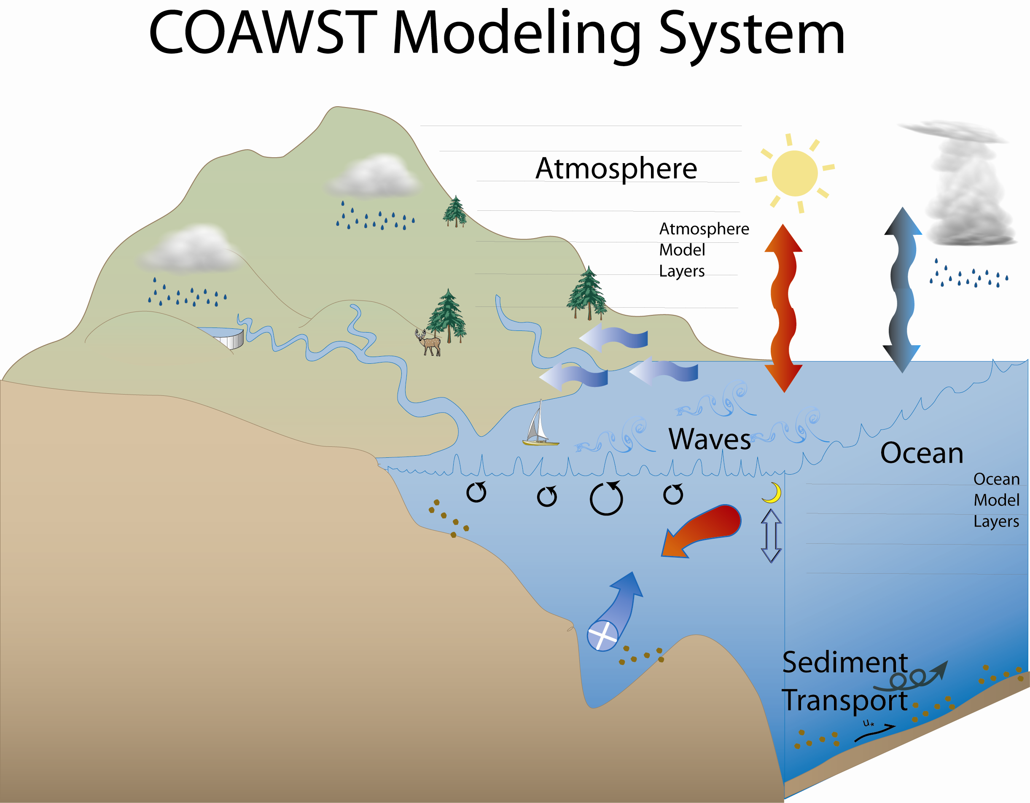
Overview
Development of a Coastal Model in a Coupled Framework
Application to Coastal Flood Risk Assessment
Updating outdated flood maps, addressing policy gaps, and including pluvial flooding in risk evaluation

Slide 3
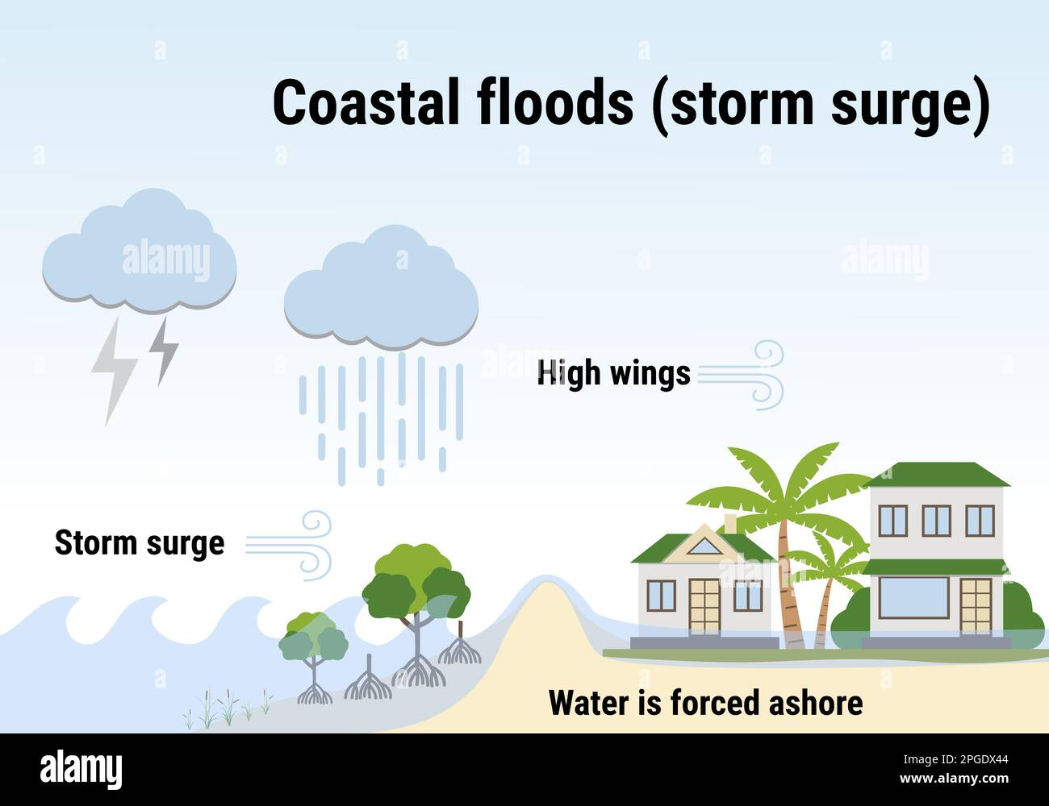
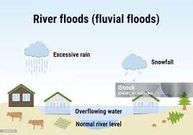
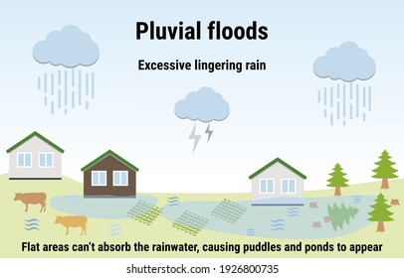
Introduction
Coastal flooding can arise from tides, storm surges, and intense precipitation, with the latter influencing direct runoff (pluvial) or increased river discharge (fluvial).
The simultaneous occurrence of multiple flood drivers, known as compound extremes, can have substantial effects.
Rainfall and storm surges drive compound flooding threats, yet flood policies often overlook these risks.
Modeling tools that can comprehensively represent the interacting Earth system components to study pluvial-coastal compound flooding, are few.

Slide 4
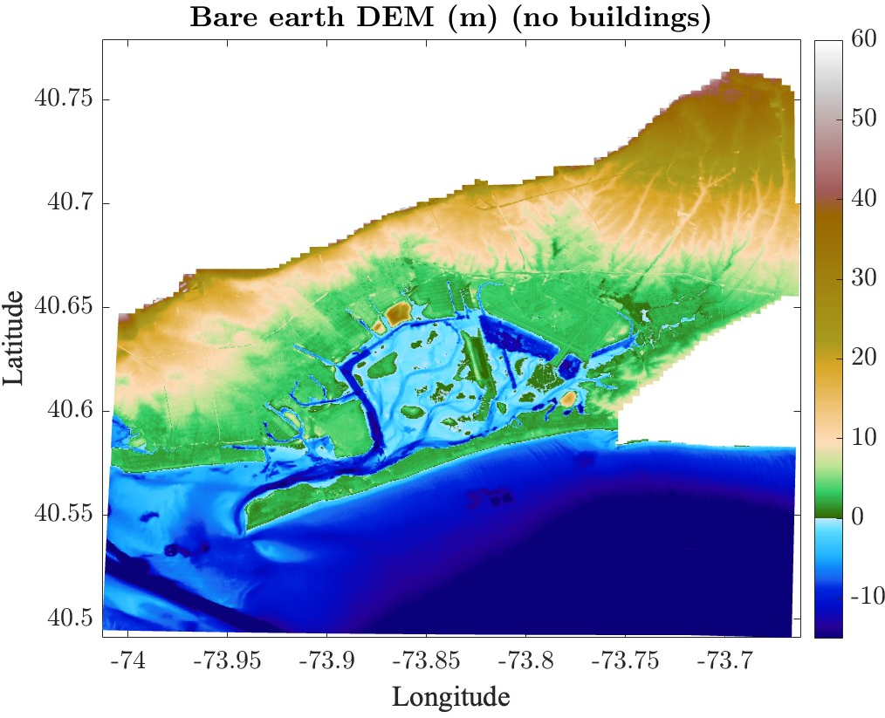
Model application
The Coupled ROMS/Ocean-Atmosphere-Wave-Sediment Transport (COAWST) model integrates several models to comprehensively simulate coastal system interactions.
The model is three-dimensional, using boundary data from the Northwest Atlantic ROMS model.
Meteorological inputs include wind and pressure from WRF-NAM, updated every 3 hours, and rainfall data from MRMS, updated hourly.
Model improved to capture volumetric effect of rainfall
And incorporate drain rate representing stormwater system or ground infiltration
We simulated Ida flooding and created first Ida flood map
Model domain: Jamaica bay watershed
Paper accepted in HESS (https://doi.org/10.5194/egusphere-2024-2058)

Slide 5
Model application to understanding compound flood risks
Research question:
Does rainfall worsen extreme coastal flooding in urban area by making it more widespread and/or deeper?
Methodology:
Explore multiple spatial patterns of rainfall, different scales of hyetograph, and different timing of the rain peak relative to storm surge to understand their impact.
Societal Impact:
Improved flood risk management by strengthening coastal defenses and optimizing evacuation planning.

Slide 6
Results
100-Year Coastal Flood + Ida rainfall
Inundation results from the simulation which perfectly match FEMA Flood map

Slide 7
Conclusion
FEMA coastal flood maps underestimate flood risk
Rainfall significantly increases flood extent
Ignoring rainfall in flood mapping can misguide evacuation planning & shelter placement
Spatial compounding depends on land slope
In areas with steep slopes, spatial compounding (wider flood extent) is far more common than increasing flood depth (depth compounding)
Pluvial and coastal flood events may be modeled separately to improve hazard assessment, especially in steep terrains where depth compounding is minimal

Slide 8
Application of a coupled modeling framework to simulate urban coastal-pluvial flooding
Shima Kasaei¹, Philip Orton¹, David Ralston², John Warner³, Thomas Wahl⁴
Research funded by US. Geological Survey
1 Stevens Institute of Technology, Hoboken, NJ, 07030, USA
2 Woods Hole Oceanographic Institution, Woods Hole, MA, 02543, USA
3 United States Geologic Survey, Woods Hole Coastal & Marine Science Center, Woods Hole, MA, 02543, USA
4 University of Central Florida, Orlando, FL, 32816, USA

Slide 9
Results
Looking at the 100-year coastal flood inundation map and comparing the flooded area deeper than 30 cm with cases accompanying historical rainfalls
Deep flooded area is more widespread when rainfall is added to the control case.
Area of deeper flood with adding rainfall is minimal (compounded depth).

Slide 10
Ida scale rainfall always causes substantial additional flooded area.
The time lag has little influence on deep flooded area.
Having a time lag equal to time of concentration can worsen the flood depth.

Slide 11
Sensitivity of results to land slope: Can these results be generalized?
Concave landscape
Sloped landscape
Different scenarios can cause 5 – 9% additional flood depth (9 – 17 cm) in the concave landscape.
Slope of the land determines whether coastal and pluvial flood maps can be combined.
Steep areas (e.g., JB): Compound flooding is mostly spatial, allowing direct map integration.
Depth-driven compound flooding: Requires simulation modeling, as it is not a linear combination.
Conclusion: A concave landscape does have depth compounding

