Slide 1
Flooding Tools for More Effective Decision-Making and Planning
Owen MacNeill | Senior Account Executive
withforerunner.com

Slide 2
Agenda
1
Introduction
2
Case Study: Manasquan, NJ
3
Walkthrough

Slide 3
Agenda
1
Introduction
2
Case Study: Manasquan, NJ
3
Walkthrough

Slide 4
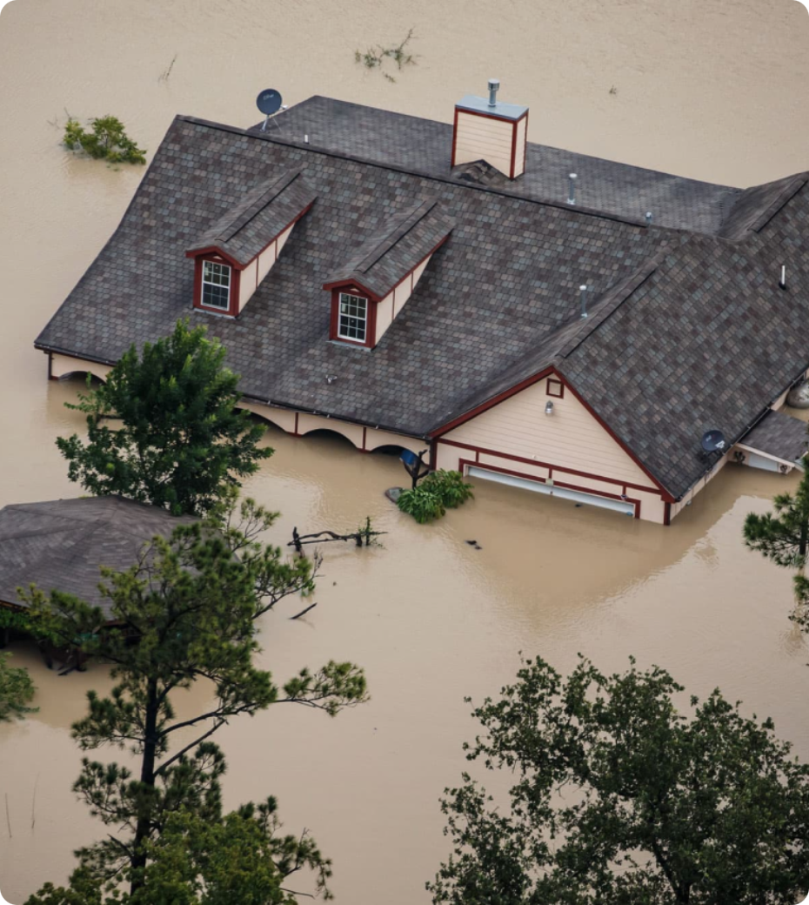
INTRODUCTIONS
Floodplain management and hazard mitigation matter more than ever.

Slide 5
How many buildings in my community are negatively rated?
What’s the best return-on-investment for different mitigation options?
Is this building in the SFHA?
Is this building compliant?
But it’s not easy.

Slide 6
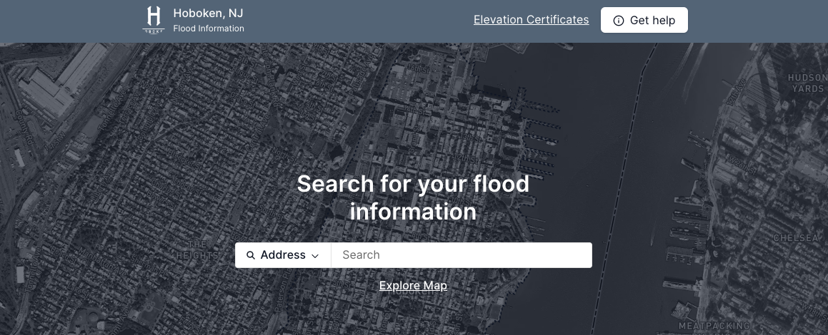
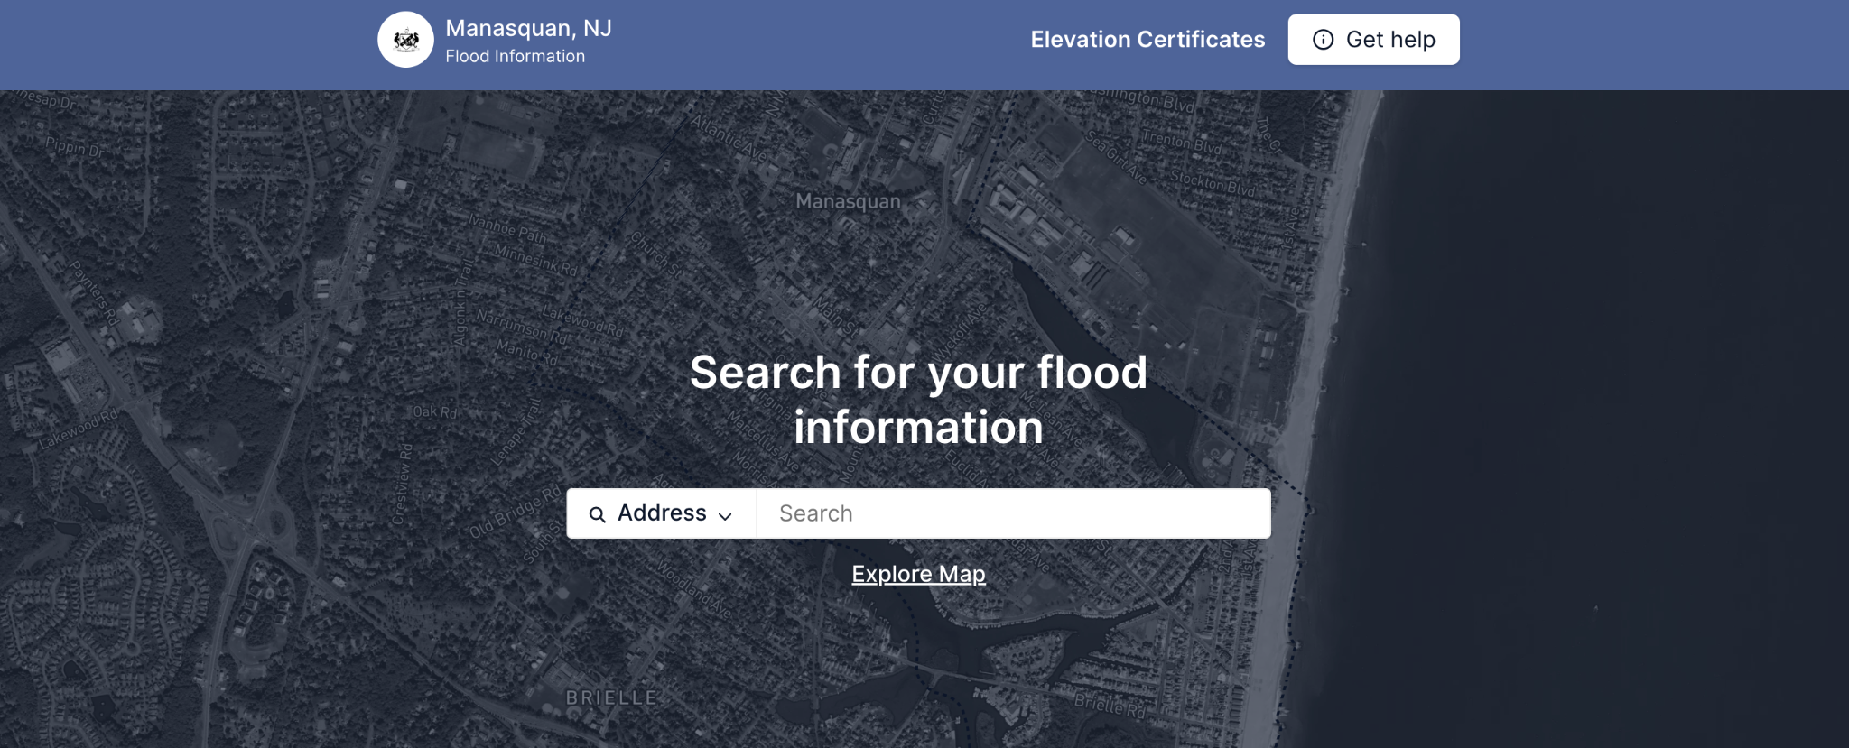
OUR SOLUTION
Forerunner empowers gov. agencies to do more.

Slide 7
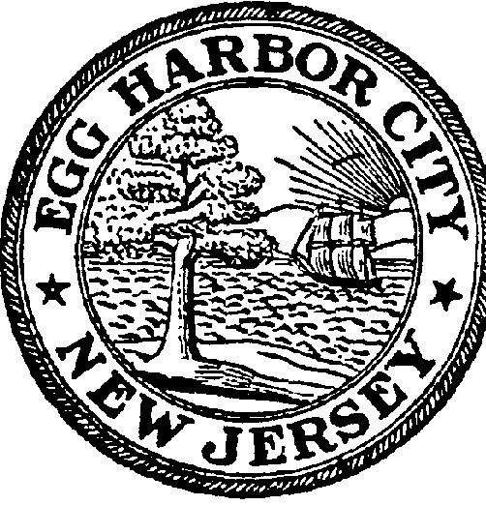
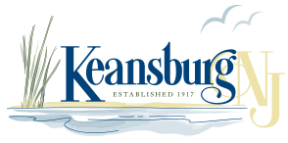
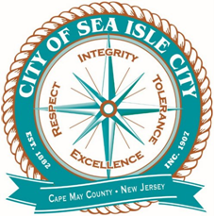
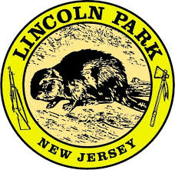
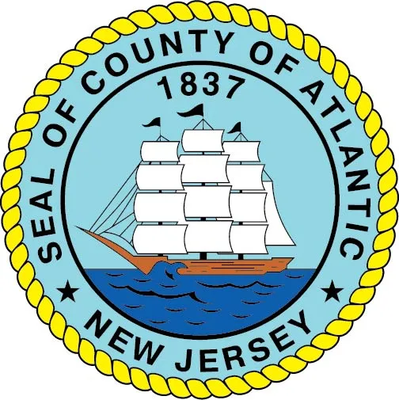
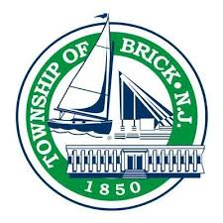
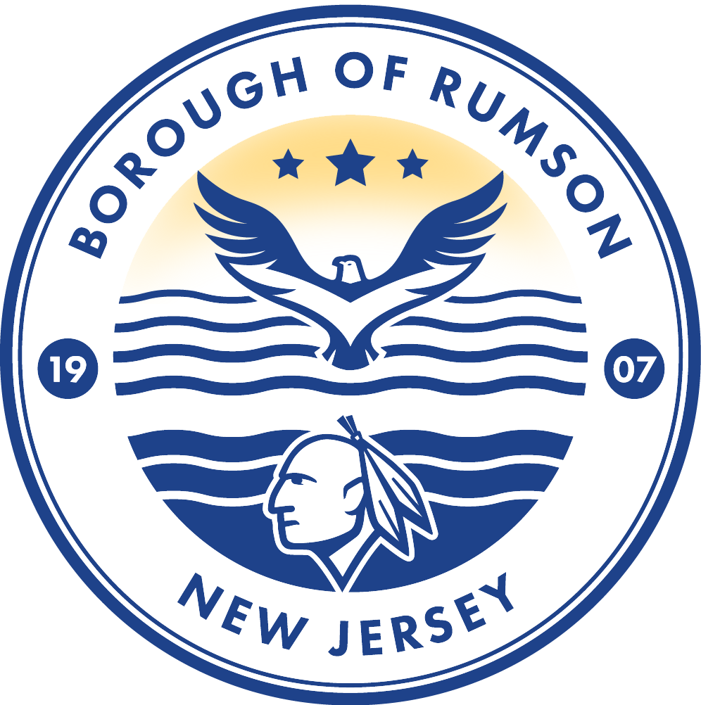
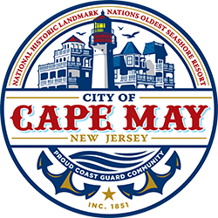
PARTNERS
We partner with 45+ communities in NJ to prepare for and adapt to future conditions.
Egg Harbor
Keansburg
Longport
Sea Isle City
New Jersey
New Jersey
New Jersey
New Jersey
Manasquan
Point Pleasant Beach
Sea Bright
Hazlet
New Jersey
New Jersey
New Jersey
New Jersey
Ocean City
Hoboken
Lincoln Park
Atlantic County
New Jersey
New Jersey
New Jersey
New Jersey
Rumson
Brick
Cape May
Oceanport
New Jersey
New Jersey
New Jersey
New Jersey

Slide 8
Agenda
1
Introduction
2
Case Study: Manasquan, NJ
3
Walkthrough

Slide 9
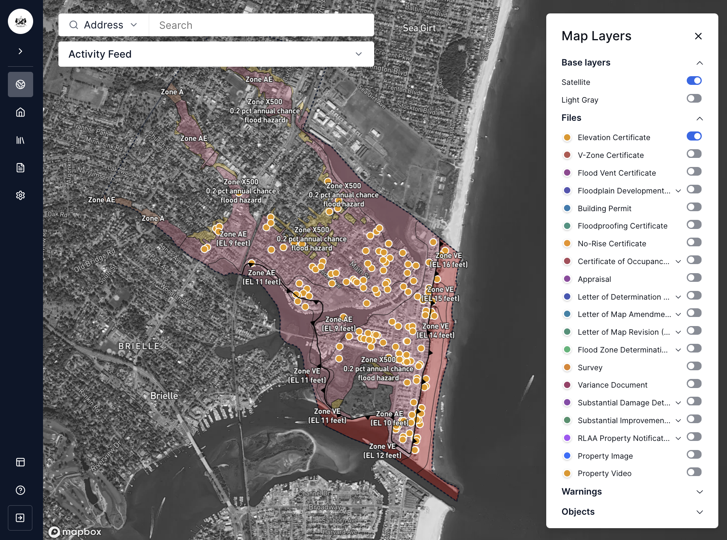
MANASQUAN, NJ
Manasquan, NJ partnered with Forerunner to consolidate their data and workflows.

Slide 10
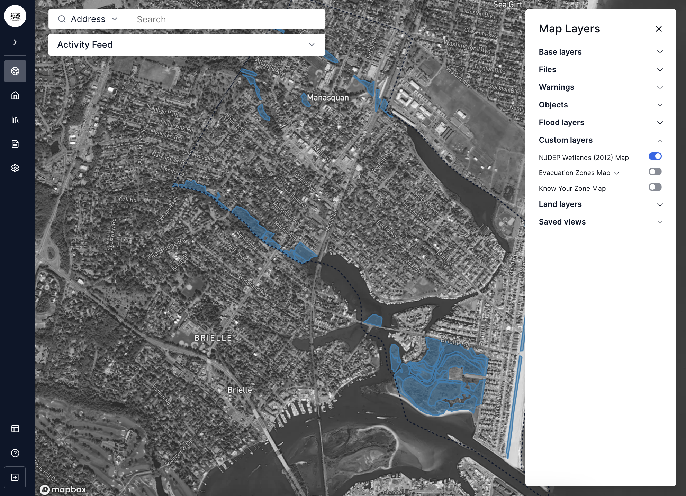
MANASQUAN, NJ
Their geospatial dashboard integrates custom maps, such as the NJDEP Wetlands Map.

Slide 11
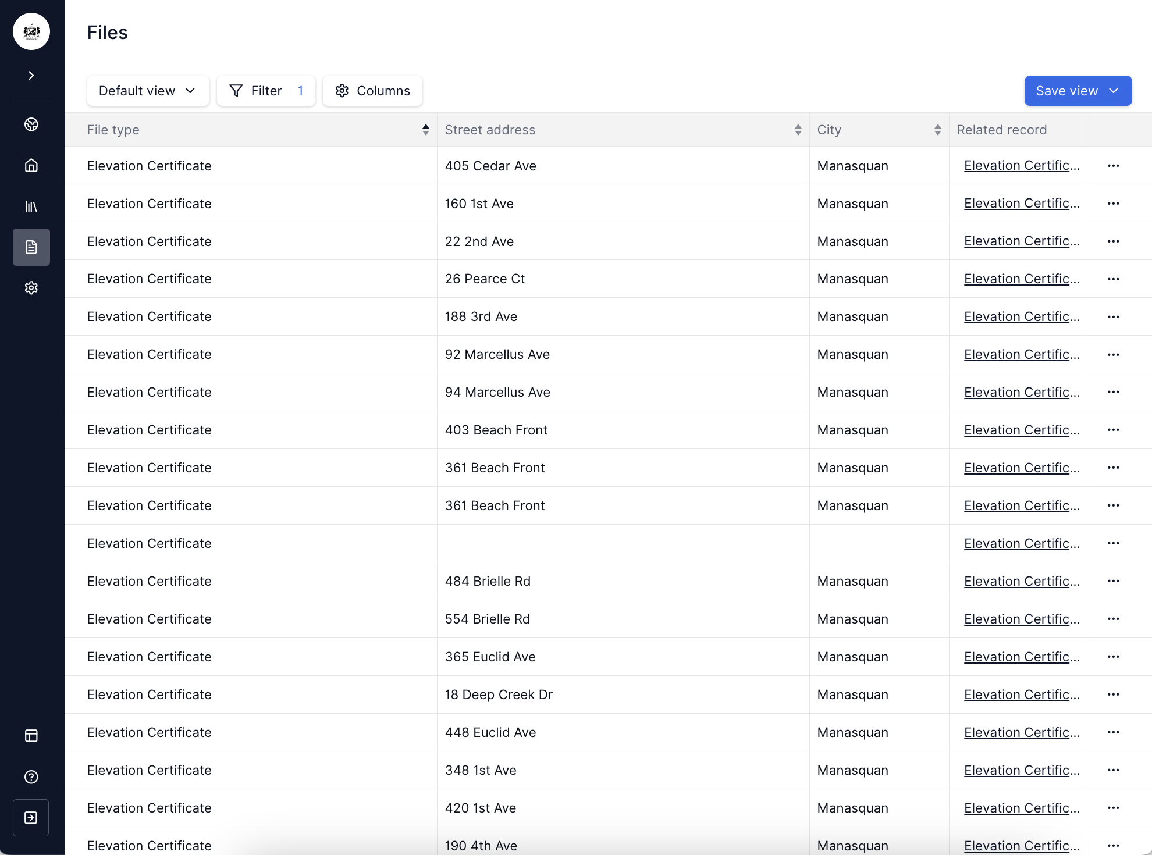
MANASQUAN, NJ
Documents, such as Elevation Certificates, are easily organized and managed.

Slide 12
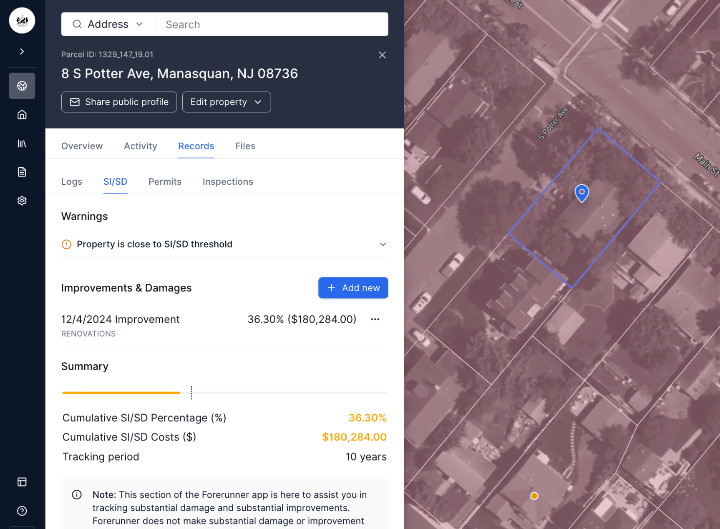
MANASQUAN, NJ
Substantial Improvement is tracked digitally to drive efficiency.
123 Flood Ave,

Slide 13
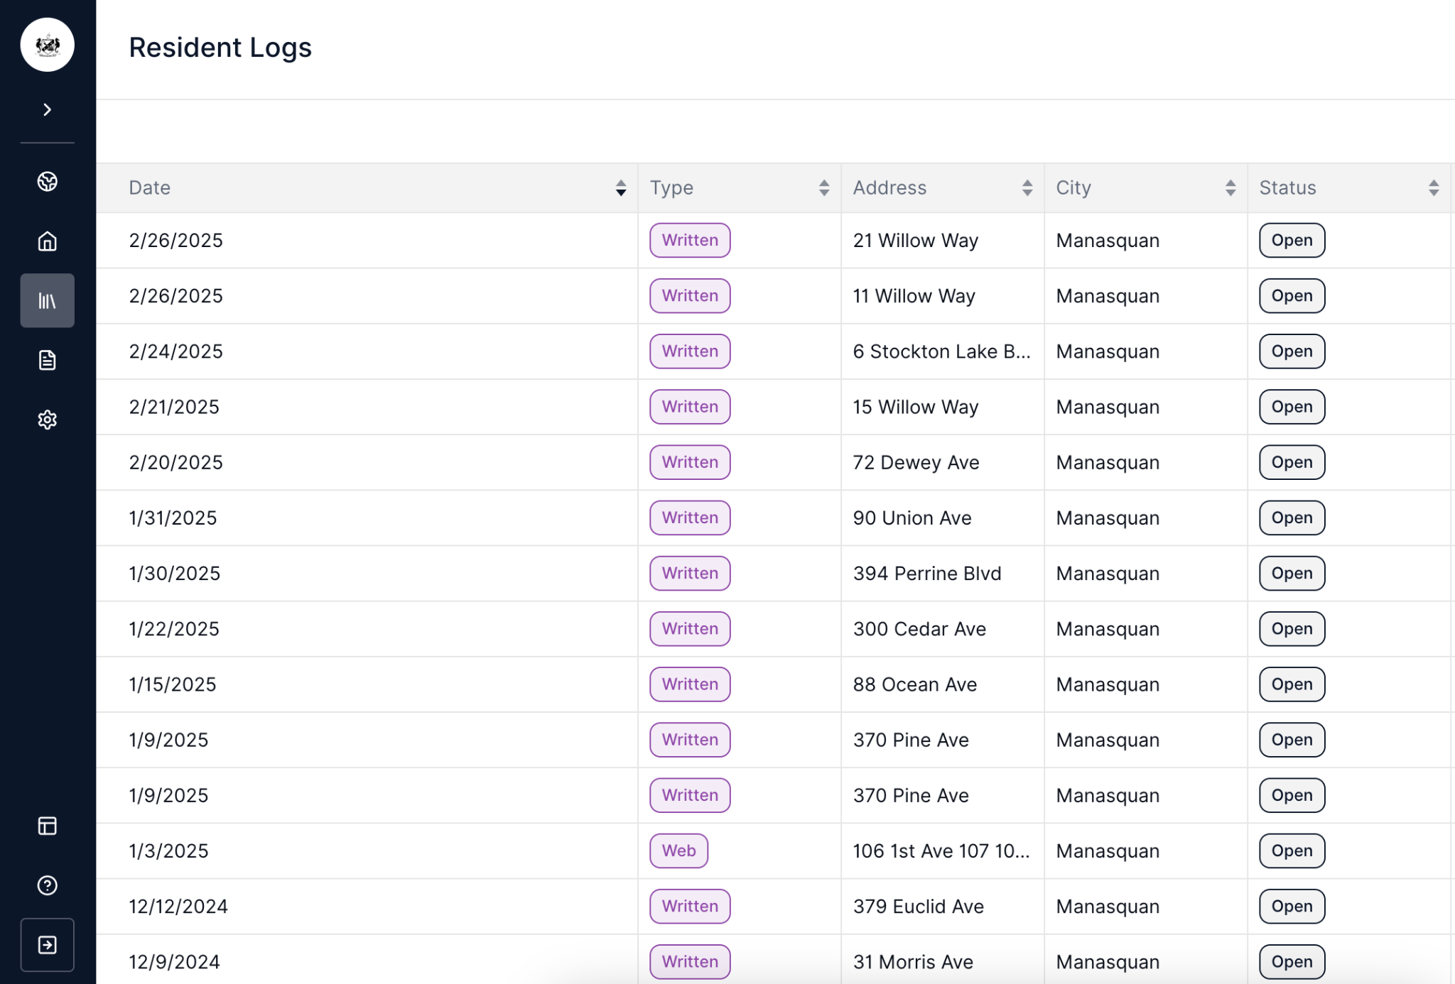
MANASQUAN, NJ
The Public Website empowers residents, and Logs track their engagement for CRS reporting.

Slide 14
Agenda
1
Introduction
2
Case Study: Manasquan, NJ
3
Walkthrough

Slide 15
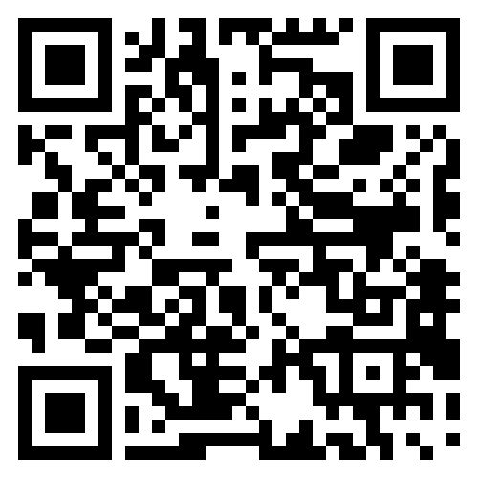
Thank you!
Owen MacNeill owen@withforerunner.com
withforerunner.com

