Slide 1
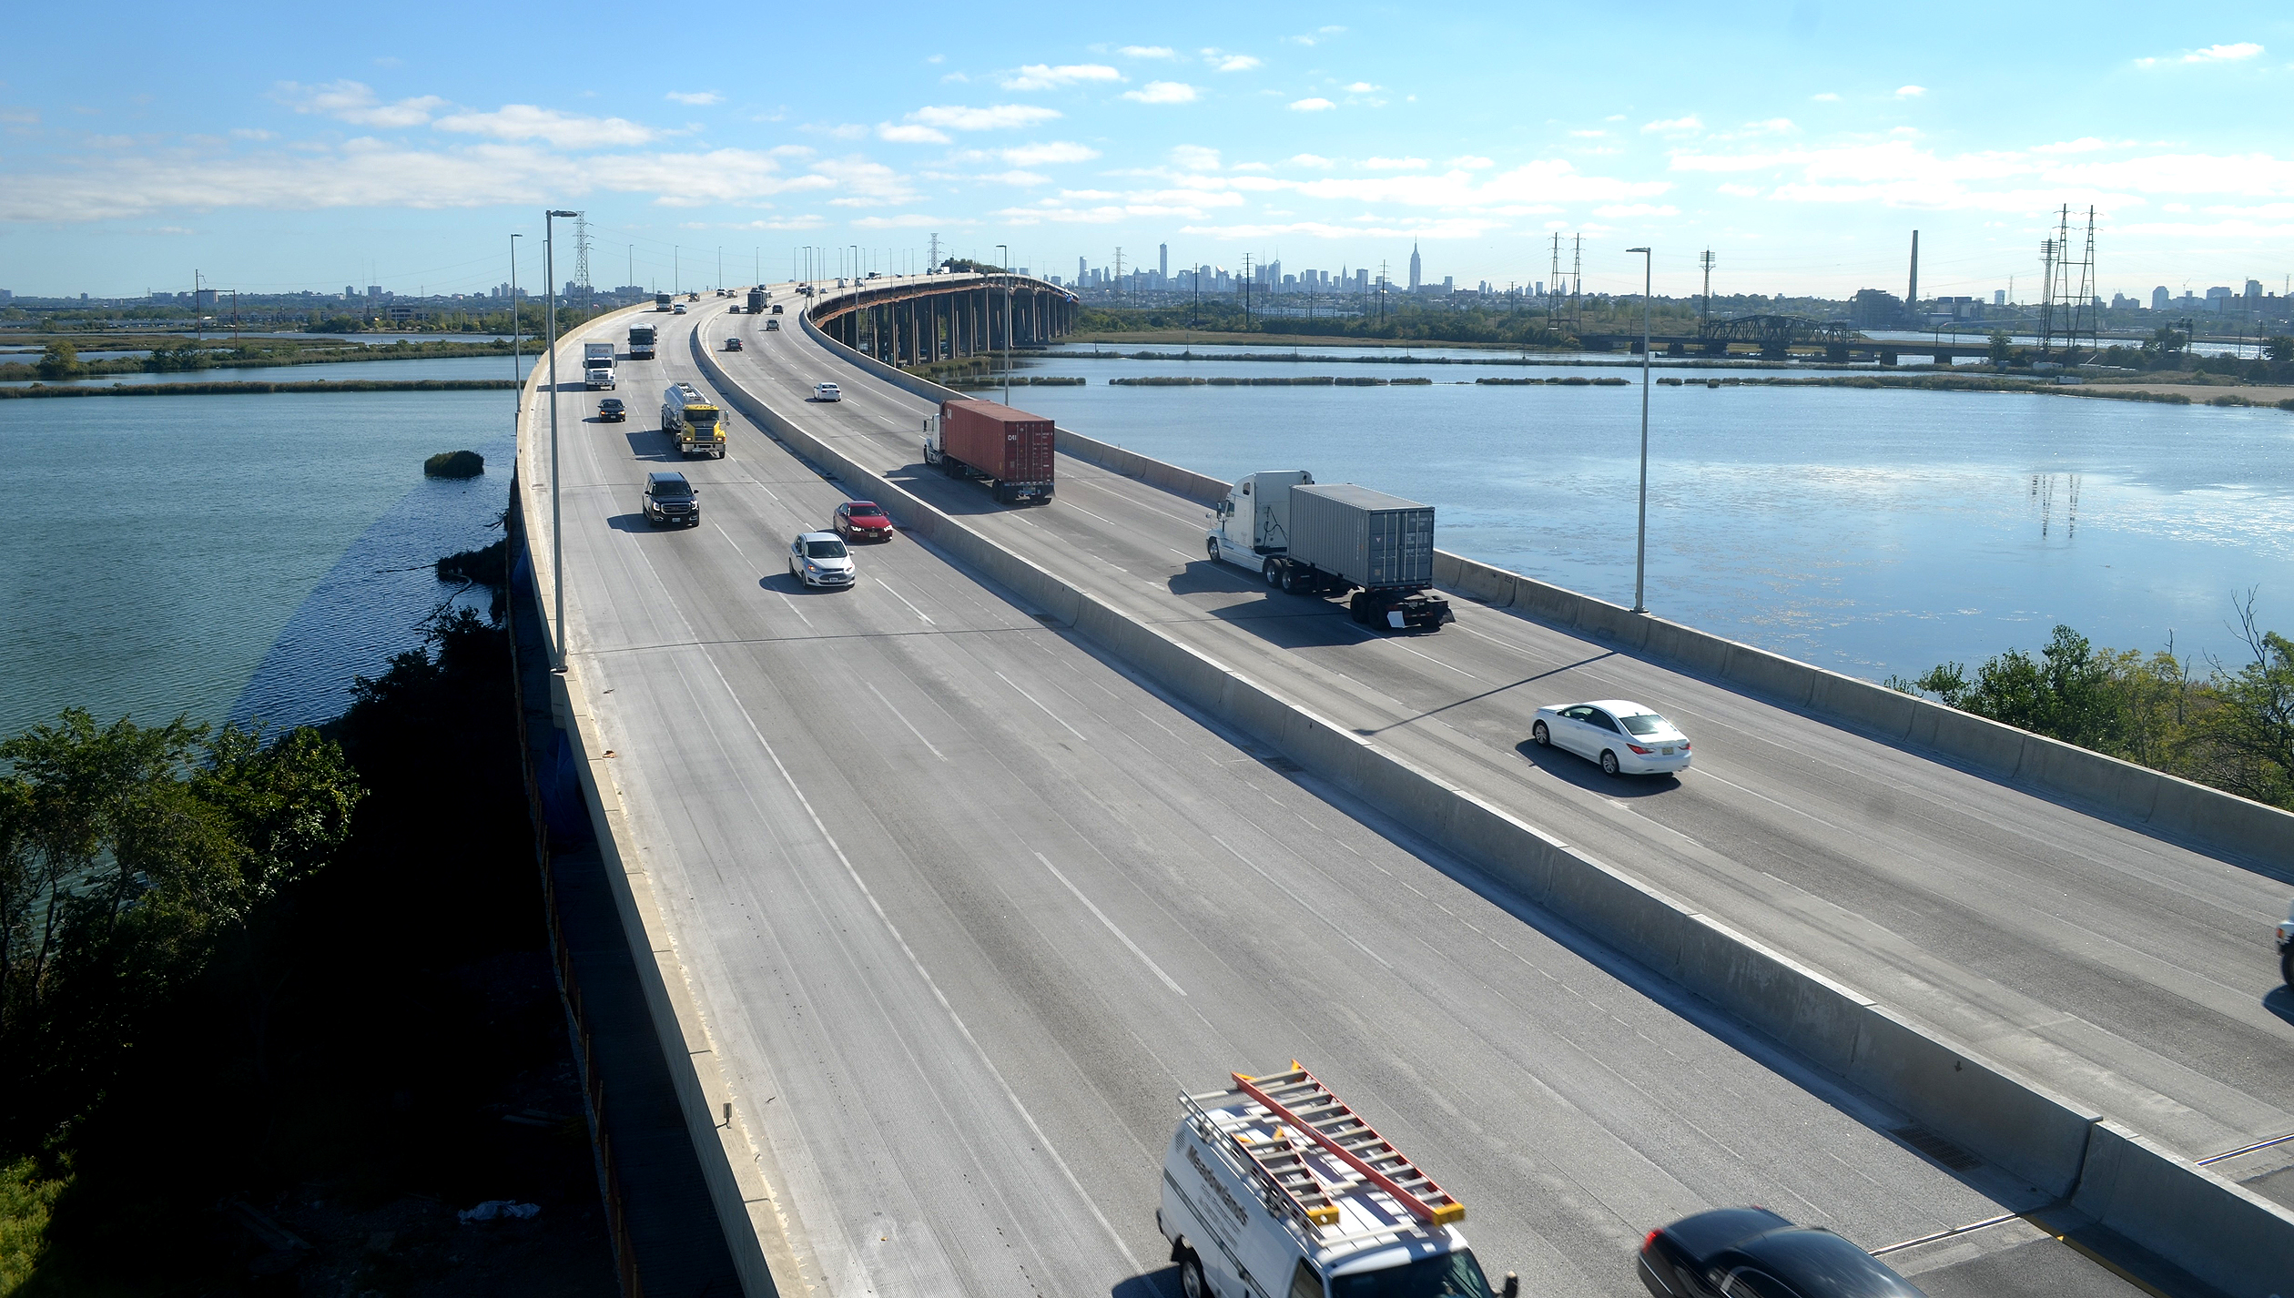
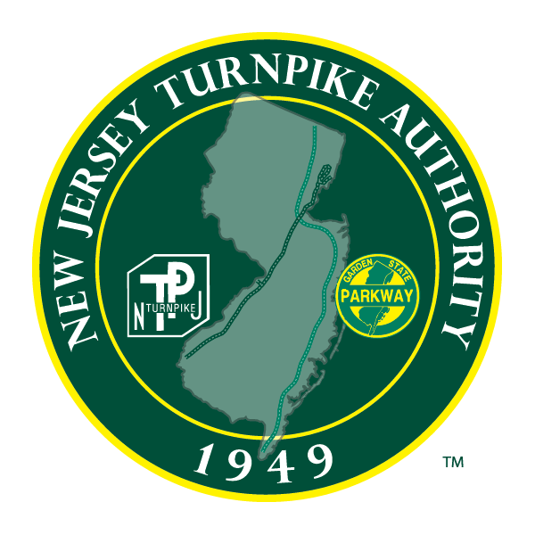
NEW JERSEY TURNPIKE AUTHORITY Bringing Resilience into Business as Usual
New Jersey Coastal Flooding Technical Workshop
Prepared by Dewberry for the New Jersey Turnpike Authority and public presentation. March 19, 2025

Slide 2
Agenda
Resilience Program Overview
Exposure and Vulnerability
Standard Operating Procedures
Next Steps

Slide 3
What is Resilience?
Resilience is the ability to:
1
BEFORE EVENT Prepare for and Adapt to changing conditions
2
DURING EVENT
Withstand
3
AFTER EVENT
Respond to and recover rapidly from disruptions
Notes:
Resilience can mean different things in different contexts and it is important to ask the questions – Resilience to Whom, What, When, Where and Why because it informs the answers. For our purposes we are using the FHWA definition.
The definition: “anticipate, prepare for and adapt to changing conditions and withstand, respond to and recover rapidly from disruptions.”
We are doing this for our people and our patrons, looking at longer term trends such as sea level rise and sudden storms and impacts on the Turnpike and Garden State Parkway. Specifically, we are focused on addressing the impacts of flood hazards such as sea level rise, storm surge, inland fluvial (riverine) and pluvial (stormwater) flooding, and temperature increases. In the future, we may look at additional hazards as well.

Slide 4
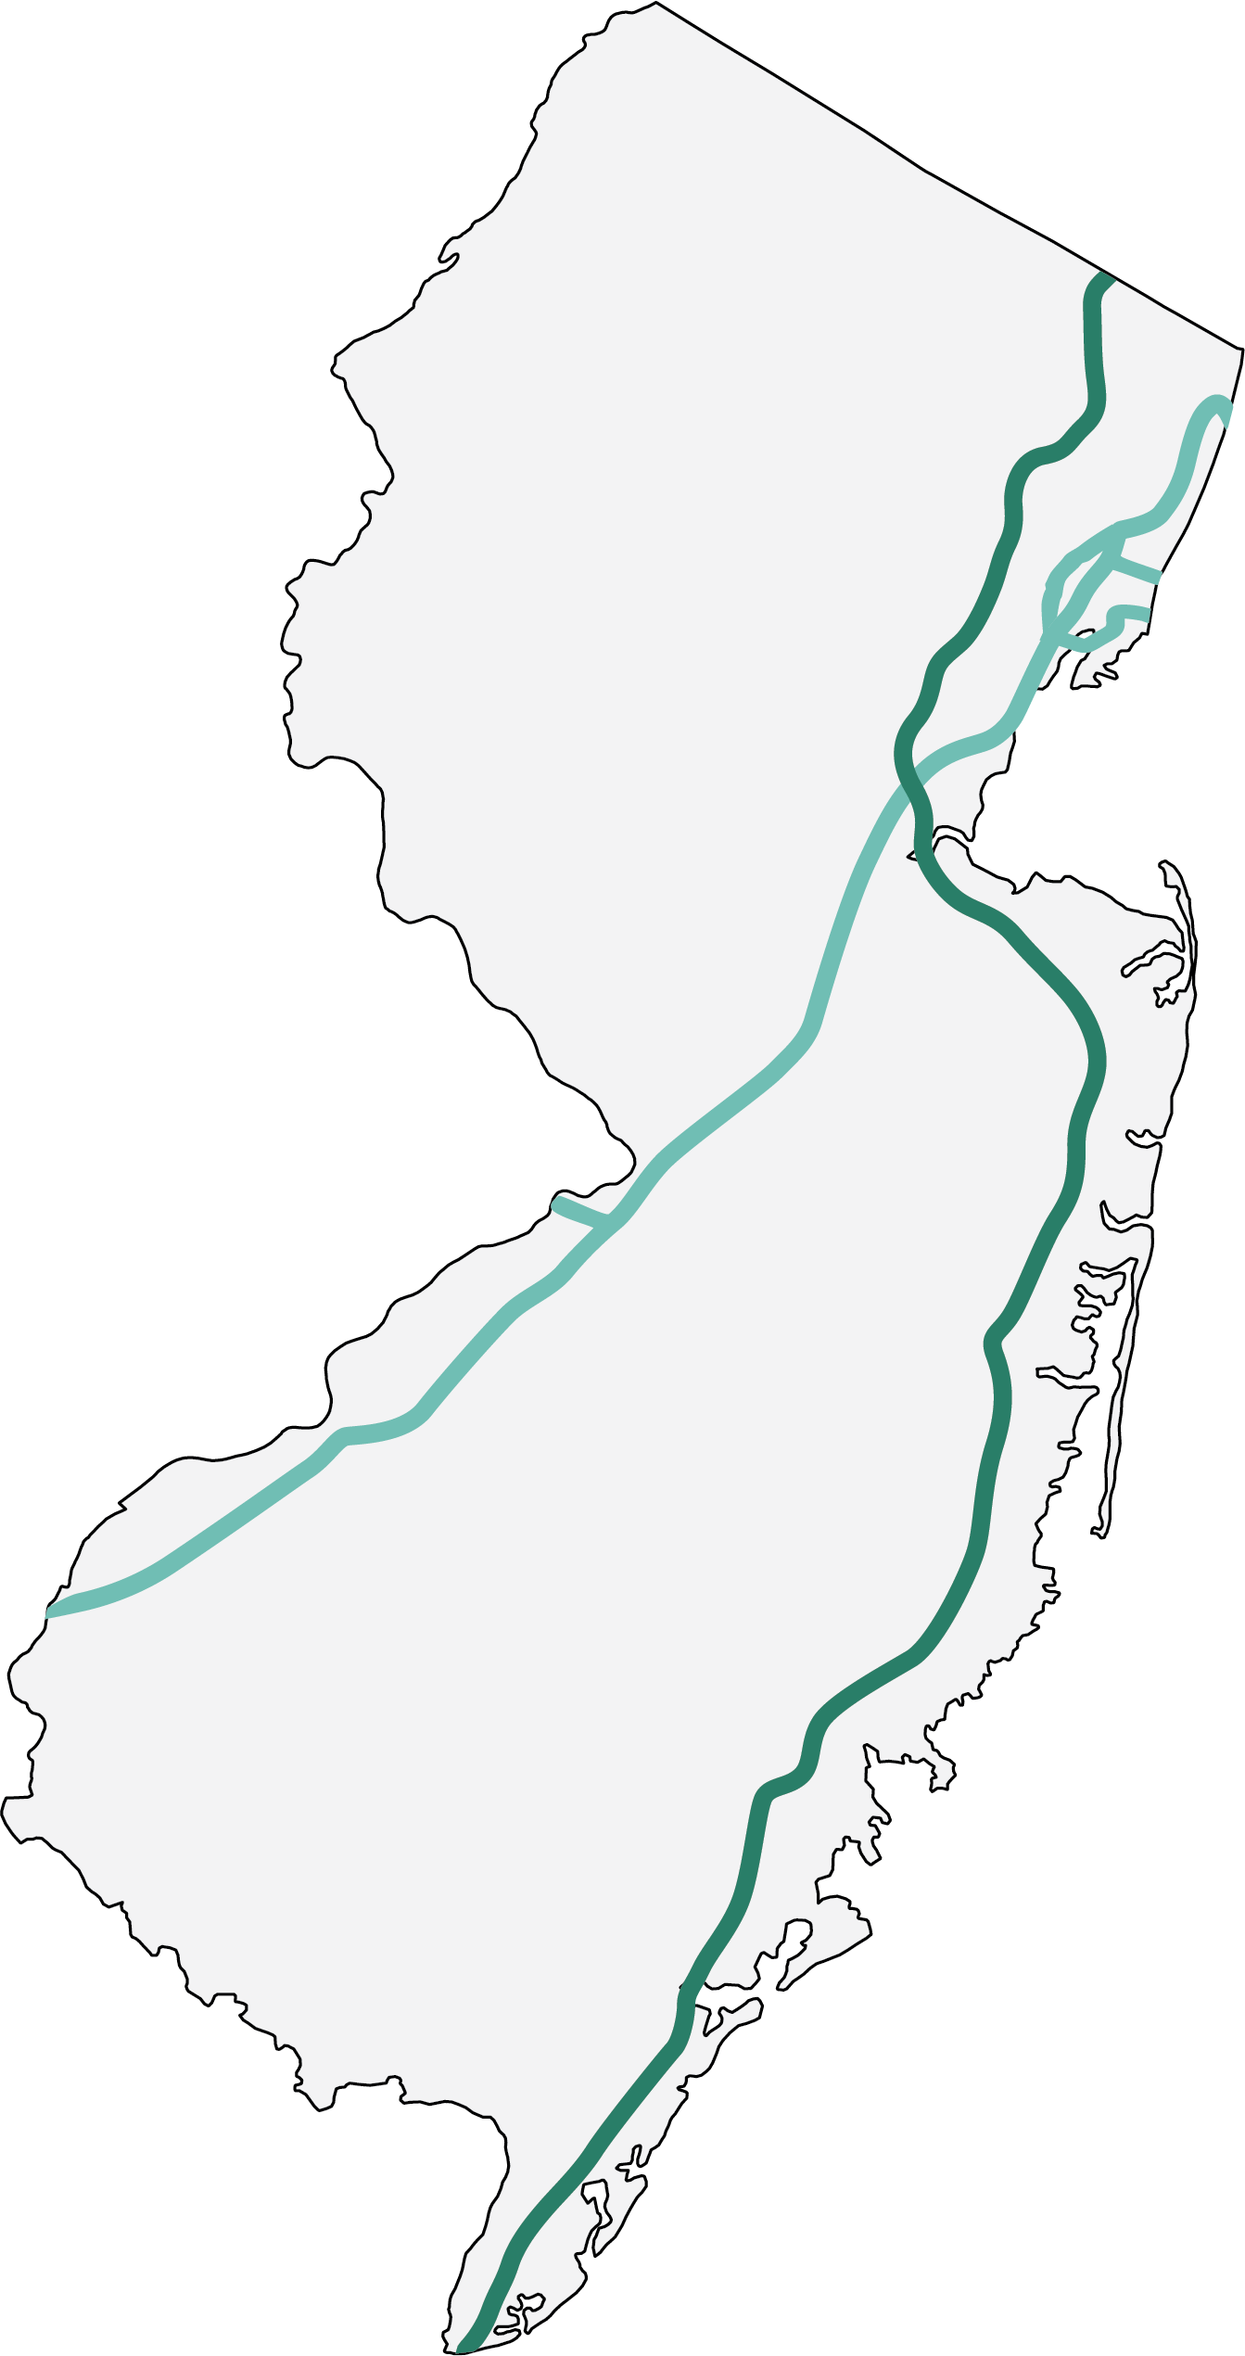
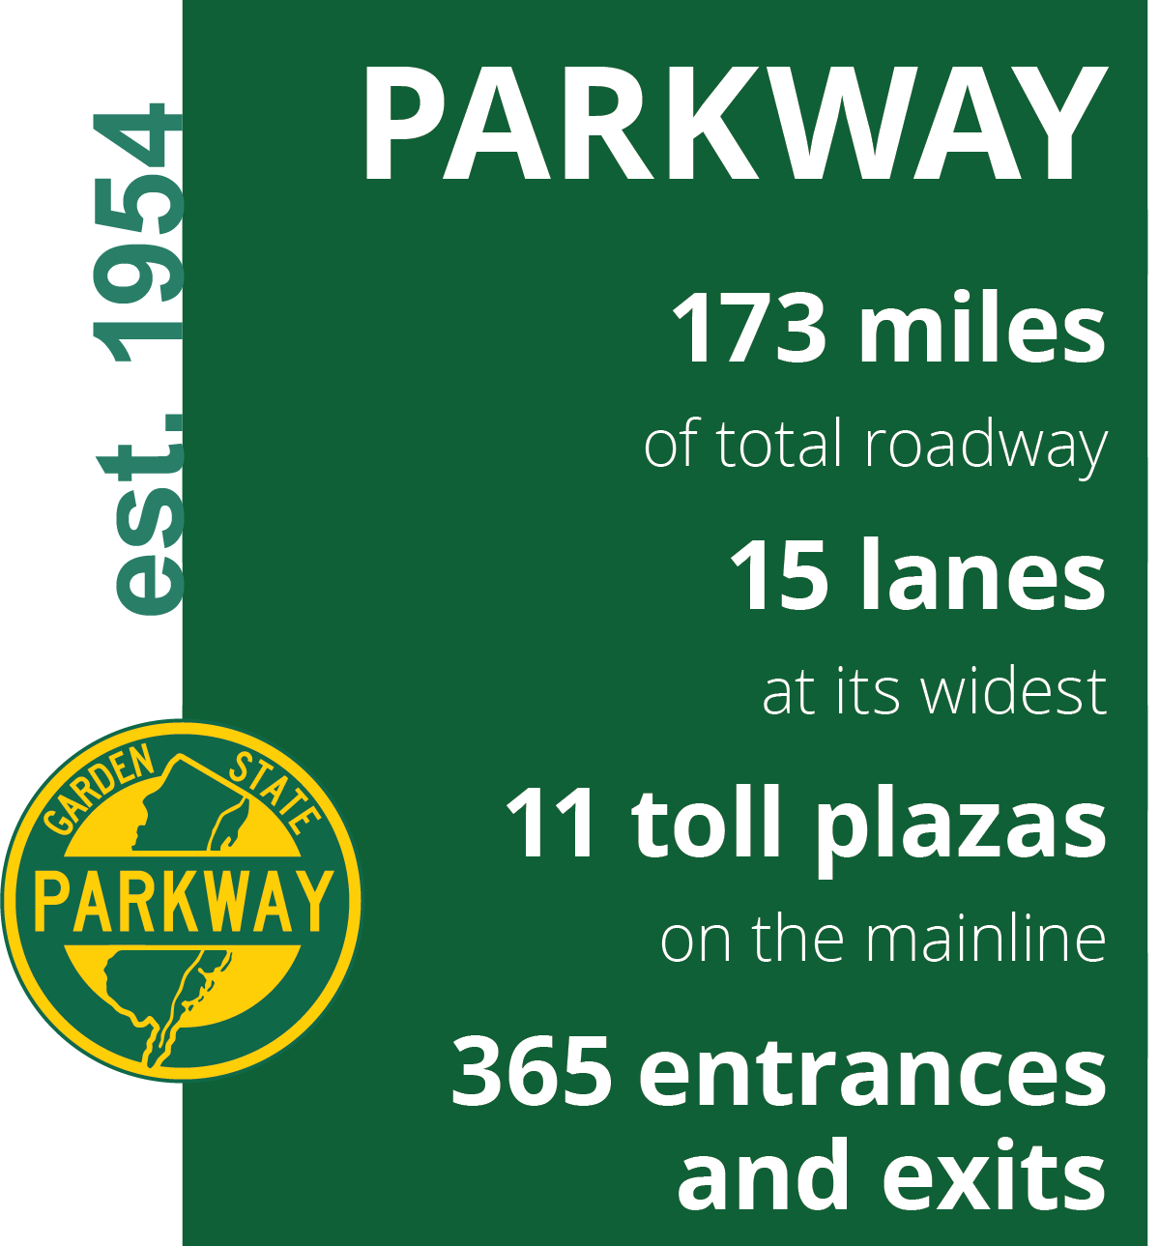

Slide 5
Turning Knowledge into Action
Impact
A Safe, Efficient, Innovative, and Resilient Toll Road System
A system that promotes continuous mobility, adapts to future climate conditions, operates sustainably, and maintains long term financial viability.
Outcomes
Reduced risk
Cost savings
Prolonged asset life
Outputs
Resilient infrastructure
Enhanced traffic efficiency
Innovative technologies
Sustainable practices
Activities
Enhanced planning
Targeted investments
Climate Informed Design
Sustainable operations and construction practices
Inputs
Data, Models, Assessments
Policies and Plans
Partnerships

Slide 6
Roadmap to Resilience
Analyze threats to assets, system-level service, and customer mobility.
Activities:
Flood exposure assessment
Flood Exposure Visualization Tool
Innovate
DEFINE
Climate-Related Hazards
Understand asset-level and system-level exposure and vulnerabilities.
Activities:
Vulnerability pilots
Risk metrics
Educate
ASSESS
Risk and Vulnerability
Consider strategies across operations including procurement, capital planning, asset management, and state of good repair.
Activities:
Resilience Plan
Resilient Design Criteria and SOPs
IDENTIFY Resilience Solutions
Communicate
Design and construct resilient infrastructure projects to maximize return on investment over a project’s useful life considering future conditions.
Activities:
Resilience policy statement
Communications plan
Building Regional partnerships
ADVANCE & INTEGRATE
Resilient Infrastructure
Notes:
Note: animation has been applied here so each click will define the roadmap strategy and a second click will reveal related activities.
The Resilience Program and Roadmap provides a coordinated structure to build on and grow the Authority’s existing resilience and sustainability activities. To support program growth into the future and meet the Authority’s strategic goals -- we developed a vision for a resilient Authority and the roadmap to get us there.
The roadmap will help us advance and integrate resilient infrastructure solutions across our plans, policies, procedures, designs and projects. And it is intended to help integrate resilience thinking into our core work by identifying climate change related threats, understanding asset- and system-level exposure and identifying resilience solutions.
The roadmap and this approach are supported by communication (internal and external awareness raising), education (training and technical assistance), and innovation (monitoring and evaluating progress and incorporating learning as we go to continue to improve and innovate).
Today’s focus is on the second step, ASSESS. We’ll also be briefly reviewing the first step, DEFINE, to share the results that informed our vulnerability assessment.

Slide 7
Building Resilience through Risk Informed Decision Making
1
Screen Existing Capital Projects for Flood Risk and Resilience Needs
Condition of Asset
Vulnerability of Asset
Criticality of Asset
2
Identify and Prioritize Potential Resilience Projects
Risk-Informed
Decision Making
3
Standardize Approach for Considering Resilience in Construction
Prioritized Projects
Long-term System Planning
Sustainable, Resilient Systems
Notes:
Condition of Asset: Current state of our transportation assets including maintenance needs.
Vulnerability: The degree to which an asset/system is susceptible to, or unable to cope with adverse effects of climate change or extreme weather events.
Criticality: Importance of the asset to the system/region/state/nation as a whole with respect to level of service and operation
By understanding the asset's condition, vulnerability, and criticality, we can make better-informed choices on how to allocate resources and where to invest to suppo long-term planning and climate resilience. By embracing a comprehensive, risk-informed approach, we can make sure that our toll-road system remains safe, efficient, and in a state of good repair for generations to come.

Slide 8
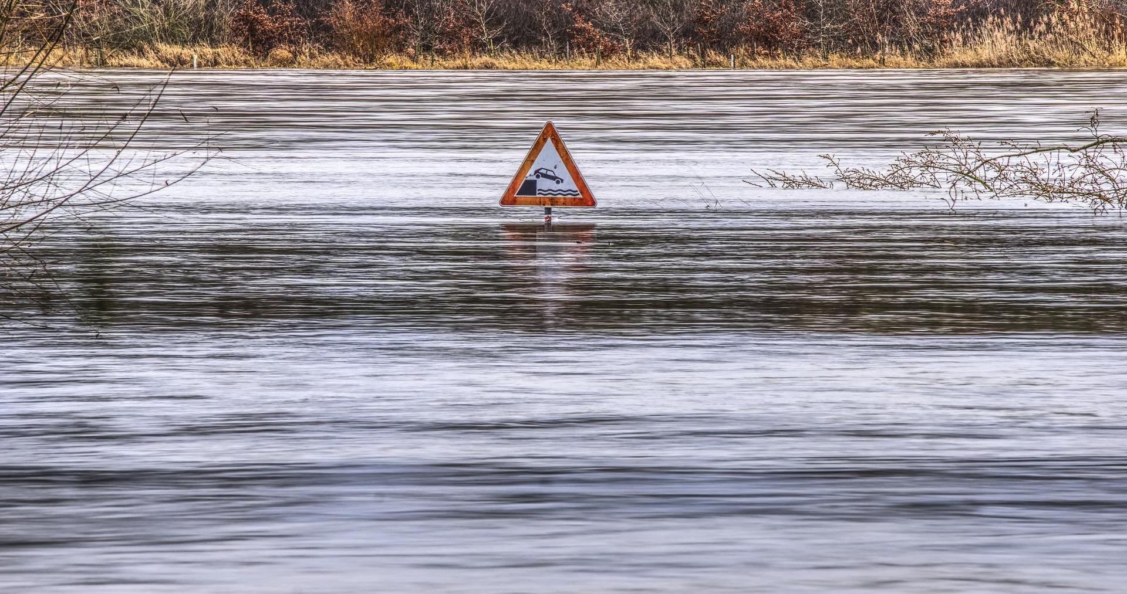
EXPOSURE ASSESSMENT
Define Climate-Related Hazards

Slide 9
Overview
8 exposure scenarios
Flood sources
Riverine
Coastal
Stormwater
Time period
Current
2050
2070
2100
Frequency
10 year
100 year
Emissions Scenario
RCP 4.5
x
x
x
=
Notes:
First, we performed a model-based flood exposure assessment. The first step was to scope the most important flood scenarios and time horizons to model.
It was important to model all the major flood sources including riverine flooding, coastal flooding, and stormwater or pluvial flooding. Riverine and stormwater in 1 framework with coastal assessed separately
We also looked at four time periods that span the lifetime of Authority assets: the current period, 2050, 2070, and 2100.
We looked at relatively frequent 10-year event and relatively rare 100-year events.
Finally, we looked at a relatively high-emissions RCP 8.5 scenarios. This is a relatively conservative scenarios that assumes a continuation of recent historic trends in global greenhouse gas emissions.
We therefore looked at a total of total of eight scenarios.

Slide 10
Exposure Methodology Highlights
Model: HEC-RAS v6.0 (plus coastal analysis)
Mesh resolution: ~10m (variable)
DEM: NJ 10ft LiDAR
Land cover: 2015 NJDEP Dataset
Infiltration: SCS CN Approach
Rainfall:
Current: Atlas-14
Future: NJ Extreme Precipitation Projection Tool
Discharge:
Current: FEMA studies, Streamstats
Future: HEC-HMS
Coastal elevations:
Current: FIS
Future: 2021 NJ Sea Level Rise Guidance
Major limitations:
No explicit modeling of subsurface drainage system (e.g., stormwater inlets, pipes, outfalls)
No fine resolution flood control structures (e.g,.floodwalls)
Assessment is more likely to overestimate flooding than underestimate flooding.
Notes:
mention HEC-RAS, that this is a custom hydro model, and mention limitations.
This slides summarizes some of the technical details of the exposure assessment.
We’ll review them very briefly, but we’d be happy to find time to discuss these in more detail with anyone who is interested.
We used the HEC-RAS model to simulate flooding, along with some specialized coastal analysis.
The average model mesh resolution was approximately 30m with higher resolution along the highway and river corridors.
We used 10ft DEM and 2015 Land Use Land Cover data, both provided by New Jersey state agencies.
We used the SCS curve method to simulate variable infiltration across different land use and soil types.
We obtained design storm rainfall data for current conditions from NOAA Atlas-14, and for future conditions from the NJ Extreme Precipitation Tool.
We obtained larger stream and river discharge data for current conditions from the FEMA flood insurance studies and Streamstats. For Future conditions, we used a set of representative HEC-HMS hydrology models to develop future change factors.
We obtained coastal elevations for current conditions from the FEMA flood insurance studies and for future conditions from the 2021 NJ Sea Level Rise Guidance.
In order to do flood modeling at this scale, it was not possible to explicitly model the subsurface drainage system, such as stormwater inlets, pipes, and outfalls). These are represented in a very course way by the infiltration approach.
We also could not explicitly model the fine resolution flood control structures, like flood walls.
As a results of these limitations and the study design in general, the assessment is more likely to overestimate flooding that underestimate flooding.
It was important for the exposure analysis to capture all the potential flood exposure, so that more detailed checks could be done if there if there is actual flood exposure.

Slide 11
Case Study – Data into Action

Slide 12
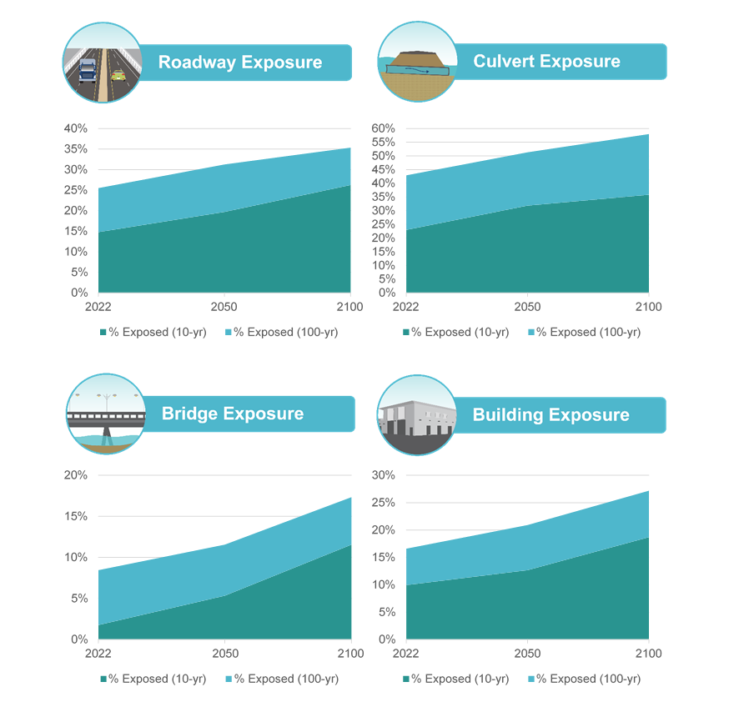
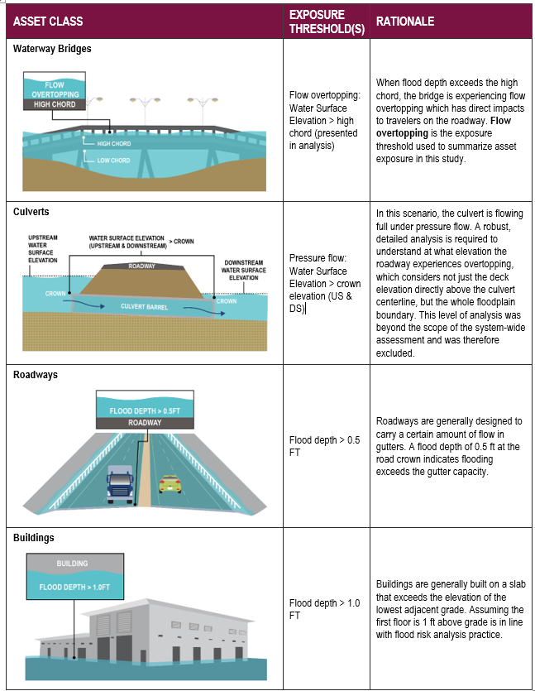
Risk Metrics

Slide 13
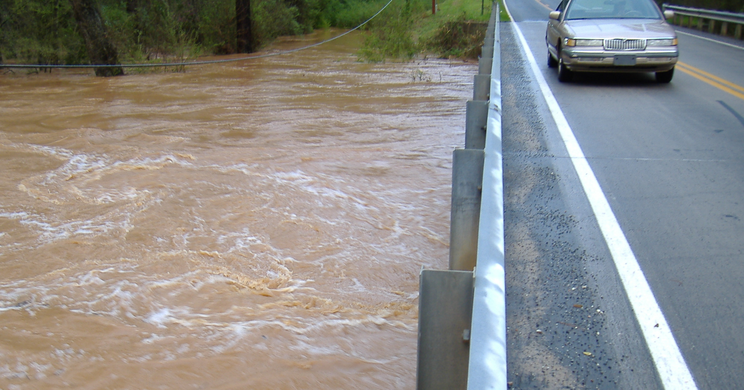
VULNERABILITY ASSESSMENT
Assess Risk and Vulnerability

Slide 14
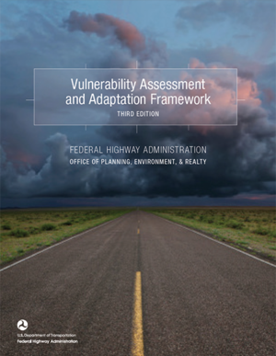
Overview
Flood Exposure
Whether the asset is located in an area experiencing direct effects of flooding
Adaptive Capacity
The ability of the transportation network to recover quickly following a shock or stress to the asset
Sensitivity
How the asset performs during and after a flood exposure event
Vulnerability Methodology
Notes:
Scott
Our vulnerability methodology follows an approach consistent with FHWA.
How
Exposure
Likelihood of exceeding flood exposure metrics – depth, duration, velocity, force
Sensitivity
Asset-specific design and condition evaluations
Adaptive Capacity
High-level, qualitative assessment

Slide 15
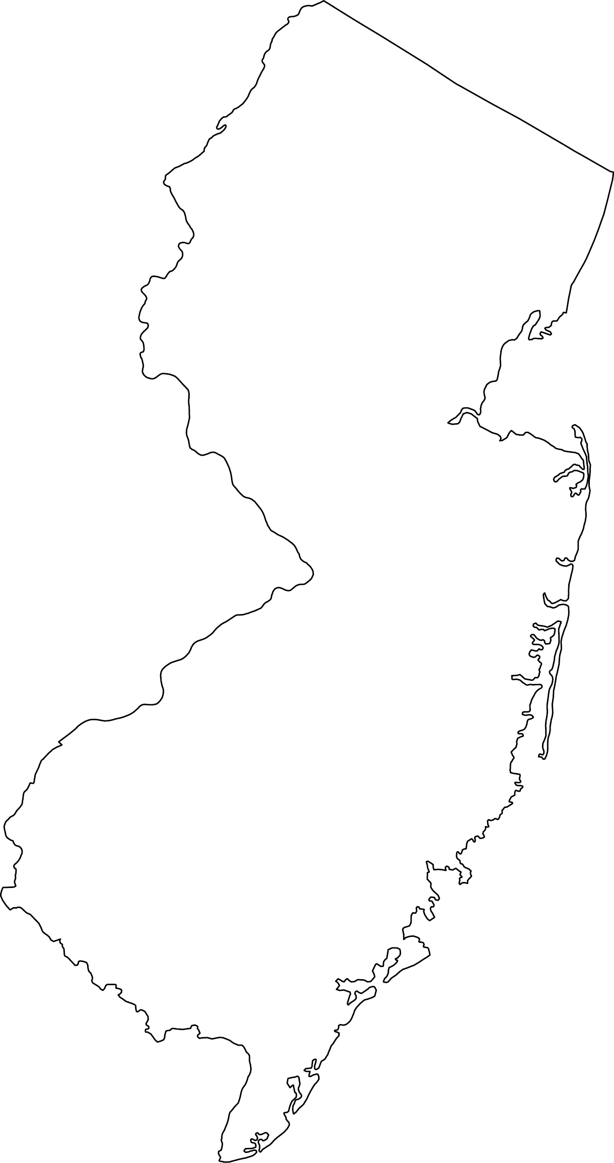
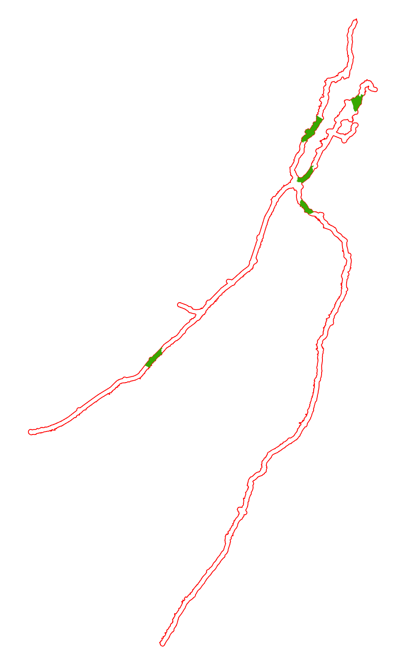
Five Pilot Sites
Westerly Alignment
Irvington
Heards Brook
Mt Laurel
Cheesequake

Slide 16
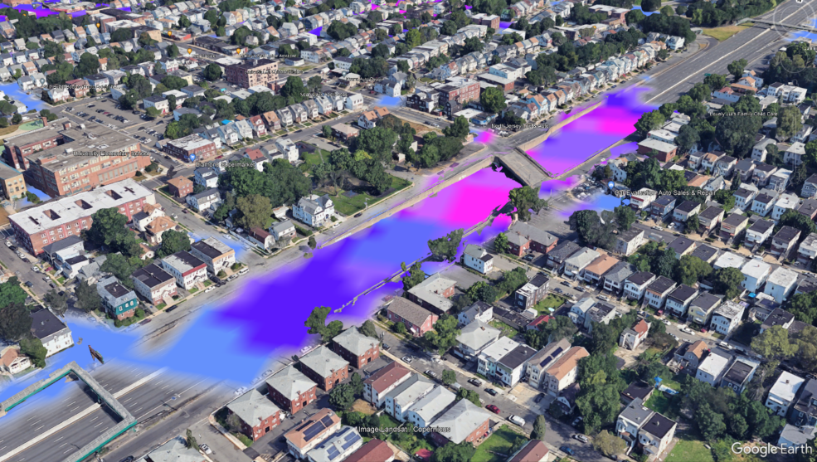
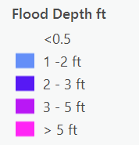
Improved Flood Modeling
Model IMPROVEMENT | Exposure Assessment | Vulnerability Pilots
Hydraulic structures | Openings added in terrain to allow flow through at significant cross-drainage structures | Physical structures added using as-built data if available or approximation method based on imagery and terrain
Rainfall scenarios | Rainfall simulation for 10- and 1-percent AEP Existing condition, 2050 condition, and 2100 condition | Rainfall simulation for events ranging from 50-pecent to 0.2-percent AEP. Rainfall depth ranges between upper and lower 90-percentile Existing condition, 2050 condition, and 2100 condition
Terrain | 10m USGS DEM | 1m USGS DEM
Boundary conditions | Fluvial inflows using regression equation method from USGS StreamStats website Pluvial simulated as rainfall-on-grids 10-percent AEP coastal surge elevation | Fluvial/pluvial simulated as rainfall-on-grids MHHW coastal surge elevation
Model extent | Half-mile buffer from roadway | Five areas of interest (AOI), and relevant intersecting watersheds
Model resolution | 200 feet x 200 feet | 100 feet x 100 feet

Slide 17
Asset-Specific (Irvington Site GSP MP 143.6) Flood Depth Probability Tables – Ex. 1
 | AEP - Annual Exceedance Probability (years)
Flood Depth (ft) | 2020 | 2030 | 2040 | 2050 | 2060 | 2070 | 2080 | 2090 | 2100
0.5 | 10% | 12% | 14% | 15% | 16% | 16% | 16% | 16% | 17%
1 | 8% | 9% | 11% | 12% | 13% | 13% | 13% | 13% | 13%
1.5 | 4% | 5% | 7% | 8% | 8% | 8% | 9% | 9% | 9%
2 | 2% | 3% | 4% | 5% | 5% | 5% | 5% | 5% | 5%
2.5 | 0% | 1% | 1% | 2% | 2% | 2% | 2% | 2% | 2%
3 | <0.2% | <0.2% | 1% | 1% | 1% | 1% | 1% | 1% | 1%
3.5 | <0.2% | <0.2% | <0.2% | <0.2% | <0.2% | <0.2% | 1% | 1% | 1%
4 | <0.2% | <0.2% | <0.2% | <0.2% | <0.2% | <0.2% | <0.2% | <0.2% | <0.2%
 | Recurrence Interval (years)
Flood Depth (ft) | 2020 | 2030 | 2040 | 2050 | 2060 | 2070 | 2080 | 2090 | 2100
0.5 | 10 | 8 | 7 | 6 | 6 | 6 | 6 | 6 | 6
1.0 | 13 | 11 | 9 | 8 | 8 | 8 | 8 | 8 | 7
1.5 | 25 | 19 | 15 | 12 | 12 | 12 | 12 | 12 | 11
2.0 | 51 | 35 | 26 | 20 | 20 | 20 | 19 | 19 | 18
2.5 | 278 | 152 | 95 | 66 | 64 | 63 | 61 | 60 | 58
3.0 | >500 | >500 | 303 | 185 | 182 | 175 | 169 | 167 | 161
3.5 | >500 | >500 | >500 | >500 | >500 | >500 | 500 | 476 | 476
4.0 | >500 | >500 | >500 | >500 | >500 | >500 | >500 | >500 | >500
Notes:
Example
Irvington Site
GSP MP 143.6
NBI 361436t
Major Culvert

Slide 18
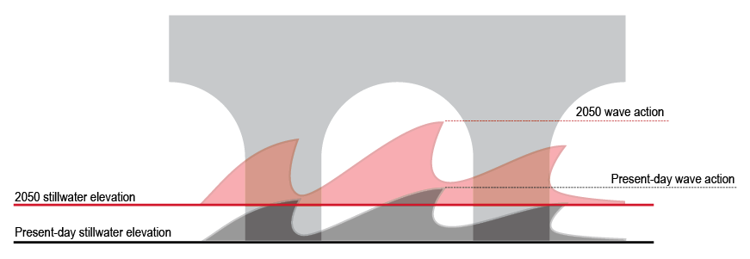
Wave Effects
With future conditions,
Increases to base flood elevation (surge + waves)
Increases in potential damage from larger waves

Slide 19
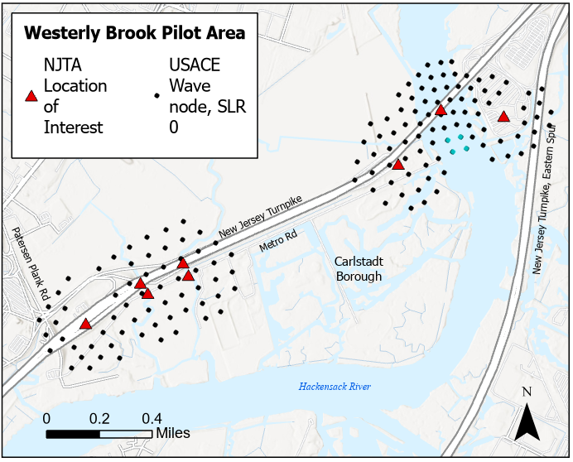
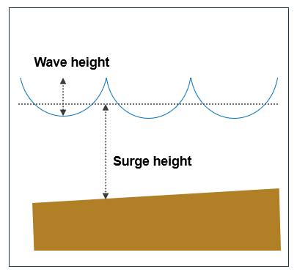
Wave Data Development
Source data: USACE North Atlantic Coast Comprehensive Study, 2015
Wave heights provided at nodes for:
Current conditions
1 meter (3.3. feet) sea level rise
Nodes extracted near NJTA assets
Significant wave heights converted to controlling wave heights
Scenarios for 1 and 2 feet of SLR were linearly interpolated
Wave height increases capped in areas of limited fetch
Wave Heights (feet), Current Conditions: 0 feet SLR
Node | e10 | e20 | e50 | e100 | e200 | e500 | e1000
91147 | 2.26 | 2.45 | 2.69 | 2.85 | 2.98 | 3.11 | 3.18
91148 | 2.27 | 2.45 | 2.68 | 2.85 | 2.97 | 3.10 | 3.18
91160 | 2.27 | 2.46 | 2.69 | 2.84 | 2.98 | 3.11 | 3.18
91794 | 2.27 | 2.45 | 2.69 | 2.85 | 2.98 | 3.10 | 3.18
Wave Heights (feet), Future Conditions: 3.3 feet SLR
Node | e10 | e20 | e50 | e100 | e200 | e500 | e1000
91147 | 2.46 | 2.70 | 2.96 | 3.12 | 3.26 | 3.41 | 3.51
91148 | 2.85 | 3.23 | 3.64 | 3.89 | 4.10 | 4.34 | 4.49
91160 | 2.54 | 2.81 | 3.11 | 3.29 | 3.44 | 3.61 | 3.72
91794 | 2.25 | 2.42 | 2.61 | 2.72 | 2.82 | 2.93 | 3.01

Slide 20
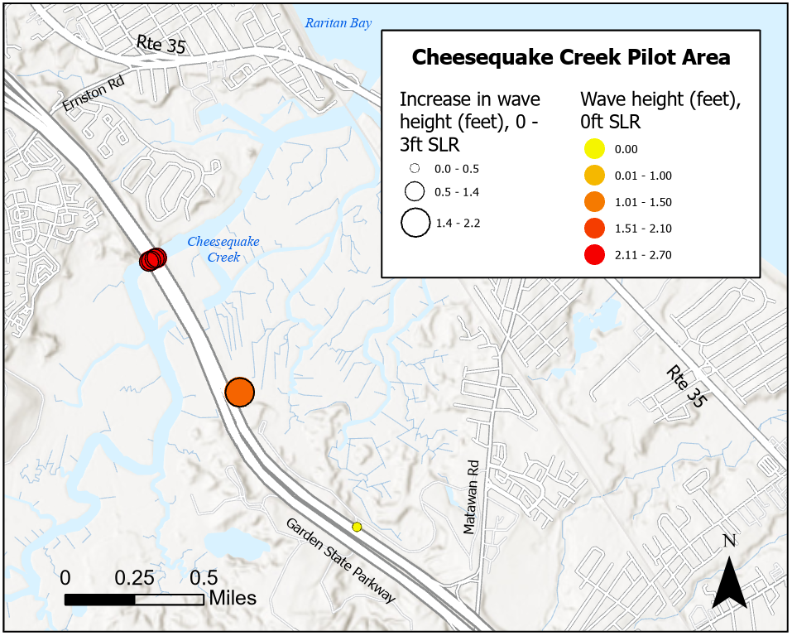
Wave Assessment: Cheesequake Creek

Slide 21
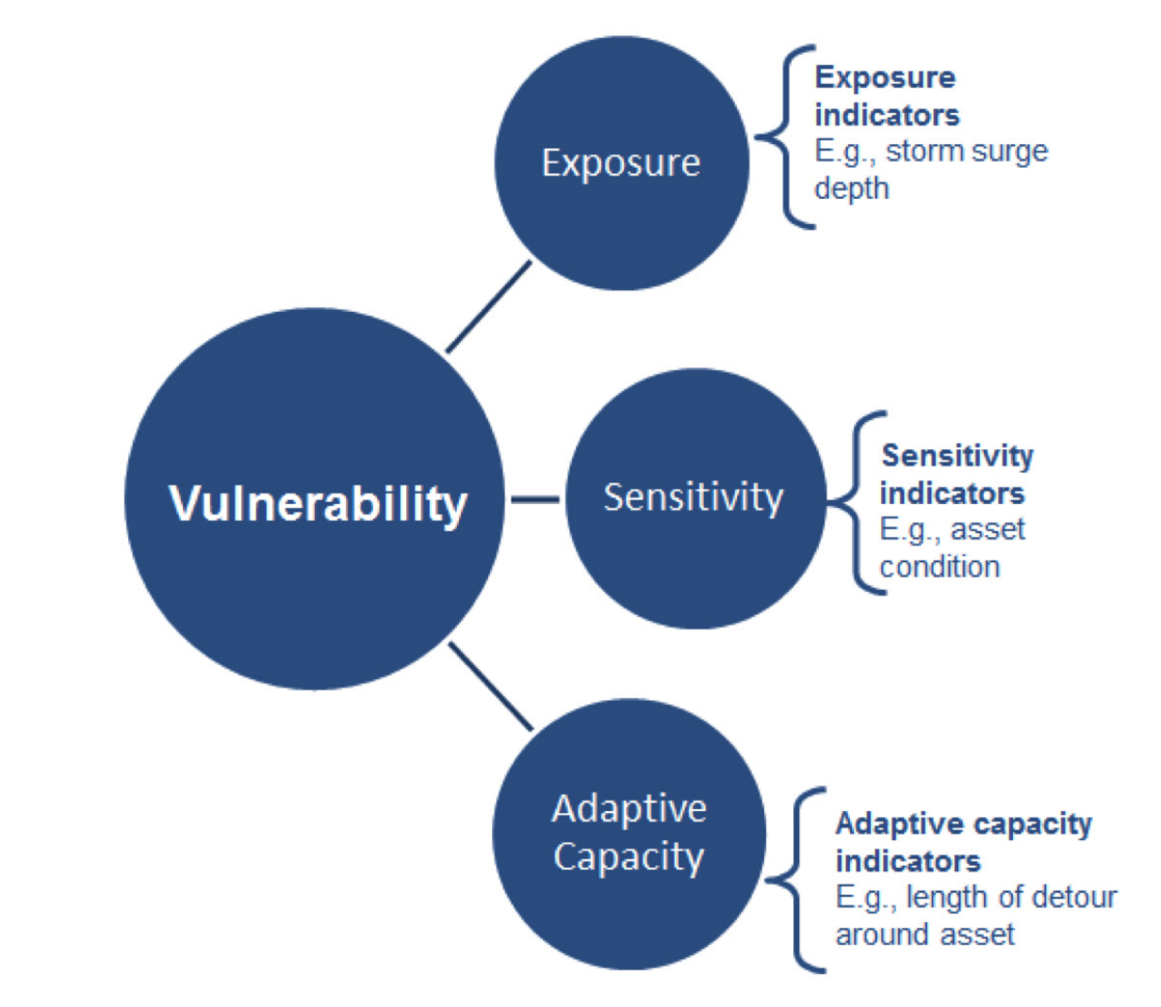
Vulnerability Scoring
Customized application of USDOT Vulnerability Assessment Scoring Tool (VAST) Framework
Three components:
Exposure
Sensitivity
Adaptive Capacity
Source: U.S. DOT Gulf Coast Study, Phase 2 Fact Sheet (FHWA-HEP-14-053))

Slide 22
Scoring Indicators – Roadways
How much will the asset be exposed?
Will flood exposure cause asset failure?
How quickly can the system adapt to asset impairment?
Exposure
Flood Depth ExCo 10yr
Sensitivity
Hazard 2 ExCo AEP
Adaptive Capacity
Roadway Type
Hazard 2 ExCo AEP Increase by 2050
Flood Depth ExCo 100yr
Flood Depth 10yr Increase by 2050
Flood Depth 100yr Increase by 2050
Coastal Flood Depth ExCo 10yr
Coastal Flood Depth ExCo 100yr
Coastal Flood Depth 10yr Increase by 2050
Coastal Flood Depth 100yr Increase by 2050

Slide 23
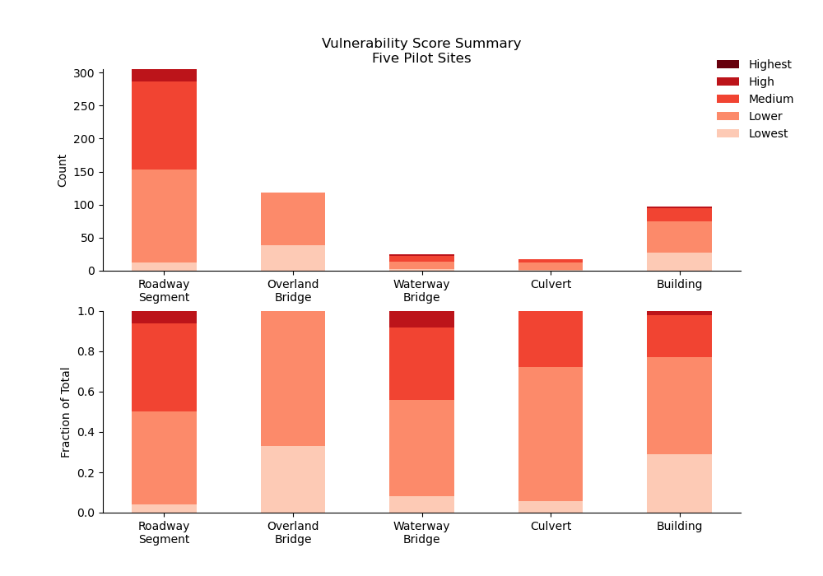
Vulnerability Scoring Results (Pilots)
VULNERABILITY COMPONENTS | SCORE | ROAD SEGMENTS | WATERWAY BRIDGES | OVERLAND BRIDGES | CULVERTS | BUILDINGS | ALL ASSETS
Exposure | 1 | 141 | 14 | 116 | 8 | 65 | 344
 | 2 | 149 | 5 | 1 | 8 | 28 | 191
 | 3 | 14 | 0 | 1 | 2 | 4 | 21
 | 4 | 1 | 6 | 0 | 0 | 0 | 7
 | 5 | 0 | 0 | 0 | 0 | 0 | 0
Sensitivity | 1 | 101 | 1 | 118 | 0 | 55 | 275
 | 2 | 35 | 15 | 0 | 15 | 9 | 74
 | 3 | 95 | 9 | 0 | 3 | 15 | 122
 | 4 | 73 | 0 | 0 | 0 | 18 | 91
 | 5 | 1 | 0 | 0 | 0 | 0 | 1
Adaptive Capacity | 1 | 30 | 1 | 7 | 3 | 1 | 42
 | 2 | 45 | 6 | 68 | 9 | 51 | 179
 | 3 | 54 | 7 | 19 | 2 | 40 | 122
 | 4 | 60 | 11 | 24 | 3 | 2 | 100
 | 5 | 116 | 0 | 0 | 1 | 3 | 120
Total Vulnerability Score | 1 | 12 | 2 | 39 | 1 | 28 | 82
 | 2 | 141 | 12 | 79 | 12 | 47 | 291
 | 3 | 133 | 9 | 0 | 5 | 20 | 167
 | 4 | 19 | 2 | 0 | 0 | 2 | 23
 | 5 | 0 | 0 | 0 | 0 | 0 | 0

Slide 24
SOPs
Identify Resilient Solutions

Slide 25
SOP Workflow
Identify Asset
Screen for Hazards and Impacts
Identify Applicable Component SOP(s)
Perform Qualitative Risk Considerations
Determine Appropriate Resilience Interventions

Slide 26
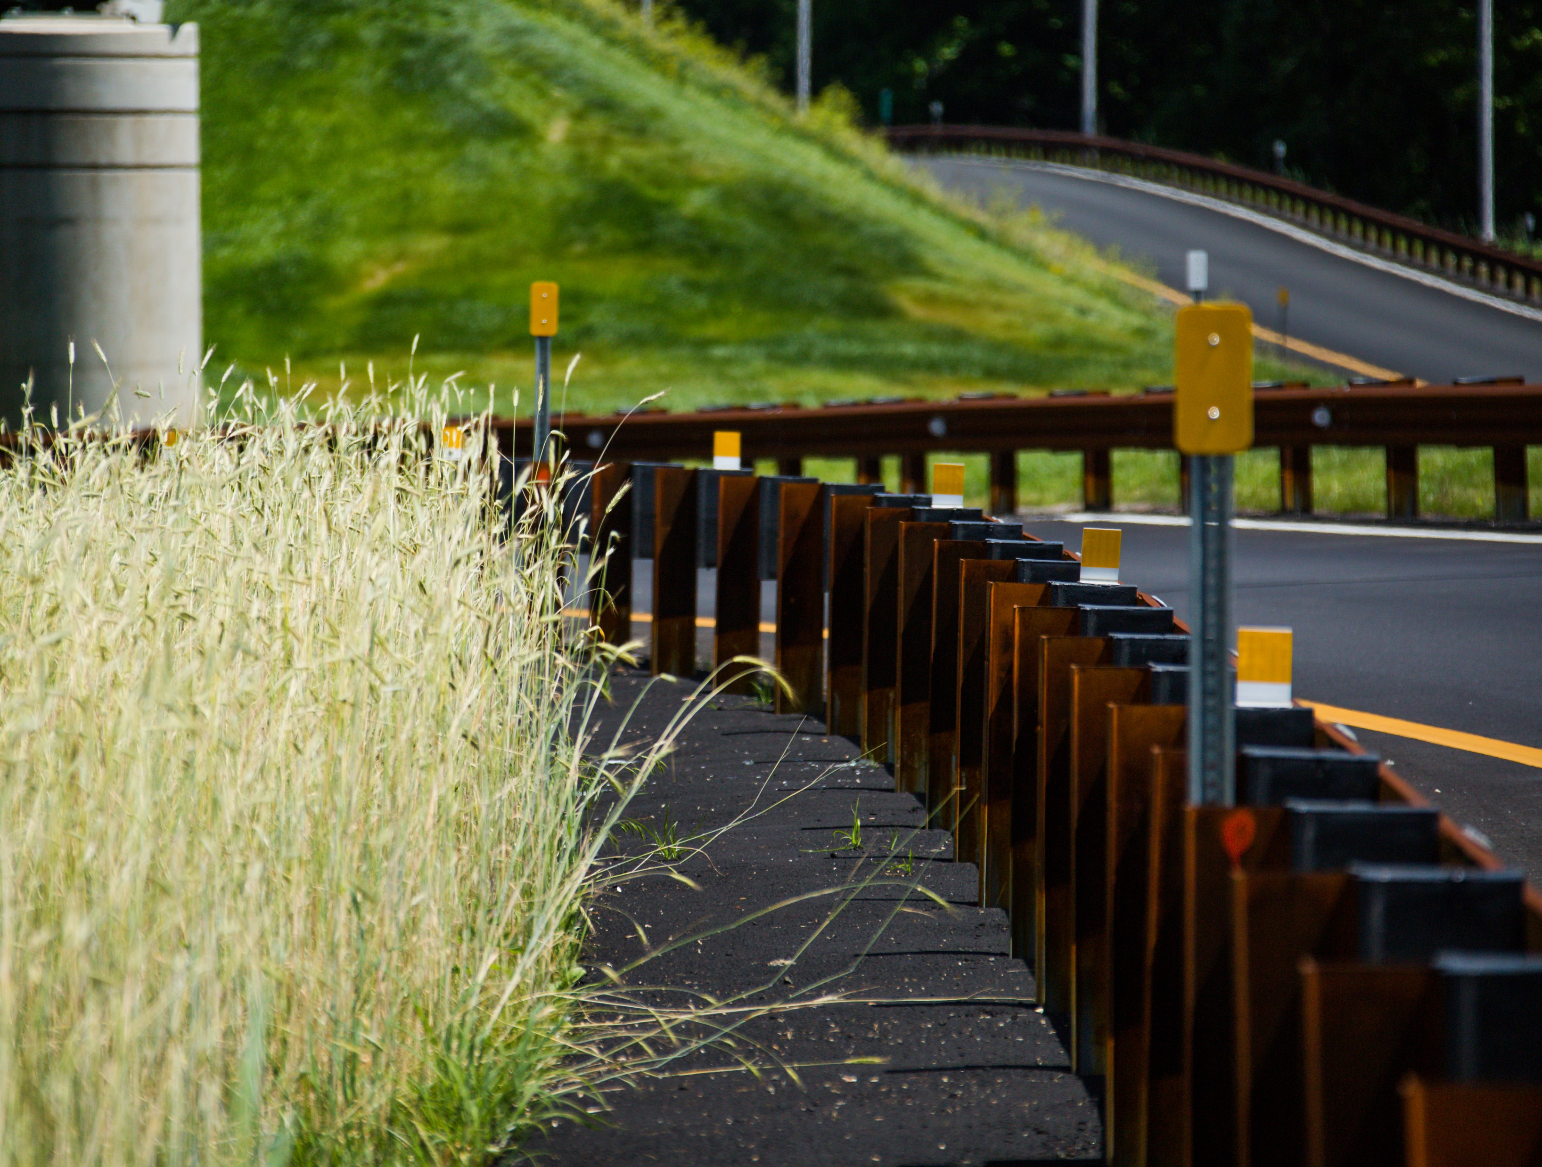
Questions?
Mat Mampara, P.E.
Vice President
MMampara@Dewberry.com
Sara Margolis, ENV SP
Project Manager
SMargolis@Dewberry.com
Notes:
Thank you

