Slide 1
Charleston’s Integrated Water Plan
Embracing future relationships with water and shedding light on environmental justice concerns

Slide 2
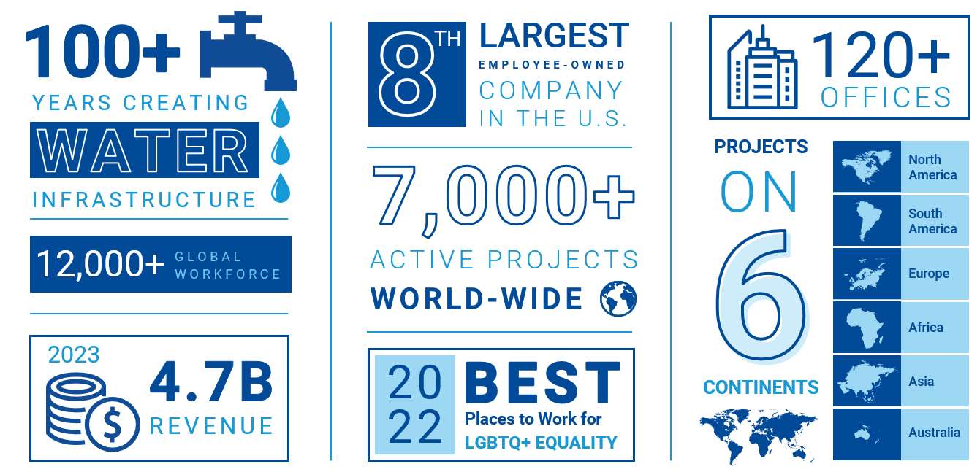
About Black & Veatch

Slide 3
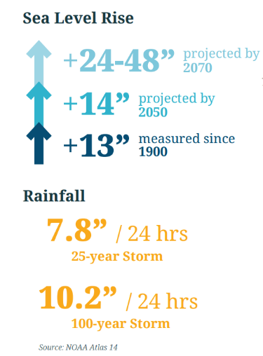
City of Charleston’s Flood Risks

Slide 4
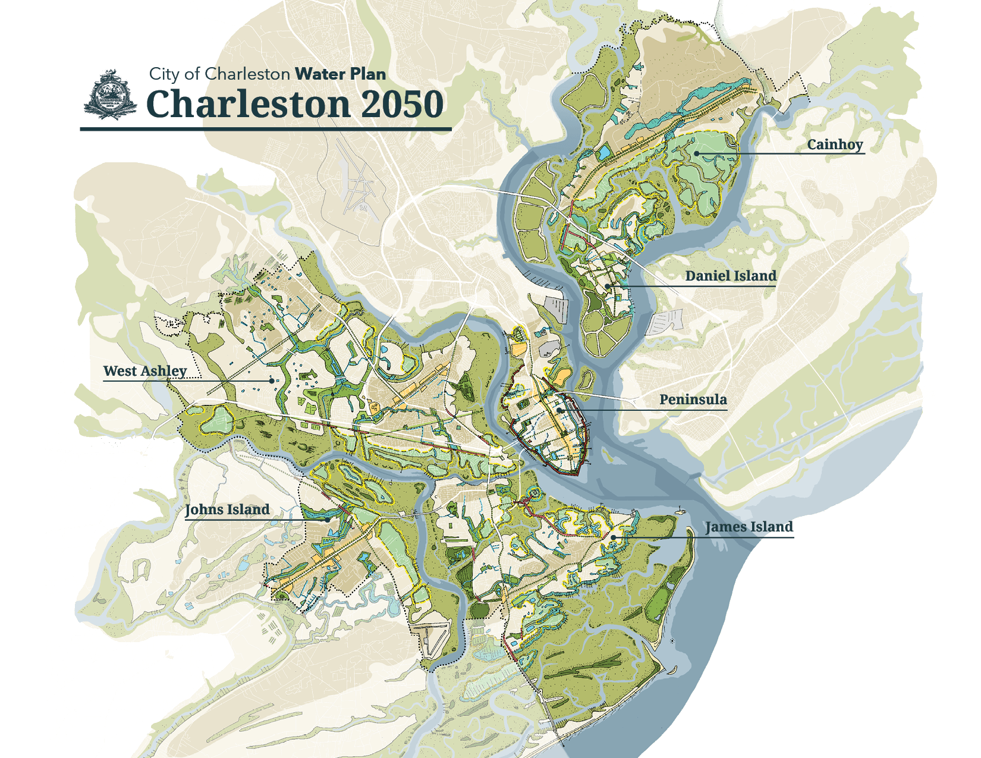
Integrated Water Plan
Developed to understand, plan for, prioritize, manage and adapt to current and future compound flood risks across all City neighborhoods, main drainage basins, and floodplains
Integration of existing plans, projects and priorities related to water
Change for Good to create systems and resources for equity and access
25-year planning horizon with consideration of longer trends and adaptation
A proactive, aspirational, and achievable vision for the City to embrace its relationship with water.

Slide 5
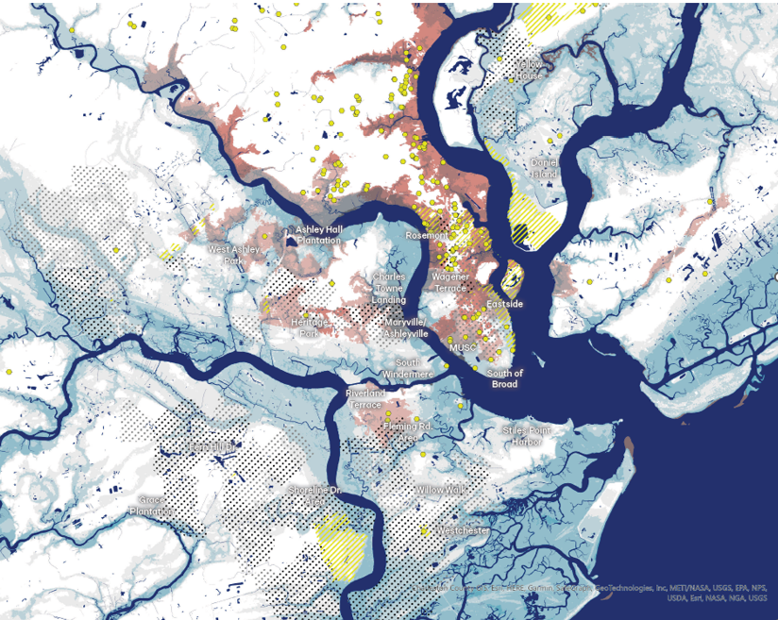
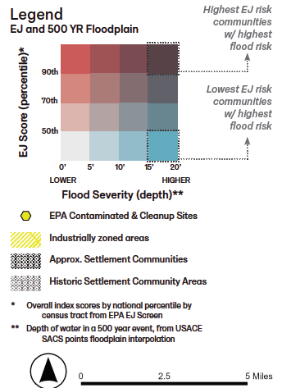
Dedicated Equity Working Group shaped the way to address equity:
Goals
Design of project selection criteria
Communication and messaging
Execution of the plan

Slide 6
Equity is a key factor in driving investment
Project Selection Criteria | Flood Protection
 | Environmental Justice & Accessibility
 | Nature
 | Community
 | Investment
The project directly benefits or brings relief to a community facing significant EJ burdens.
The community is involved in defining projects and project benefits
Provides public access to water and nature.
Incorporates cultures and history of underrepresented communities.

Slide 7
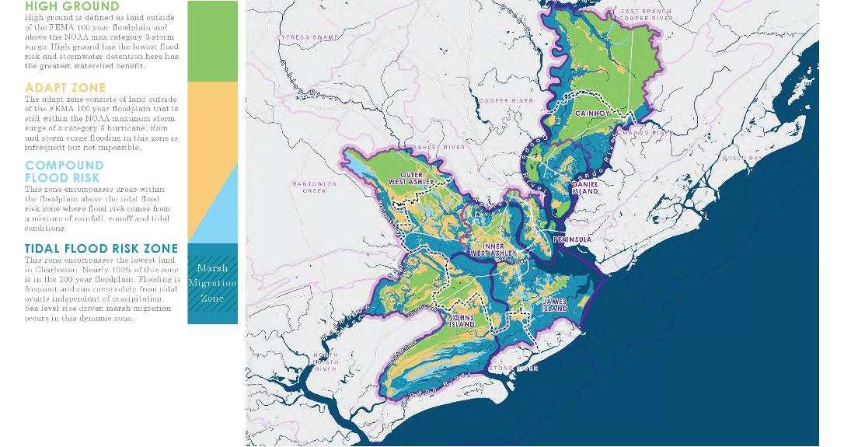
Adaptation Strategies

Slide 8
Thank you!
Black & Veatch Corporation
Alison Miskiman
+1 201 977-4432
MiskimanAM@bv.com

