Slide 1
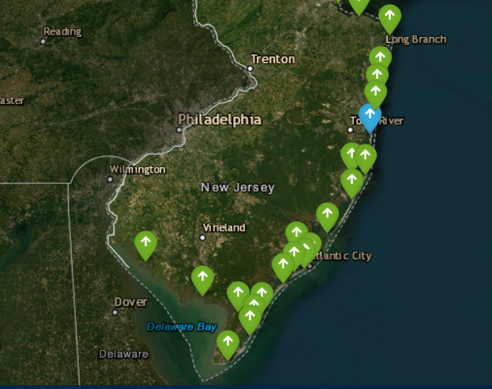
Synthetic Storm-Driven Flood-Inundation Maps for Coastal Communities in 10 New Jersey Counties U.S. Geological Survey in cooperation with NJ Dept. of Environmental Protection and Office of Emergency Management
Wednesday March 19, 2025
Project Team: Thomas Suro, Michal Niemoczynski, Lukasz Niemoczynski and Anna Boetsma.

Slide 2
Linking Realtime USGS tide gage data and Coastal Flood Inundation Mapping interface.
The USGS NJWSC has a tide gage network of 25 tide gages from Cape May to Bergen Counties linked to new mapping
Users can see real-time tide data and investigate what areas may flood for planning and mitigation purposes.
Find your community, find your tide gage, and start to understand what areas may flood (which access roads may get cut off)

Slide 3
Modeling behind the Mapping
Built from the original (2014) FEMA Coastal Study for New Jersey and New York.
Since the project began the original study is being re-studied
New “re-study” is on going and approaching completion, but existing mapping was done using output from the core hydrodynamic modeling used in the original study.

Slide 4
Why? Wind driven surge vs. Bathtub
Differences between wind driven surge compared to flat “bathtub” type mapping

Slide 5
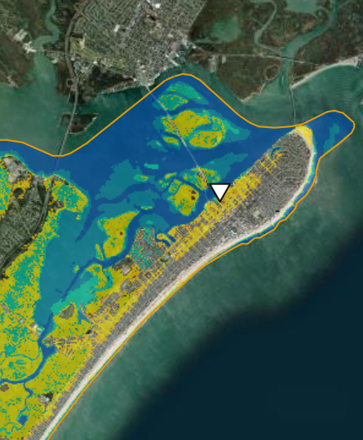
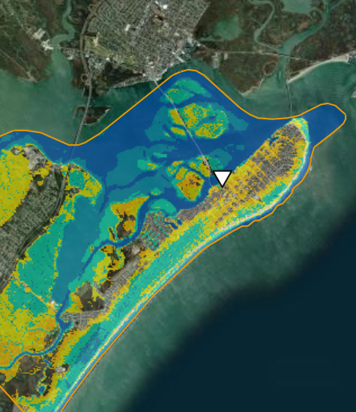
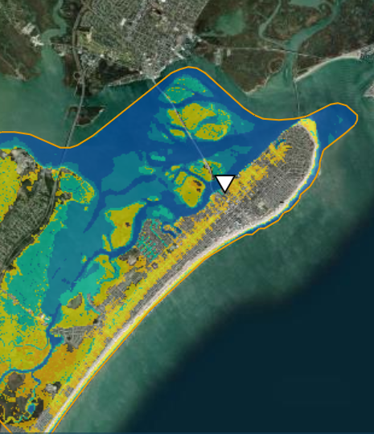
Comparing Storms: 01411320 Ocean City, NJ
Bathtub (5.0 ft)
Direct Landfall (5.0 ft)
Landfall further South (5.0 ft)

Slide 6
Using existing USGS tide gages as early warning tool.
Finding your tide gage. (each community should know where tide gages are located)
Learning your community tide range. (understand high-tide, minor to major flooding and 1% AEP elevations)
Investigate tide peak data for your community (what can we learn from historic data)
Finding important access routes, bridges, access ramps, your community assets (Grocery store, gas station, drug store).

Slide 7
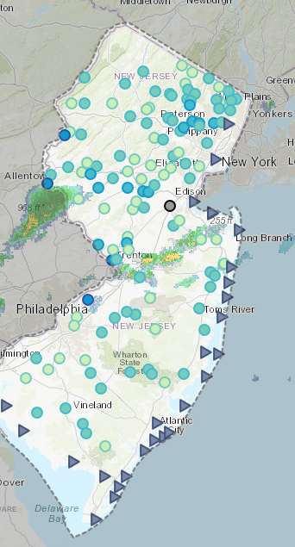
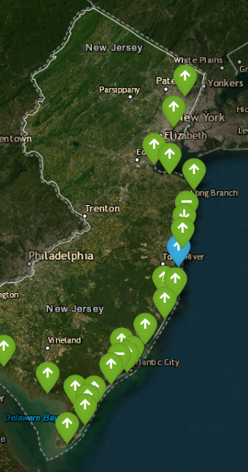
How to access the data
USGS Tide Gage data
USGS Coastal Inundation Maps
USGS Informational Webpage – Tutorial on mapping

Slide 8
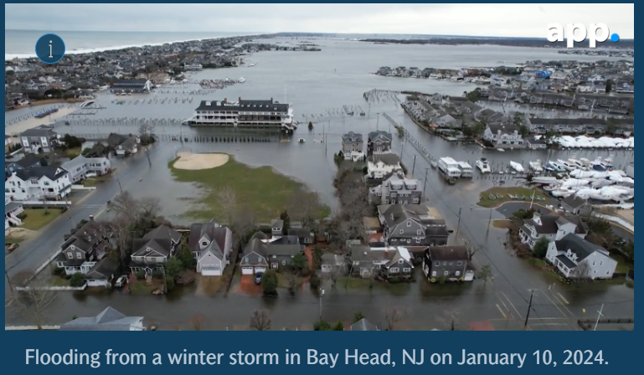
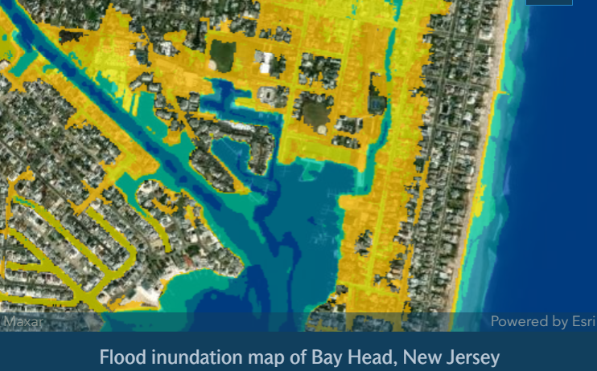
Improving the early warning tide gage network in NJ

Slide 9
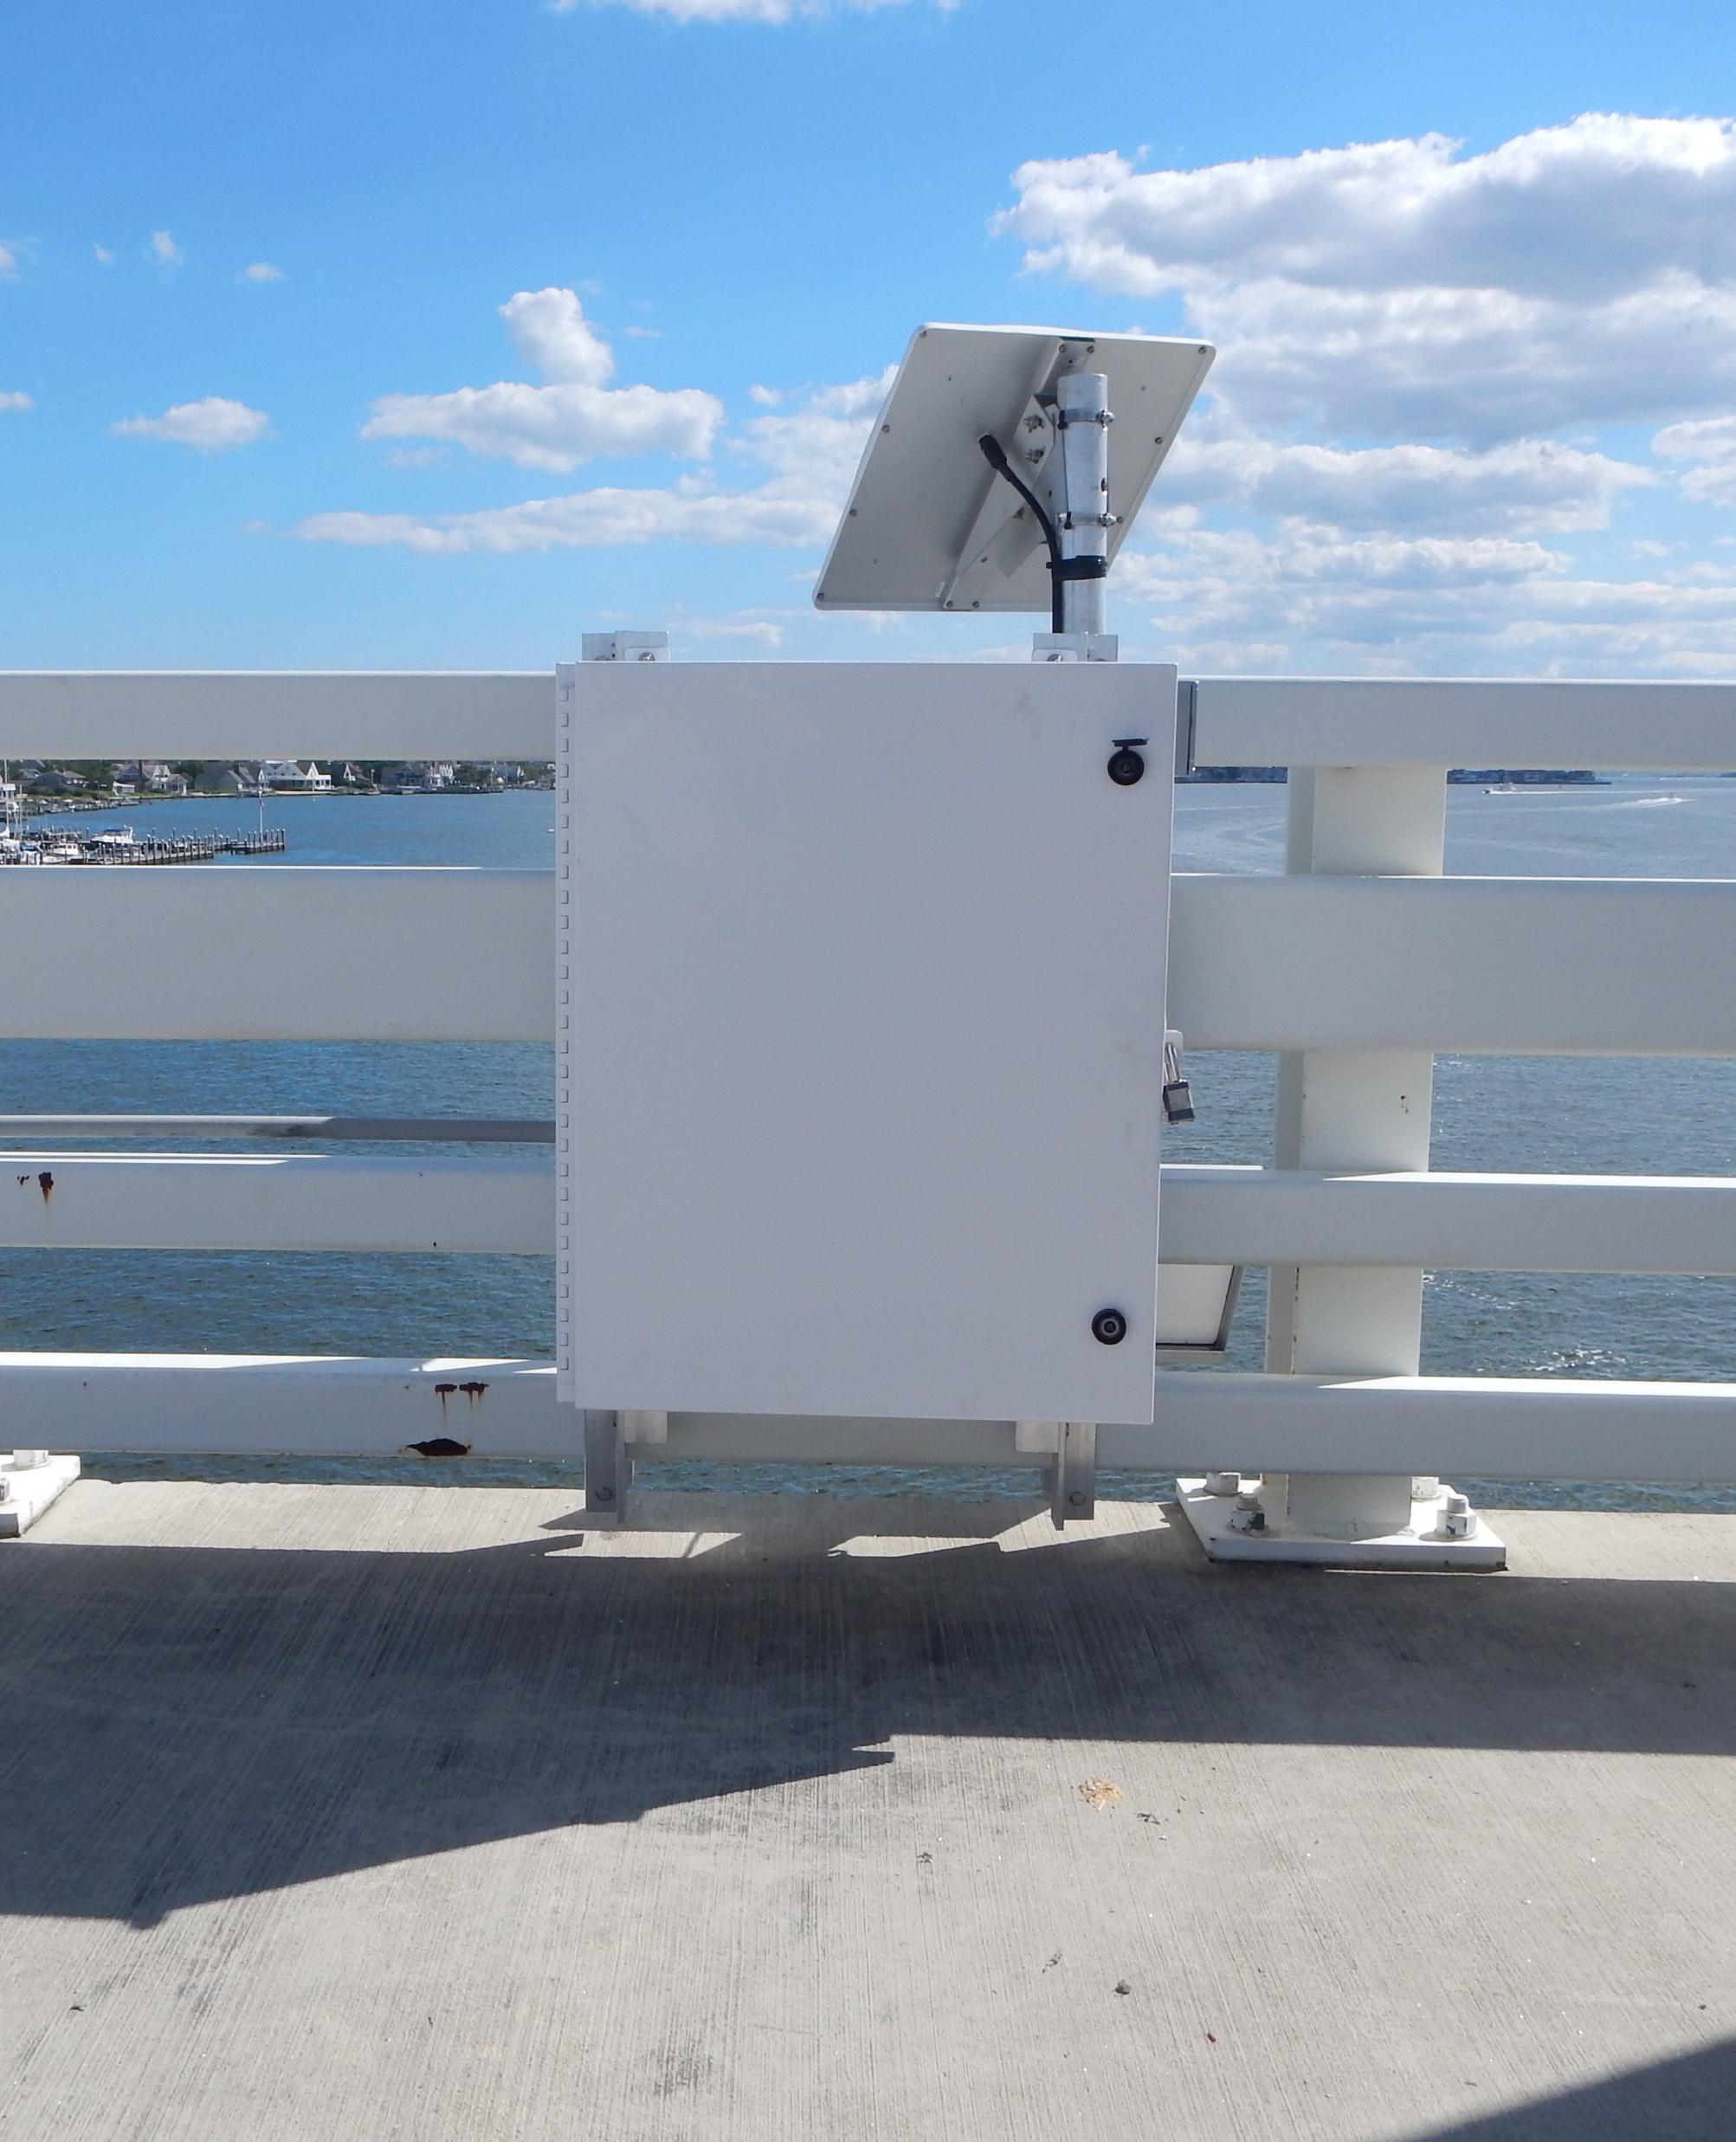
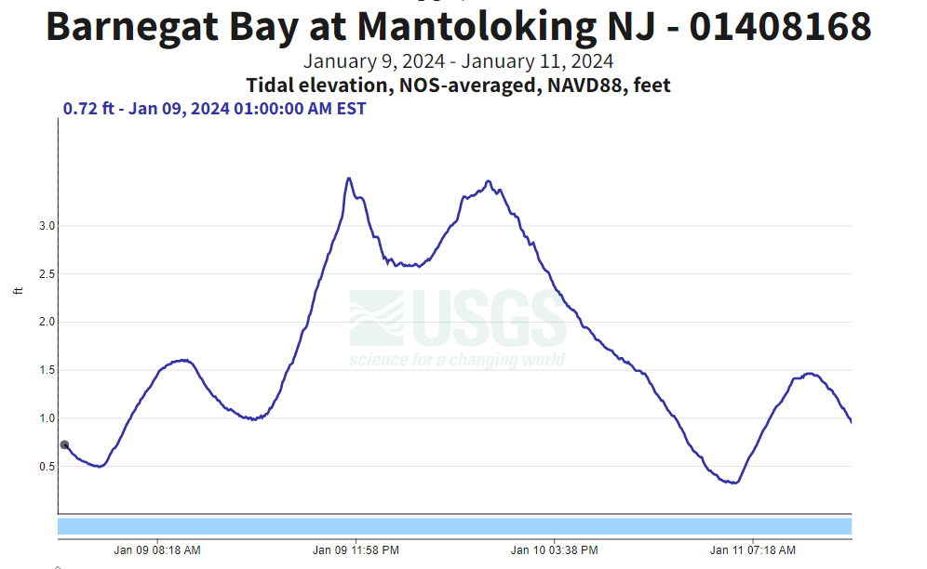
01408168 Mantoloking, NJ January 10-11, 2024

Slide 10
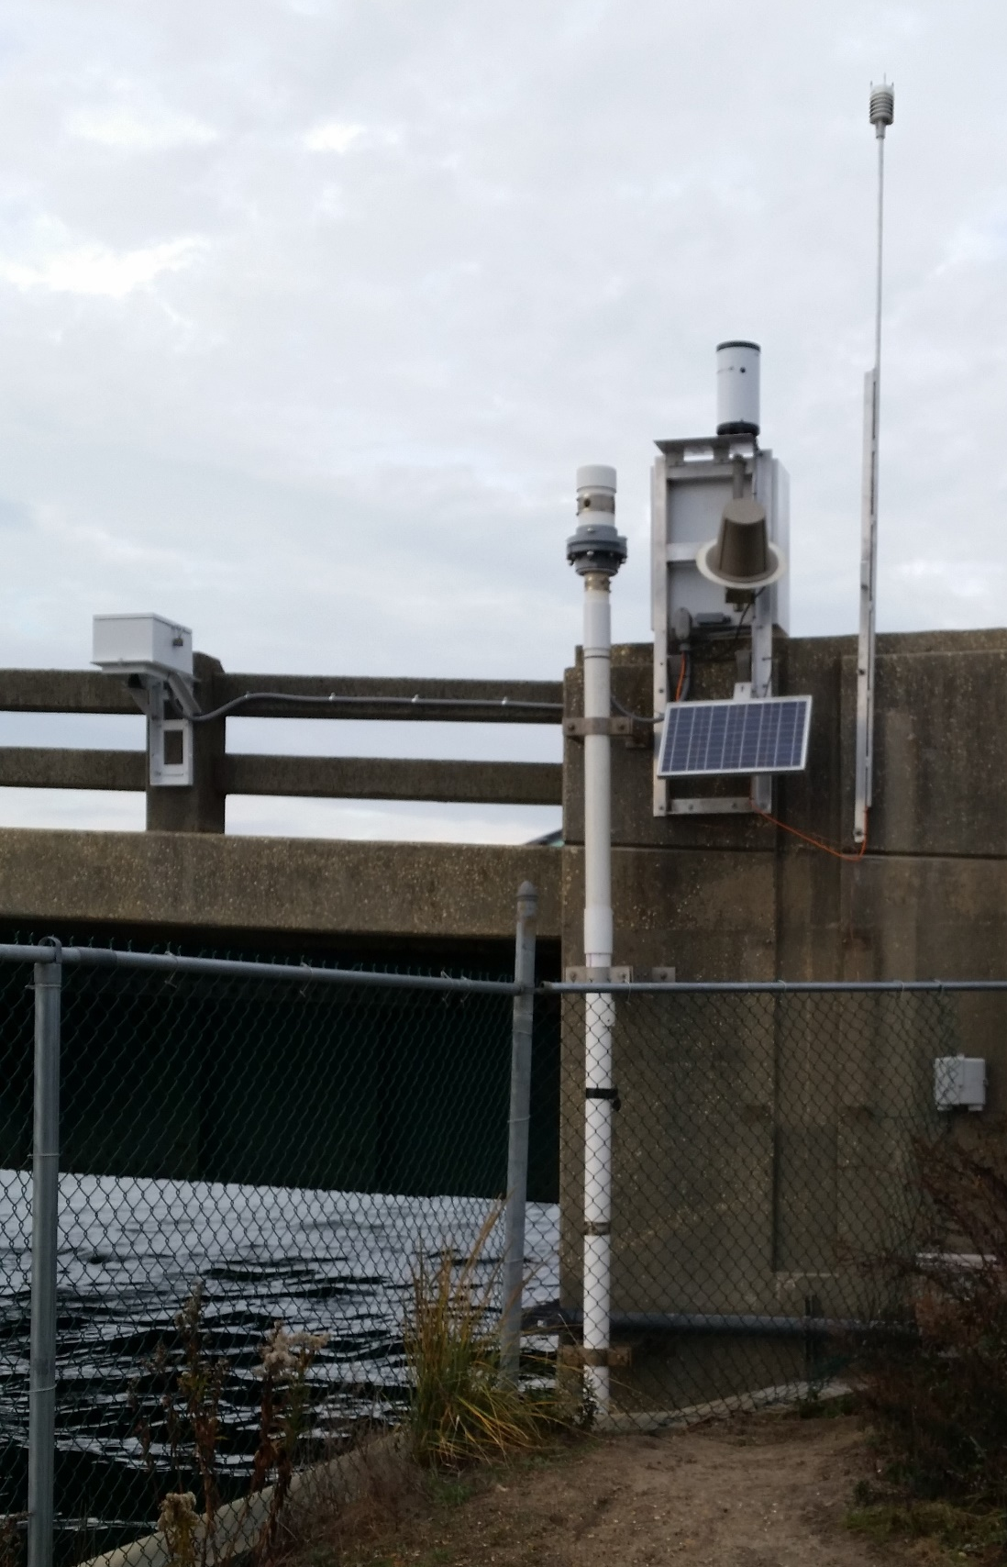
01407600 Sea Bright, NJ: Minor to Moderate Flooding
Landfall near Atlantic City, NJ (3.5 ft)
Landfall in Long Island, NY (3.0 ft)

Slide 11
Limitations:
Areas of Uncertainty
Nuisance Flooding
Total Water Level

Slide 12
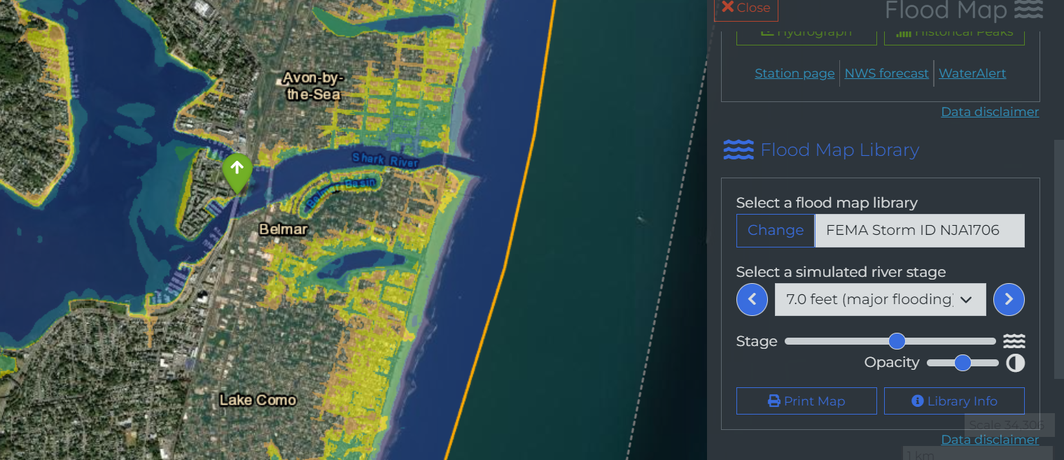
Online Product Links:
Information and Instructions:
New Jersey: Coastal Flood Inundation Mapping (usgs.gov)
Flood Decision Support Toolbox:
InFRM | Flood Decision Support Toolbox (usgs.gov)

