Slide 1
The Stevens Flood Advisory System: User Applications and Forecast Assessment
Philip Orton, Ziyu Chen, Nickitas Georgas, Mahmoud Ayyad, Laura Kerr, Jessica Kuonen, Hannah Burnett, Jon Miller, Muhammad Hajj
Stevens Institute of Technology
TetraTech, New York Sea Grant
Funding: Port Authority of NY/NJ, NOAA Climate Adaptation Partnerships, NOAA ORR via New Jersey Sea Grant Consortium

Slide 2
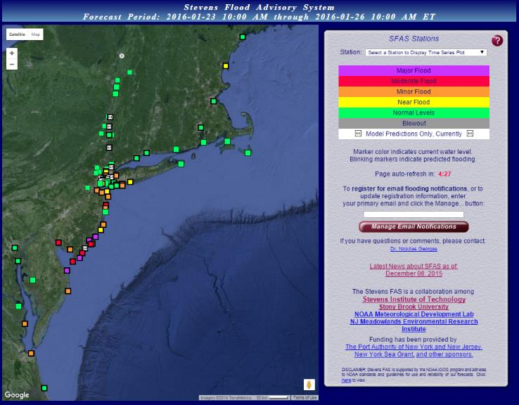
Stevens Flood Advisory System (http://stevens.edu/SFAS)
Key Features
Water levels forecasts and an uncertainty range
Includes river effects on coastal flooding (tidal water bodies)
Sends emails for flood watches and advisories
SFAS has been running since 2016, and its precursor SSWS since 2005

Slide 3
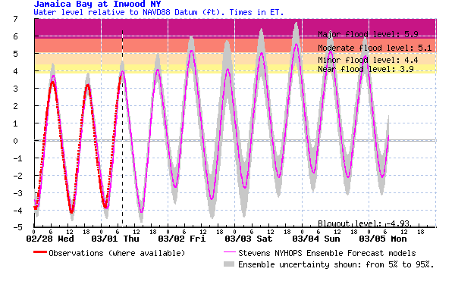
Assessment Methods
National Weather Service flood thresholds
The forecast: water level
Water level (feet above NAVD88)
The “spread”:
90% confidence
of prediction
Observed
water levels

Slide 4
Who uses SFAS and what are their applications and interests?

Slide 5
Stevens Shares its Data for NWS Forecasts
Stevens shares our SFAS data with National Weather Service Weather Forecast Offices (WFOs) from Maryland to Maine, where five different WFOs use the data to help develop their forecast guidance.
“[Stevens forecasts] have been tremendously helpful during our forecast and warning operations. Not only has this guidance helped forecasters make routine day-to-day tidal forecasts, but it also increased their confidence during [storms].” - Robert Deal, NWS WFO Mt. Holly (NJ/PA)
“The NWS New York, NY office has a rich and productive history of collaboration with Stevens Institute … SFAS is used by NWS New York, NY in real time for coastal flood forecasting and watch/warning decision making.” - A. Ross Dickman, NWS WFO New York/Upton
“We rely heavily on storm surge and water level guidance produced by Stevens Institute in order to provide timely Watches and Warnings for coastal flooding events that impact the coastlines of Massachusetts and Rhode Island and provide email briefings to federal, state, and local emergency managers to provide specific flood impacts.” - Joseph Dellicarpini, NWS WFO Boston

Slide 6
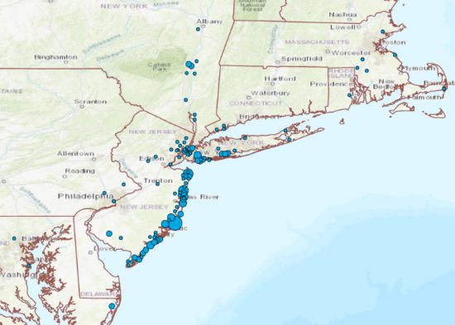


SFAS Users: Respondents to a Recent Poll
An anonymous survey was created and completed by 351 (23%) users out of about 1500 SFAS users who were invited to take it.
Those invited are advanced users who are signed up to receive flood watch and advisory emails.

Slide 7

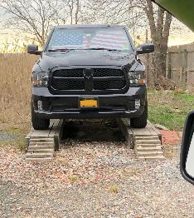
Poll Findings
A subset of 99 respondents were community, company or government users that share forecasts or use it for their operations.
  Through these users alone, the forecasts affect on-the-order-of 100,000 people, according to their own estimates.
  Common response activities include closing flood gates or storm surge barriers, moving cars to higher elevation, closing roads, protecting industrial equipment, preparing facilities to accommodate floodwaters, triggering OEM activities, and issuing PR notices to the public
Another 225 respondents were “household users”.
  About half are flooded several times per year or more
  Common response activities to a forecast flood include sharing with others (84%), adjusting schedule (71%), moving a vehicle to higher ground (58%), applying flood protections to home (31%)
  → SFAS is enabling ‘micro-adaptations’ to sea level rise induced high-tide flooding

Slide 8
How does SFAS work and how accurate is it?

Slide 9
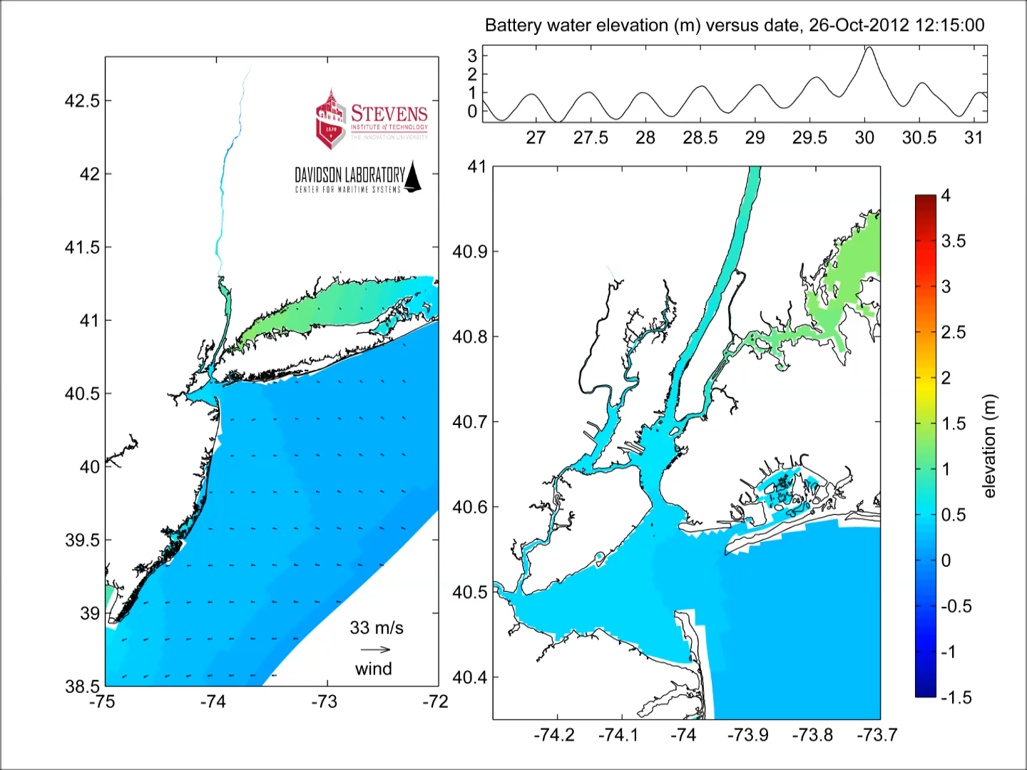
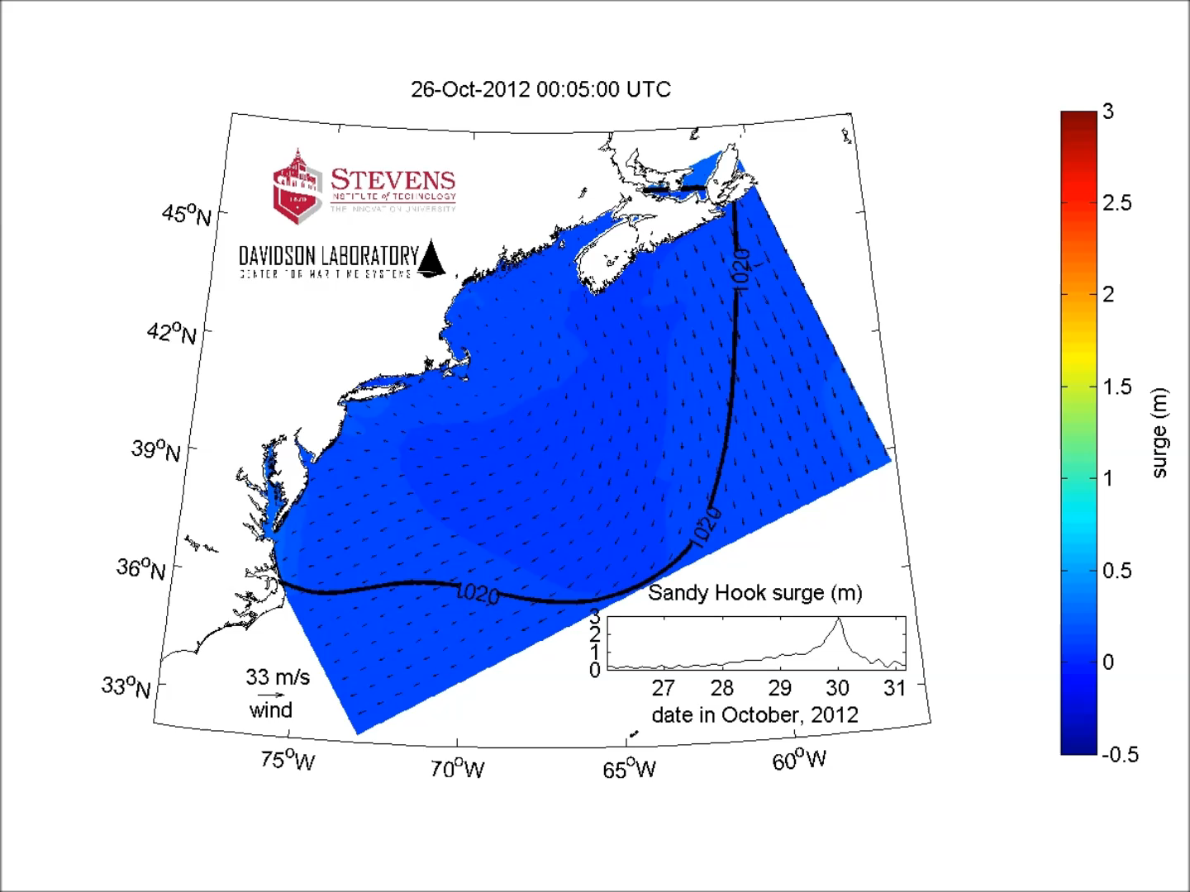
Forecast Methods: 3D Regional Nested Modeling
NEST 1: 5km resolution
NEST 2: down to 100m resolution in NY/NJ Harbor
Water level model – Stevens ECOM (Blumberg et al. 1999; Georgas et al. 2010) coupled with GLERL wave model (Donelan, 1977; Schwab et al.,1984)
Meteorological forcing from US forecast products (GFS, NAM, GEFS ensemble), European products (ECMWF-Hi Rez, ensemble) and Canadian ensemble (GEPS)
Hydrology: HEC-HMS simulations for NY/NJ Metro and Hudson River watersheds (Saleh et al. 2016; 2017)
Notes:
The baseline assessment used here is probably the one that is closest to the median of prior recent assessments shown in the prior figure. We want a model-based result so that we can map flooding, so a central estimate of all the curves won’t work because it would only apply to the Battery tide gauge location.

Slide 10
Assessment Methods
National Weather Service flood thresholds
The forecast: water level
Water level (feet above NAVD88)
The “spread”:
90% confidence
of prediction
Observed
water levels

Slide 11
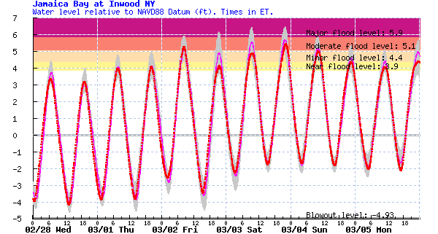
Assessment Methods
Forecast Error is quantified as RMSE
Water level (feet above NAVD88)
Spread is Quantified with Coverage of Uncertainty by observations (COU; optimal value of 90%)

Slide 12
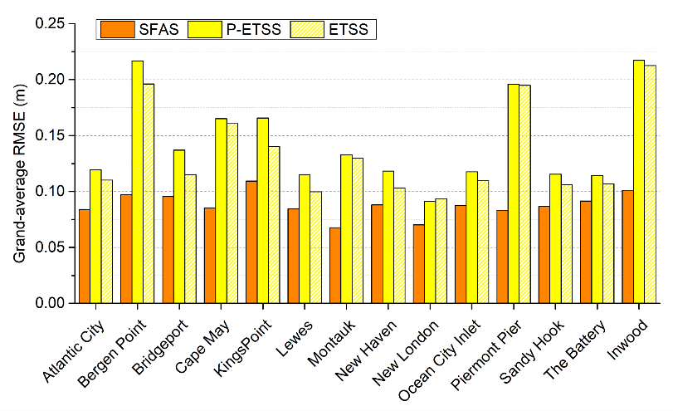
Comparison with NOAA: 2020-2021 Accuracy
The SFAS stations have a 0.06 m to 0.11m RMSE across the 14 stations, while NOAA forecasts (P-ETSS, ETSS) have higher RMSE (worse accuracy).

Slide 13
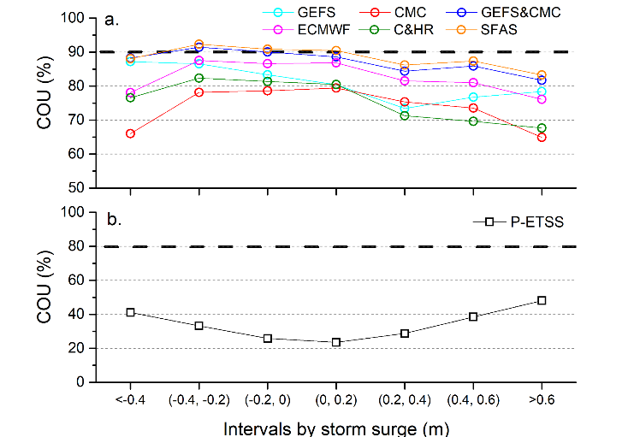
Comparison with NOAA: Spread (Uncertainty)
The COU variation with surge threshold for SFAS is shown (panel a), and the NOAA forecast (panel b).
Panel a includes the full SFAS ensemble and several smaller sub-ensembles for comparison.
The COU optimal value for P-ETSS is 80% but data are far lower – very often, the observation falls outside NOAA’s estimated 80% confidence interval.

Slide 14
Future Improvements, Forecasts
Flood forecast mapping: Flood forecast mapping and wave observations and forecasts are coming to Barnegat Bay under a new 2025-2028 project. Other sites under consideration, pending funding.
Accuracy Improvements: Improved atmospheric forcing data expected in 2025 will enable improved central forecasts (lower RMSE). Localized modeling (e.g. Barnegat Bay) will also lead to improved accuracy.
Website upgrade: We are working on a new website, targeting a summer 2025 or 2026 release.
Erosion: A Stevens Senior Design team is working on integrating SFAS and wind wave forecasts to create estimates of erosion potential and dune vulnerability. The team plans to have a working erosion forecast dashboard ready this spring.

Slide 15
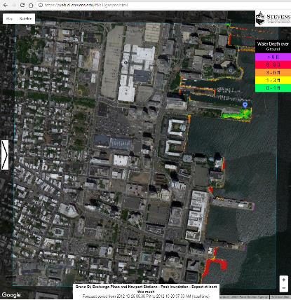
Local Street-Scale Flood Forecast Mapping
Retrospective Example: Hurricane Sandy
“Expect at least this much water over ground” (5th percentile)

Slide 16
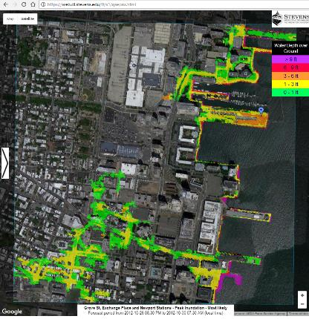
Local Street-Scale Flood Forecast Mapping
Retrospective Example: Hurricane Sandy
“Most likely flood depth above ground” (50th percentile)
Notes:
Speak specifically of the high resolution – “predicted down to 10-foot spatial scales, resolving water flow down streets”

Slide 17
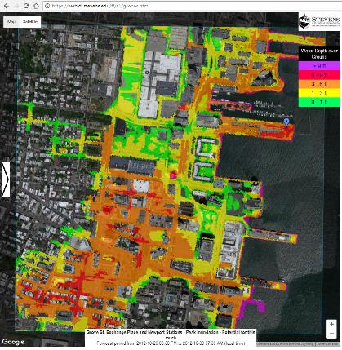
Local Street-Scale Flood Forecast Mapping
Retrospective Example: Hurricane Sandy
“Potential for this much water over ground” (95th percentile)

Slide 18
Conclusions
Accuracy: Our SFAS assessment results indicate higher accuracy for SFAS central forecasts than NOAA P-ETSS and ETSS from high-tide floods to severe storm events
Spread: The COU of the SFAS 5th-to-95th percentile is close to the 90% optimal value, better than the spreads of P-ETSS or any of the individual ensemble products
After 20 years, SFAS has become part of the “infrastructure of coastal preparedness” for the New Jersey / New York metro coastal region
  NWS uses SFAS data in preparing their forecasts and official storm briefings
  A wide user base relies on SFAS for a wide range of activities, including government emergency management and household users
  SFAS is enabling ‘micro-adaptations’ to sea level rise induced high-tide flooding, including moving vulnerable property and changing travel schedules through flooded streets

Slide 19

References for Capabilities, Assessments
Survey –
Orton, P. M., Kerr, L., Eisler Burnett, H., & Kuonen, J. (2024). User Survey for the Stevens Flood Advisory System. Retrieved from: https://data.mendeley.com/datasets/x6rtf59w4c/1
Forecast assessment –
Chen et al., Assessment and Improvement of a Mid-latitude Ensemble Coastal Water Level Forecast System, manuscript to be submitted in March 2025
Ayyad, M., Orton, P.M., El Safty, H., Chen, Z. and Hajj, M.R. (2022). Ensemble forecast for storm tide and resurgence from Tropical Cyclone Isaias. Weather and Climate Extremes, 38, p.100504.
Georgas, N., et al., (2016). The Stevens Flood Advisory System: Operational H3E flood forecasts for the greater New York/New Jersey Metropolitan Region. Flood Risk Management and Response, 194.
Jordi, A., et al., (2019). A next-generation coastal ocean operational system: Probabilistic flood forecasting at street scale. Bulletin of the American Meteorological Society, 100(1), pp.41-54.
Orton, P. M., Z. Chen, H. El Safty, M. Ayyad, R. Datla, J. Miller, and M. R. Hajj (2021), Stevens Flood Advisory System 2020 Ensemble Forecast Assessment: NY/NJ Harbor Area, p. 21, Hoboken, New Jersey, USA.
Orton, P. M., Z. Chen, H. El Safty, M. Ayyad, R. Datla, J. Miller, and M. R. Hajj (2022), Stevens Flood Advisory System 2021 Ensemble Forecast Assessment: NY/NJ Harbor Area,, p. 23, Hoboken, New Jersey, USA.

