Slide 1
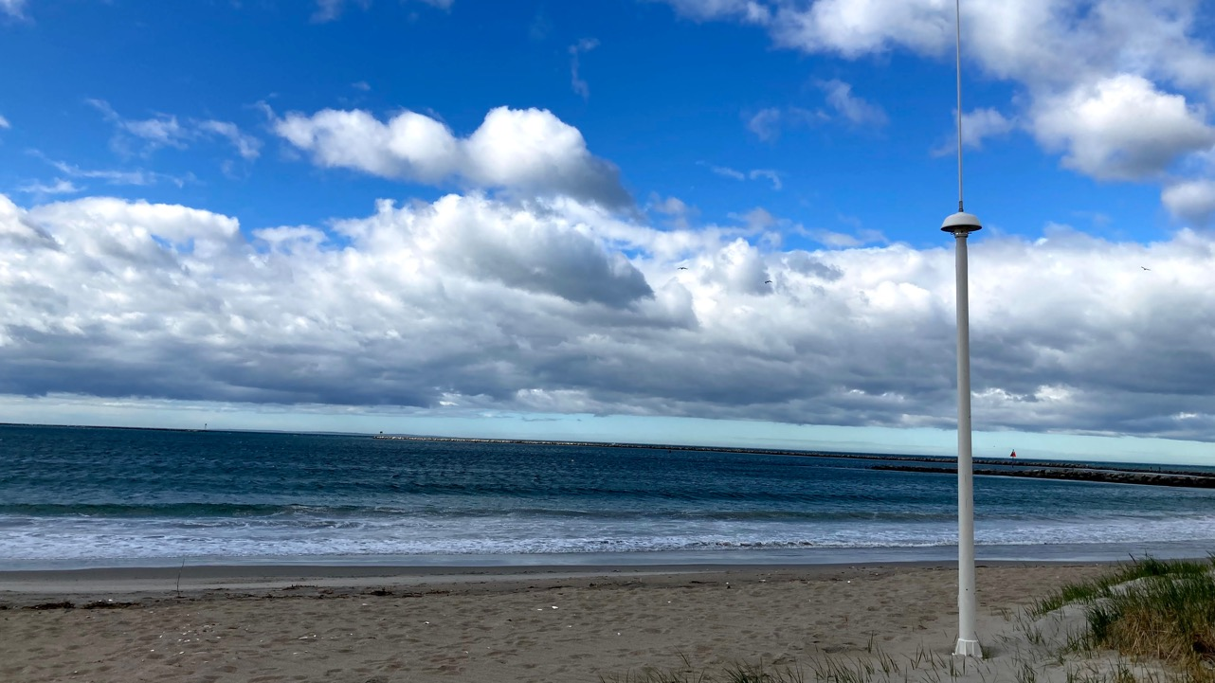
Impact of Surface Current Measurements on NY Harbor Water Levels
Hugh Roarty
Ethan Handel
Tim Stolarz
Josh Kohut
Scott Glenn

Slide 2
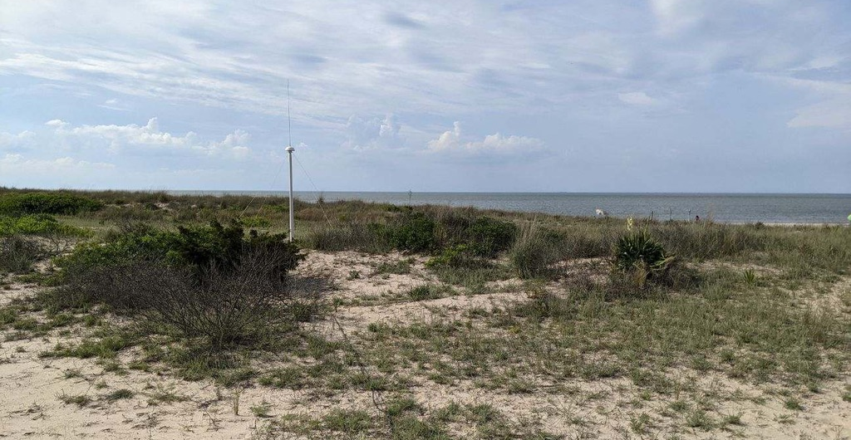
Outline
Introduction to HF radar
Tidal Currents in Raritan Bay
Long term statistics 2012-2024

Slide 3
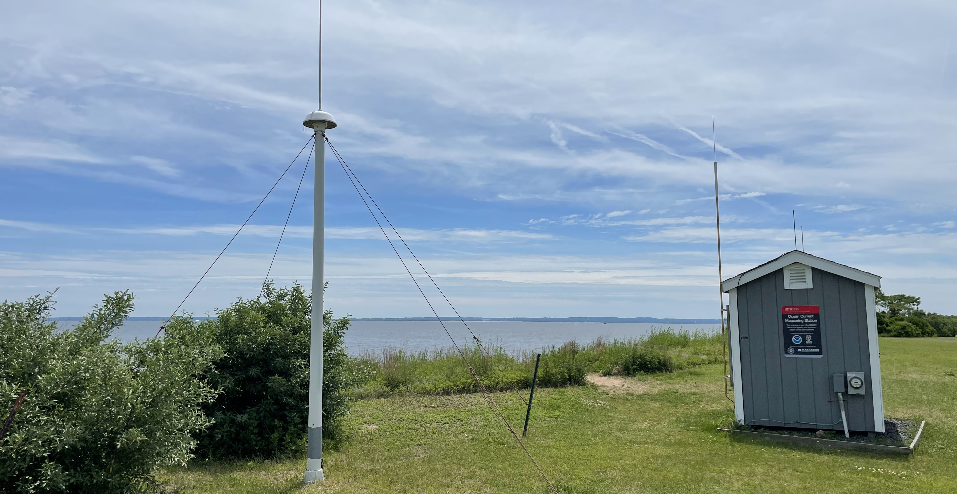
High Frequency Radar
CODAR Tx/Rx Antenna
GREAT KILLS PARK, NY

Slide 4
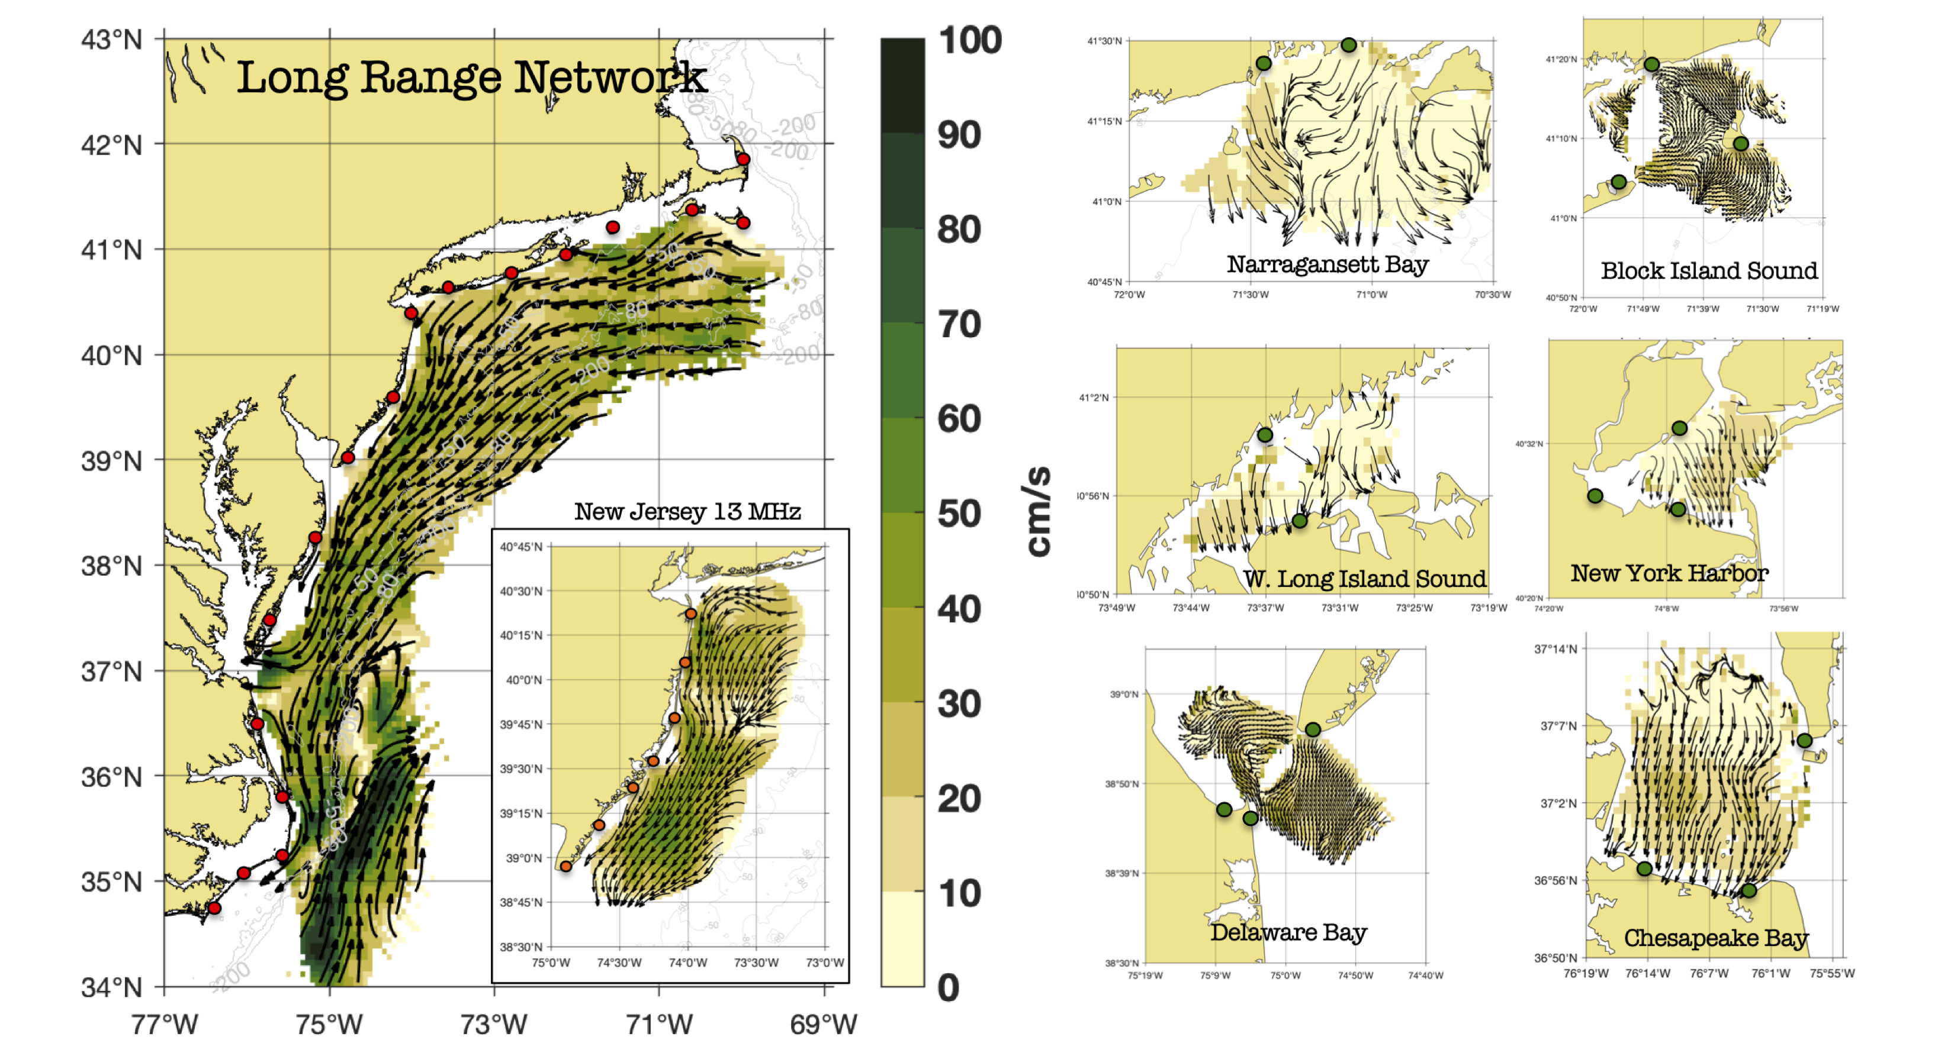
Mid Atlantic Surface Current Network

Slide 5
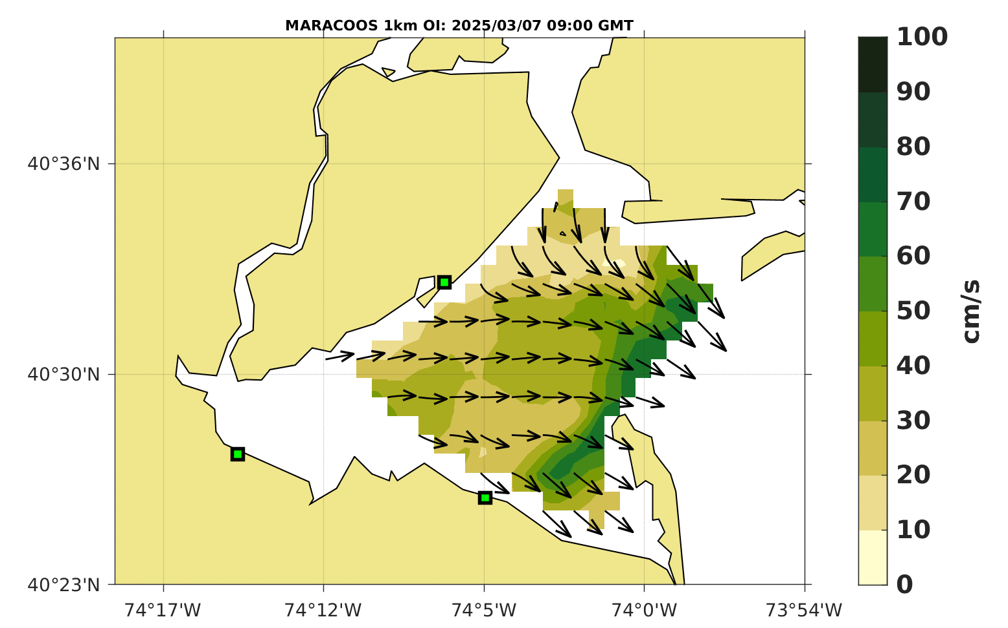
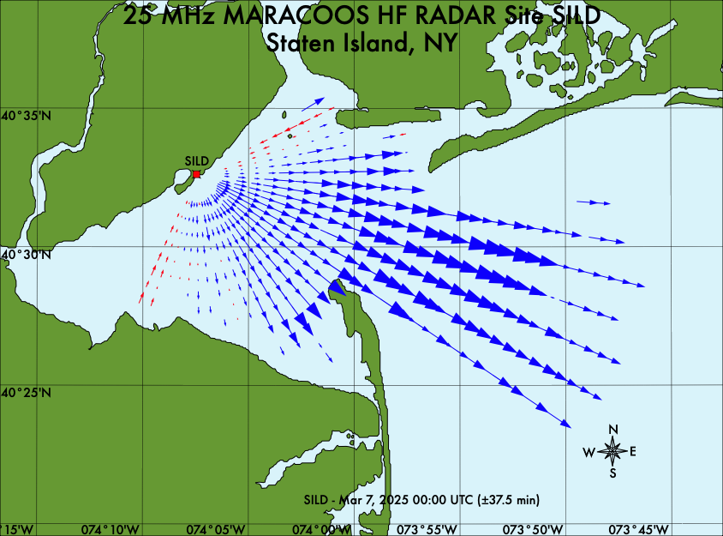
Surface Currents from SeaSonde HF Radar
Radial Map of Currents
Total Map of Currents

Slide 6
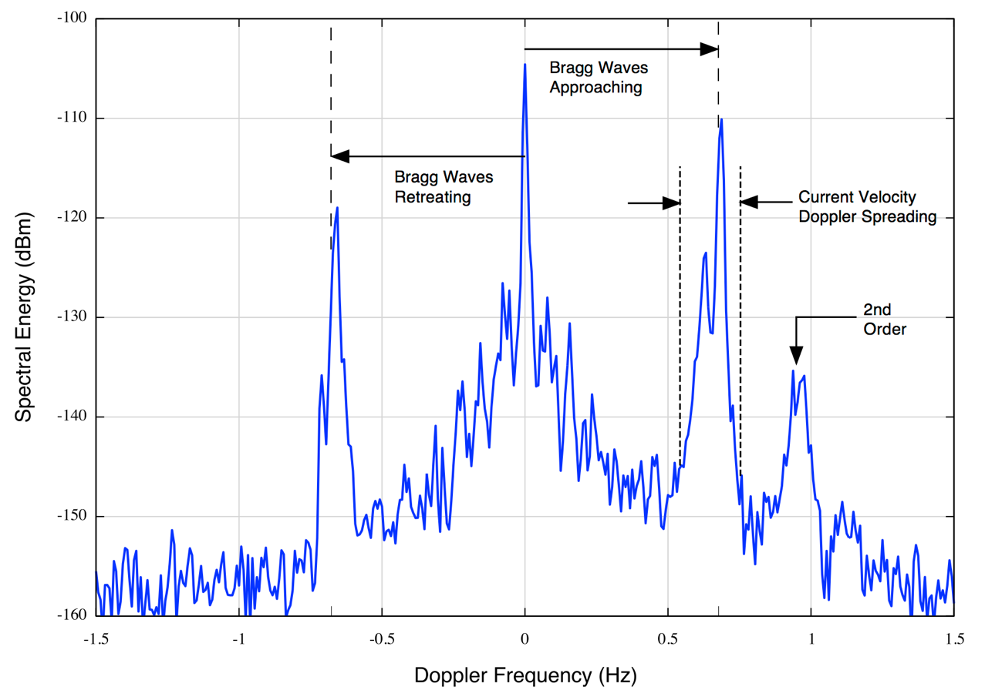
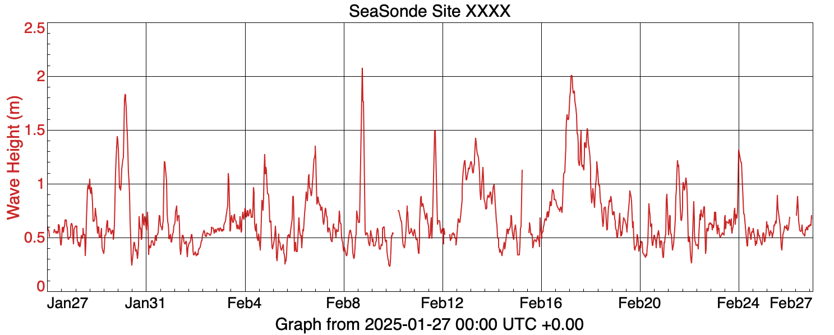
Surface Waves from SeaSonde HF Radar
SILD
JAN/FEB 2025

Slide 7
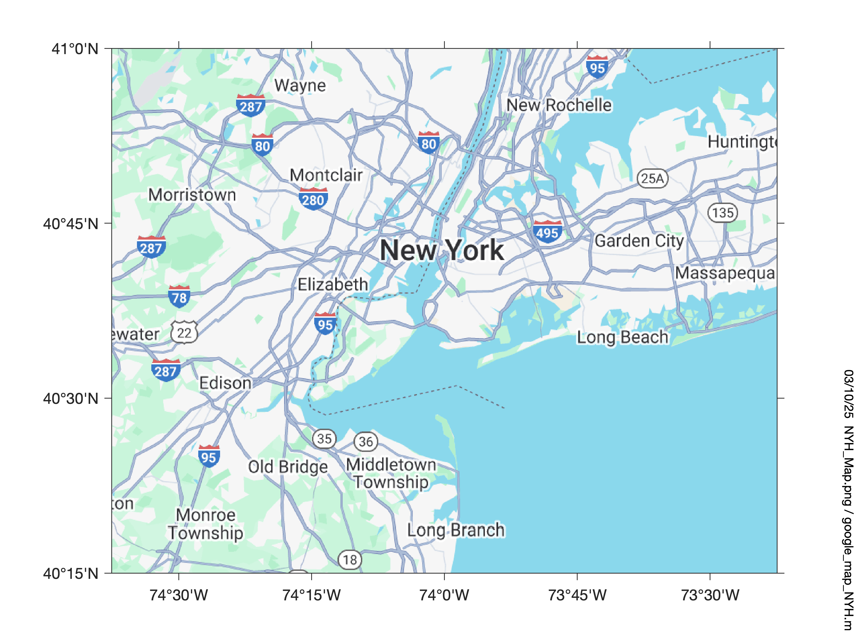
Study Area
Staten Island - 2006 January
Port Monmouth - 2012 March
Old Bridge - 2015 October
Water Level at Battery
Staten Island
Old Bridge
Port Monmouth

Slide 8
Tidal Currents

Slide 9
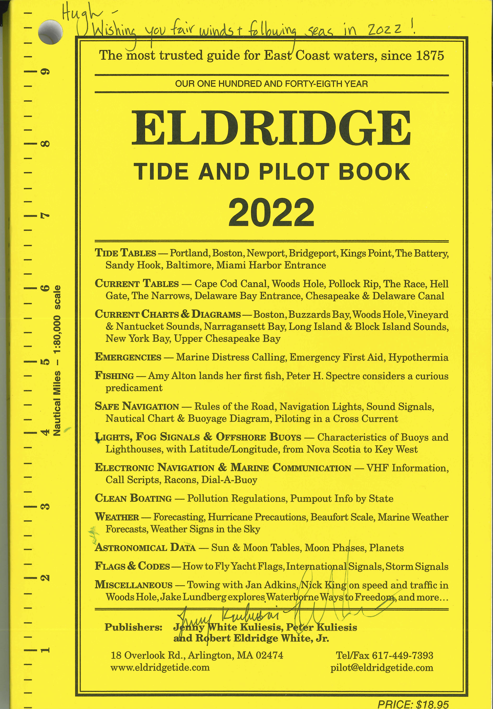
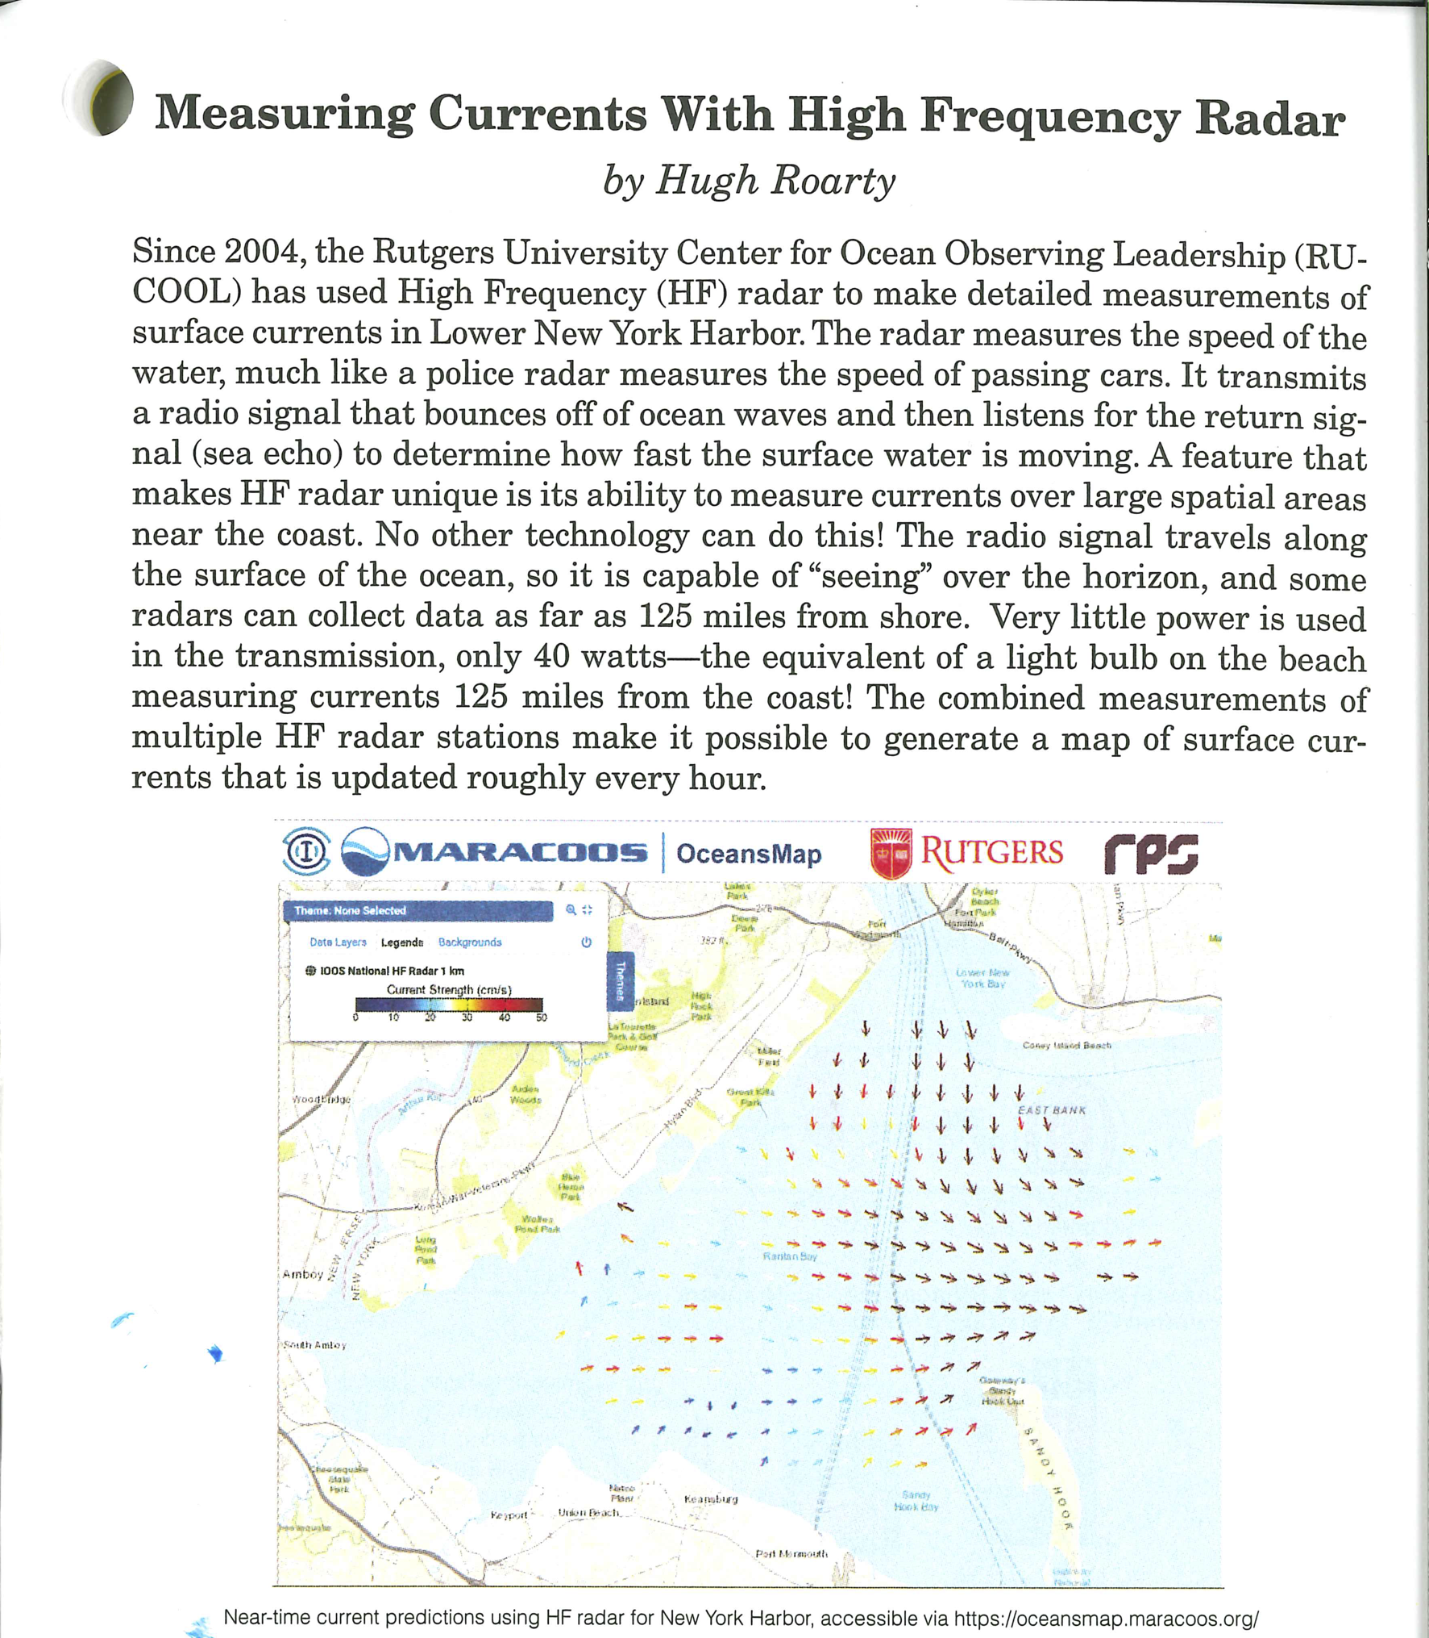

Slide 10
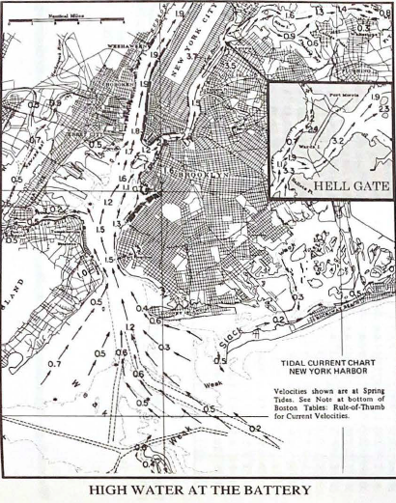
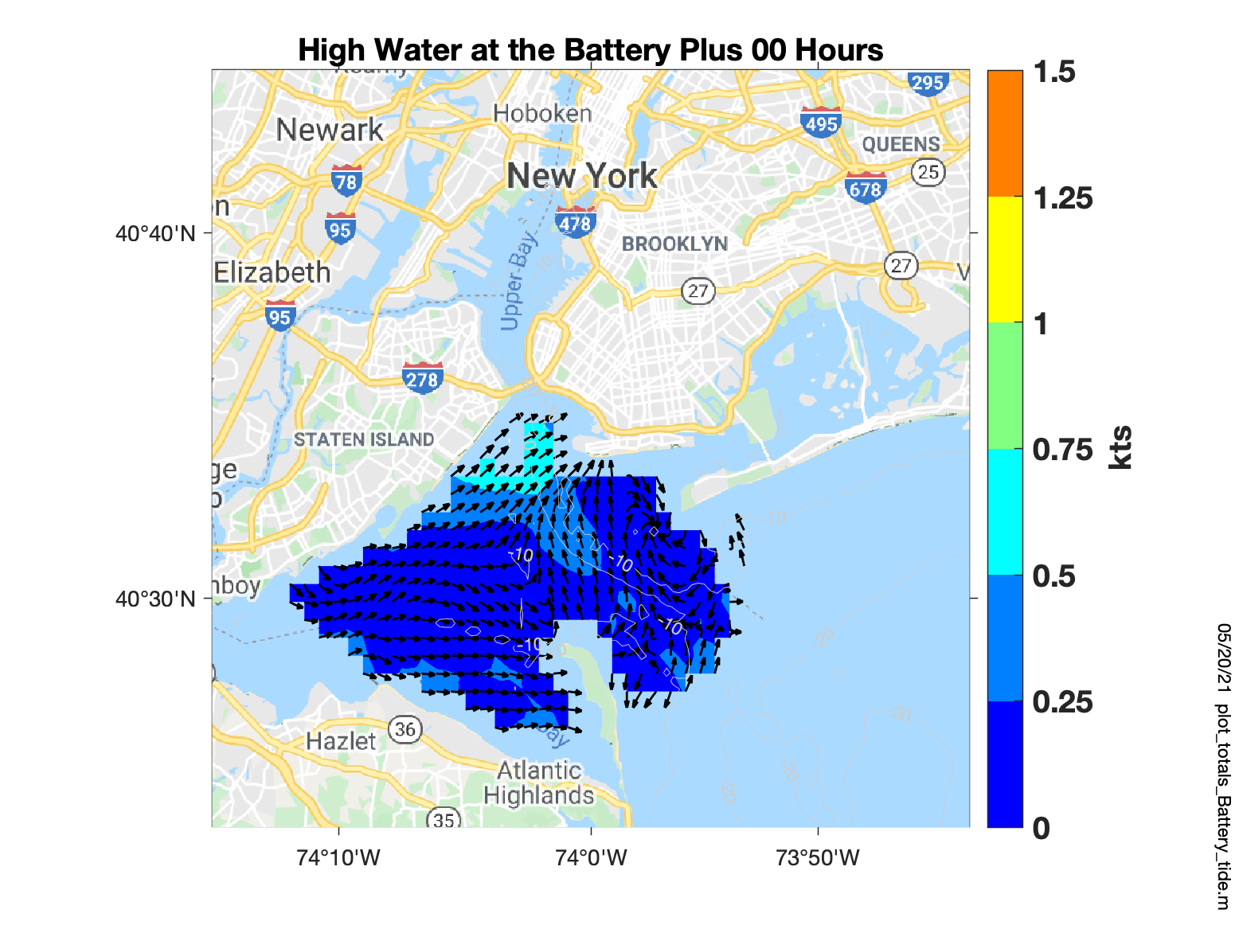

Slide 11
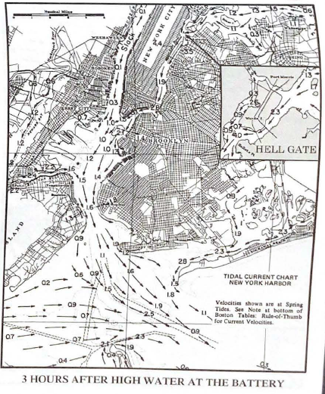
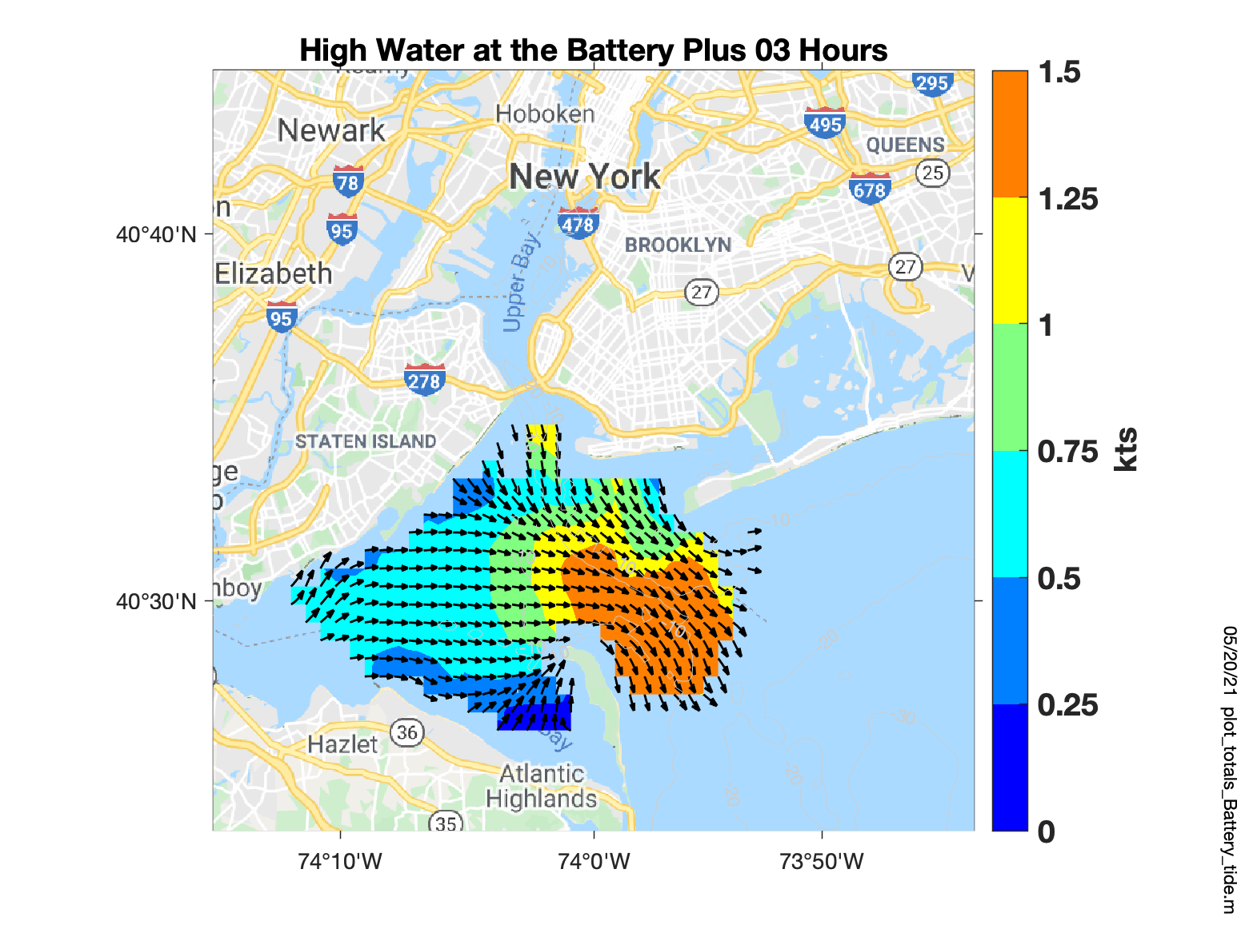

Slide 12
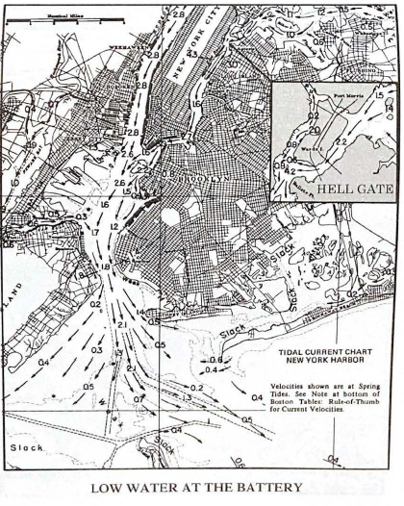
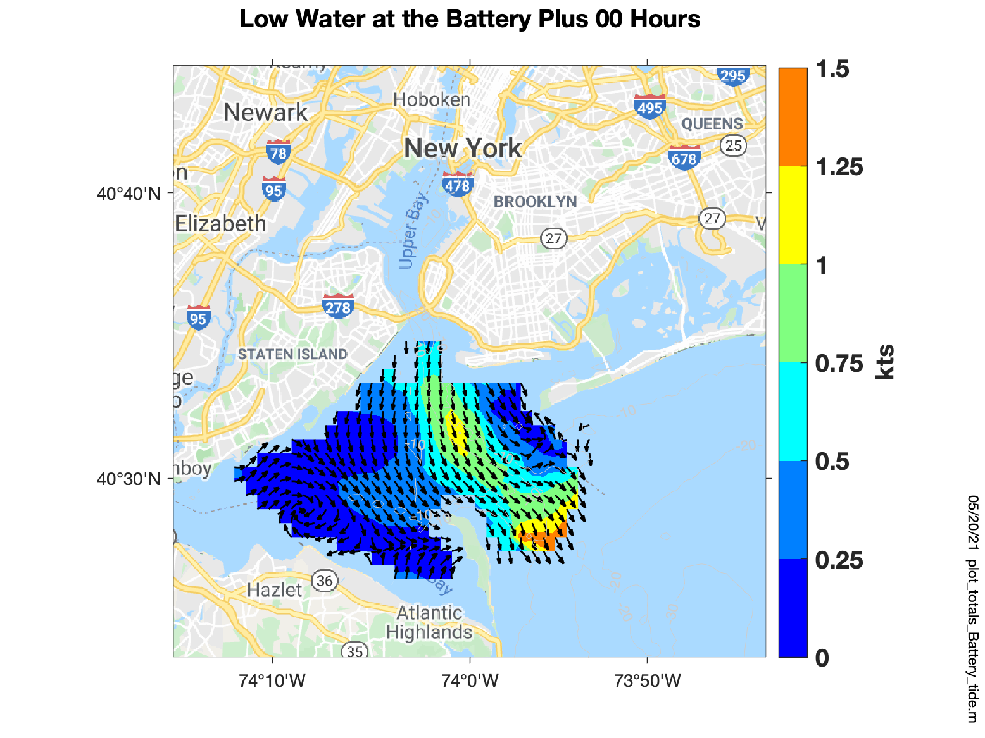

Slide 13
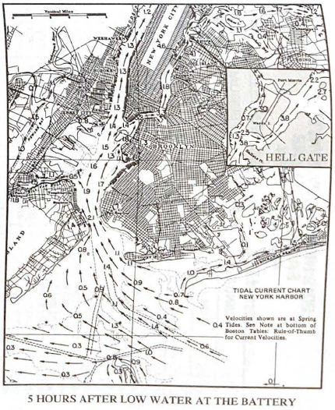
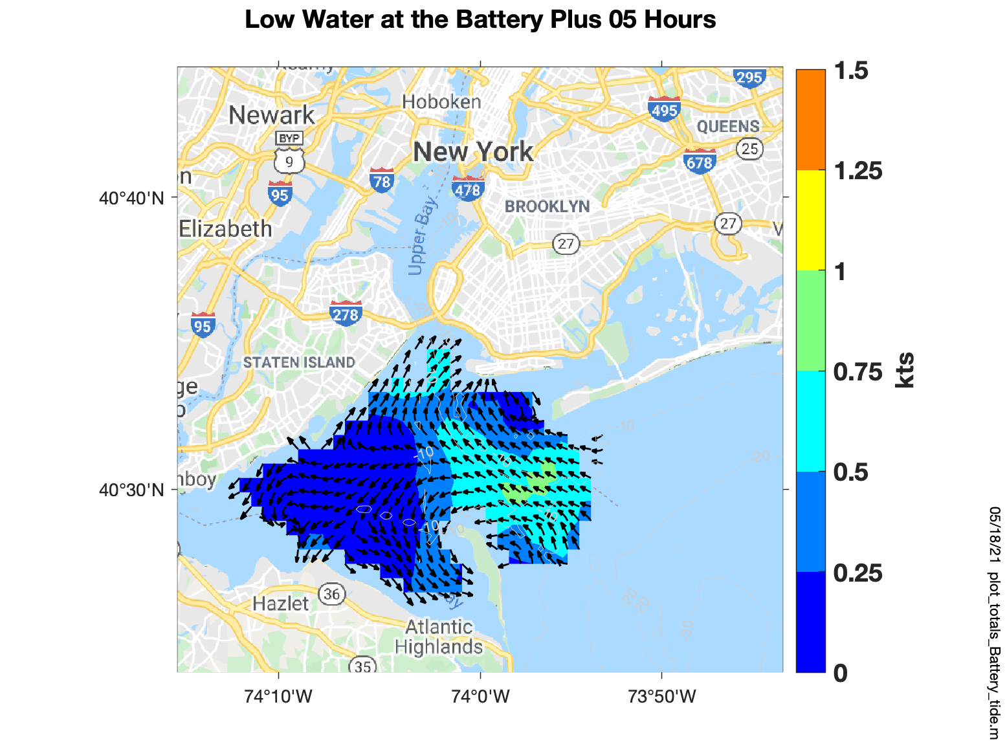

Slide 14
Statistics 2012 - 2024

Slide 15
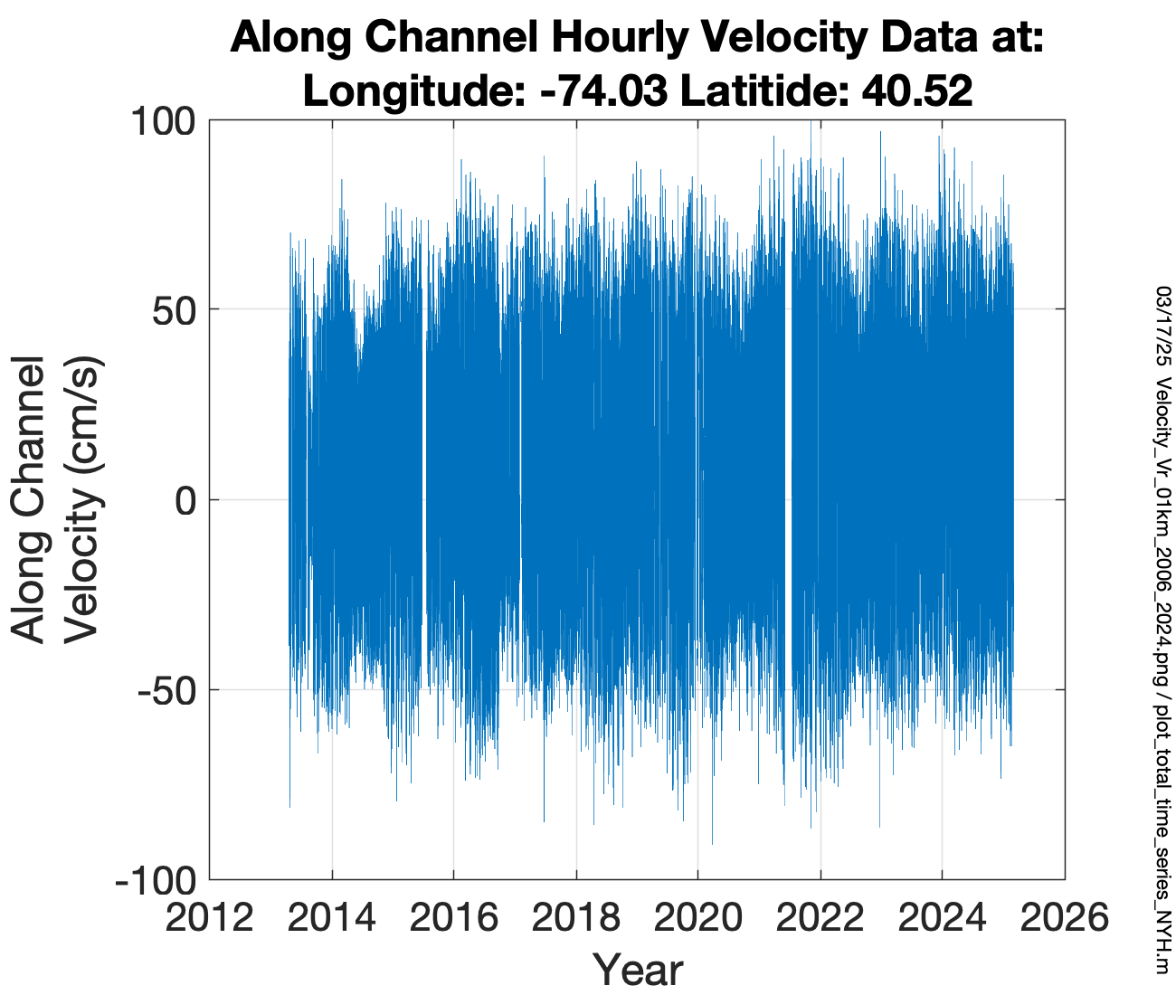
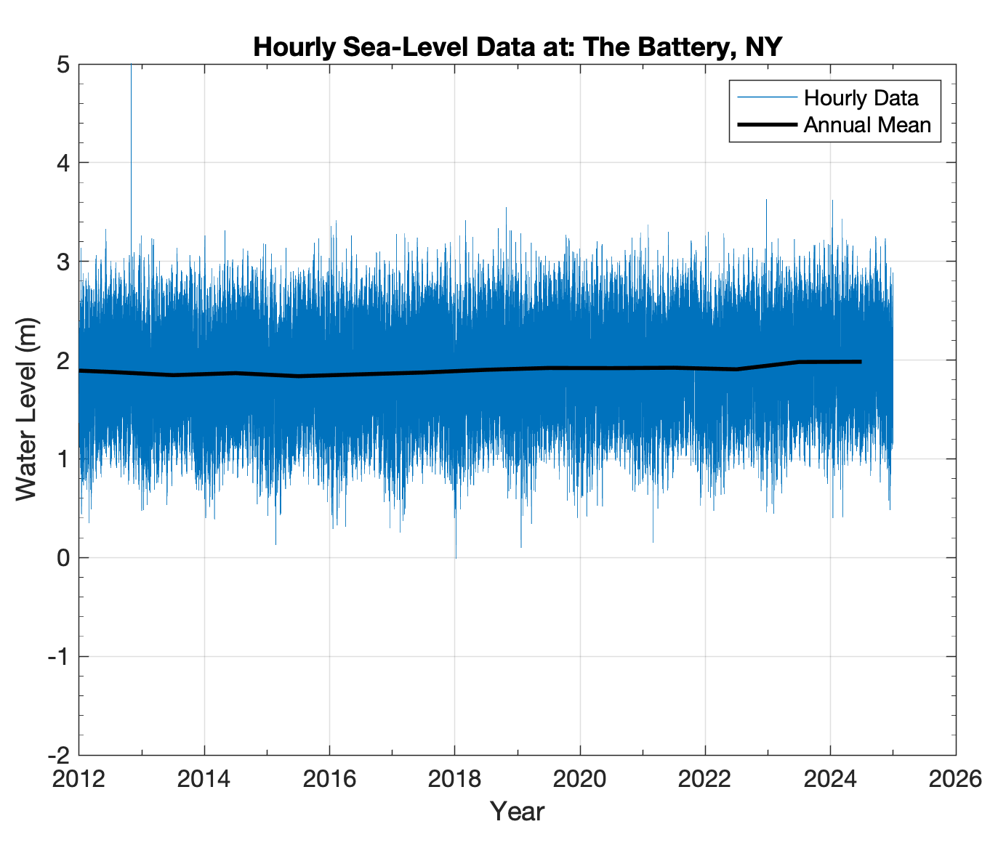
Water Level
Currents
+

Slide 16
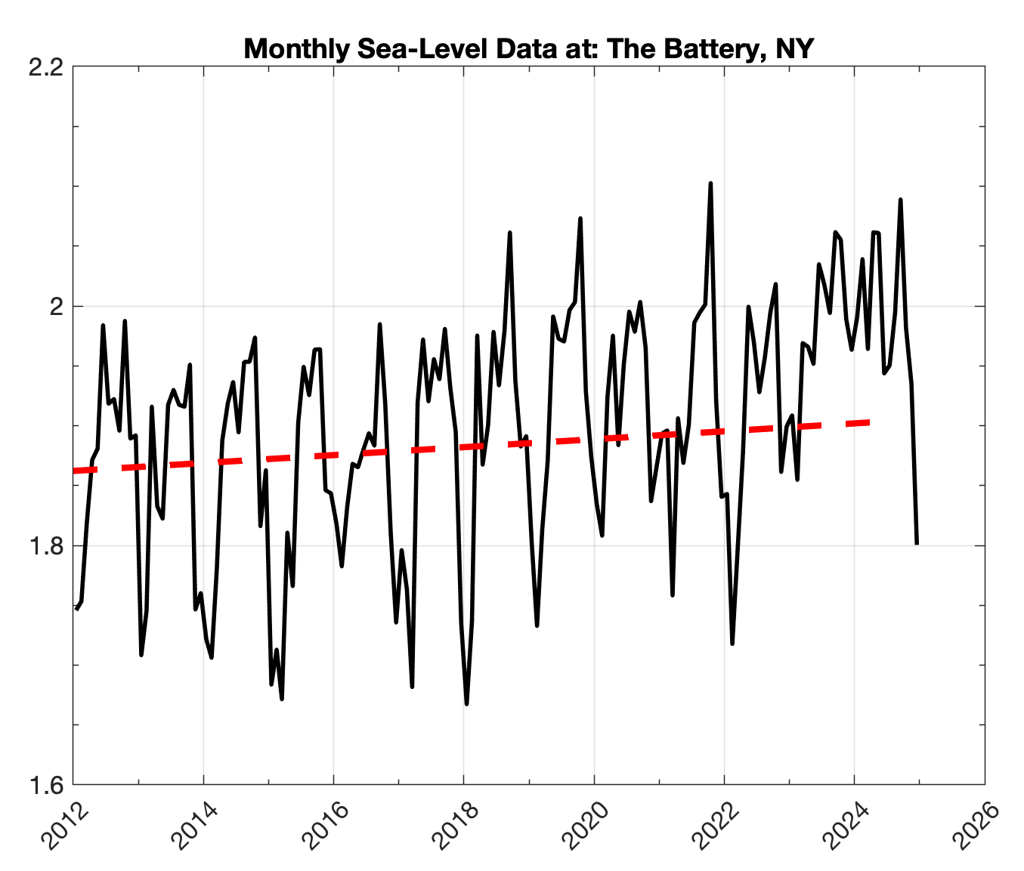
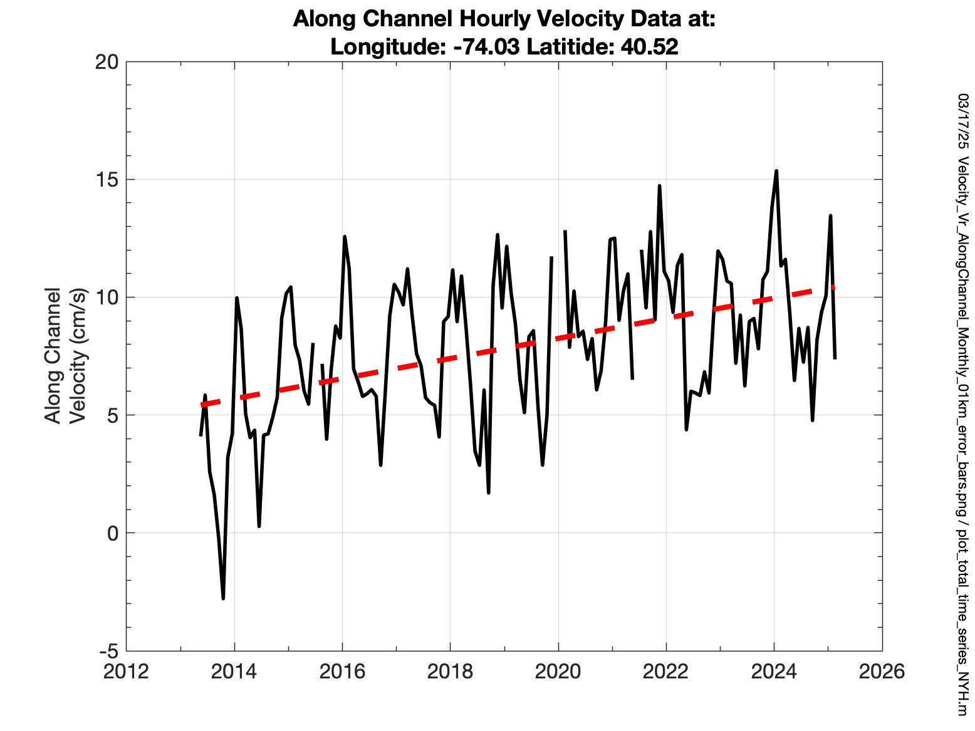
Water Level
Currents
Notes:
Water level increased 4 cm over the past 12 years while currents increased from 5 to 10 cm/s, doubling over the same time period

Slide 17
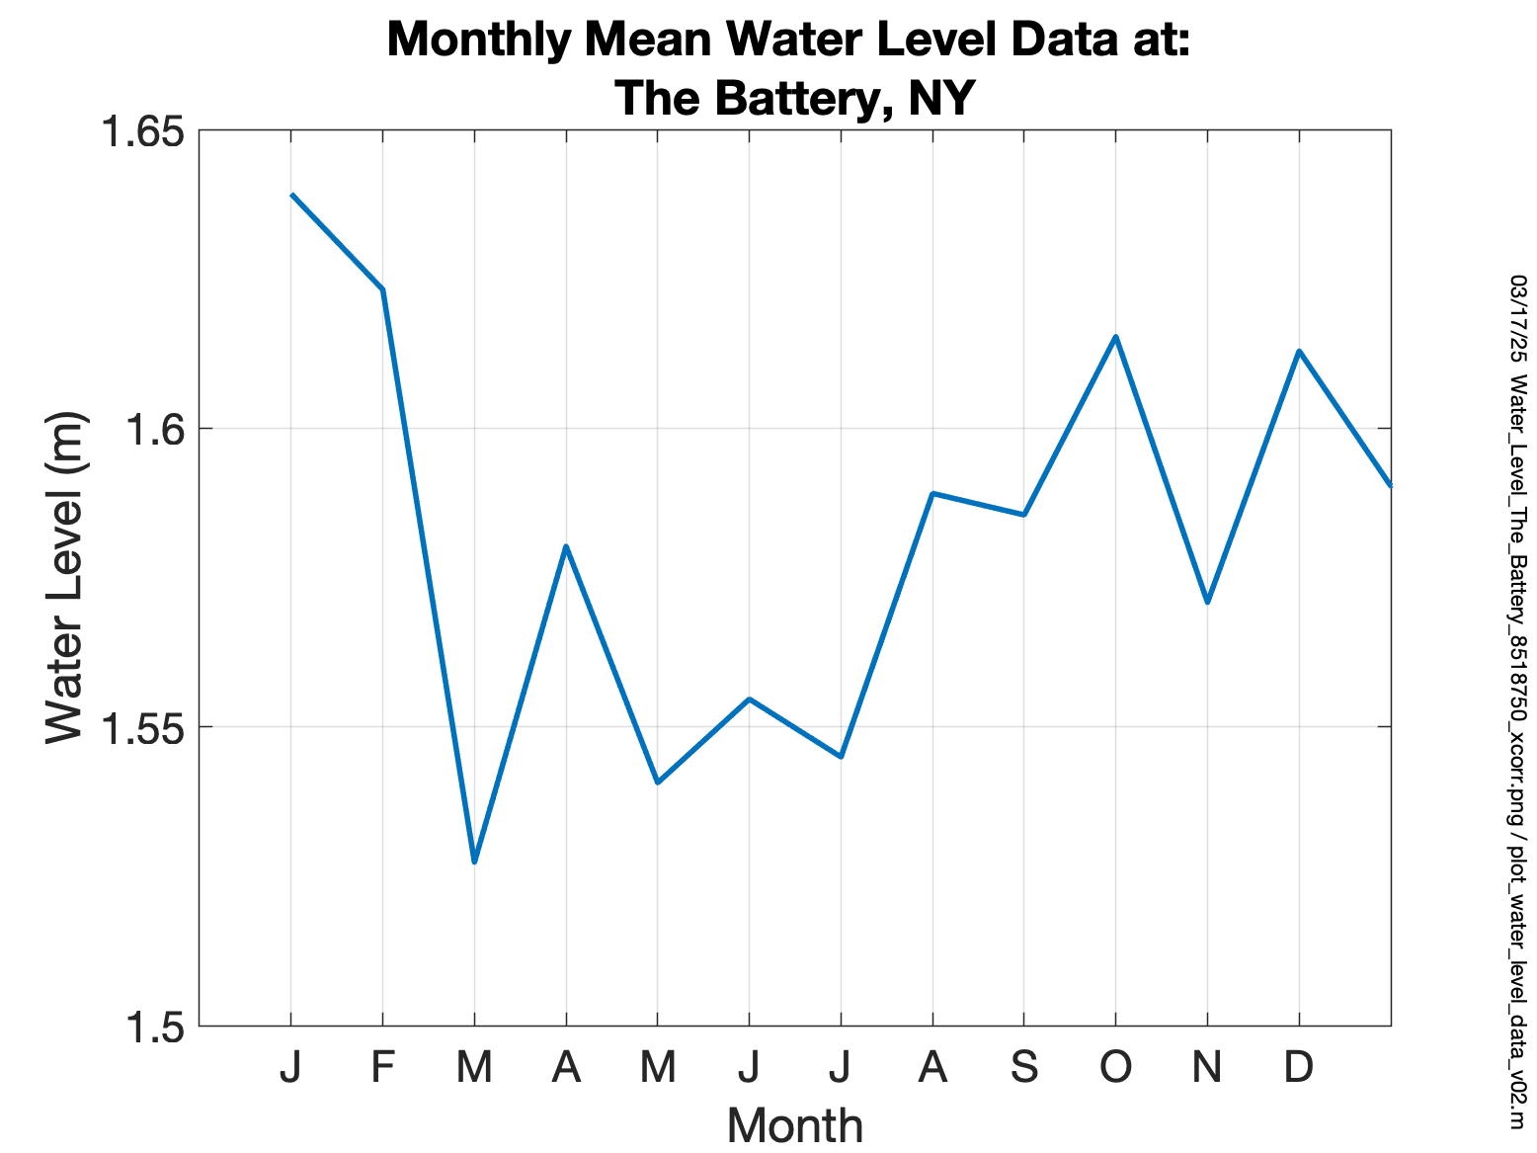
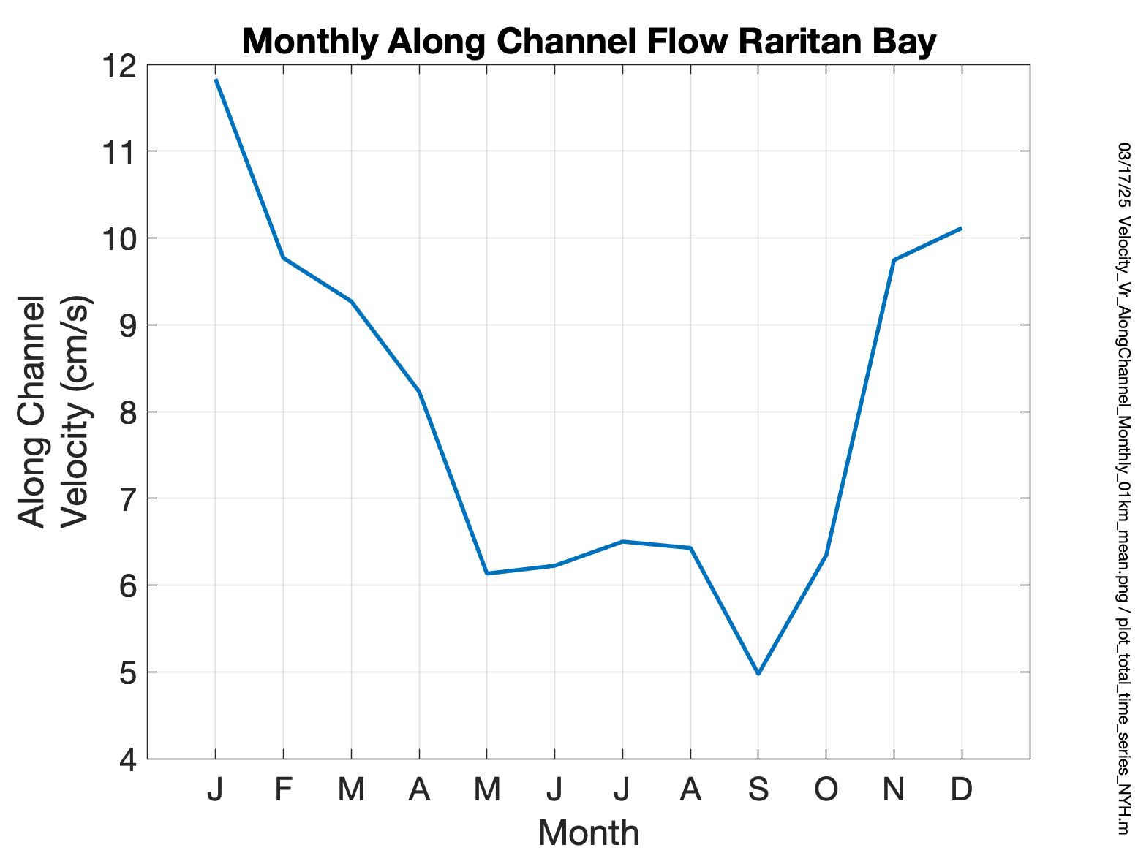
Water Level
Currents

Slide 18
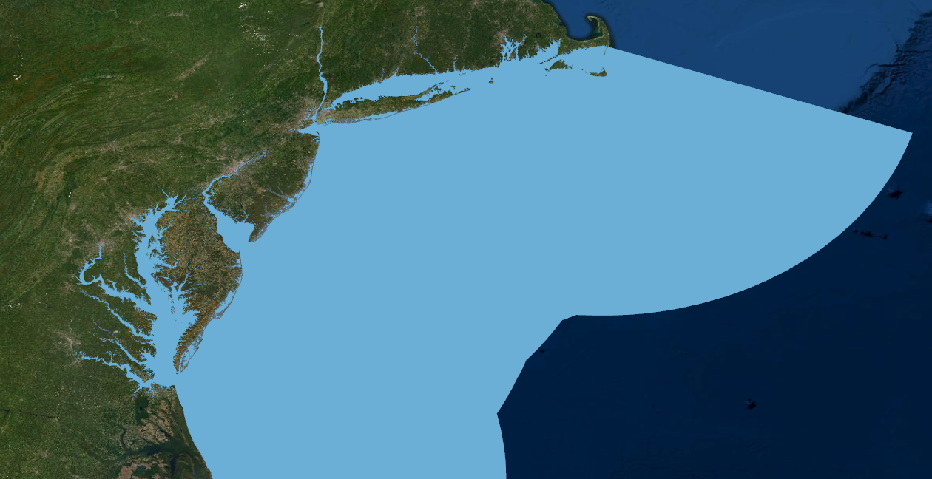
Conclusions
Provided introduction to HF radar
Tidal Currents from January 2021 match Eldridge
Current magnitude is increasing in Raritan Bay along with sea level at Battery

Slide 19
Impact of Surface Current Measurements on NY Harbor Water Levels
Thanks

