Slide 1
Shelf Seiche Induced Coastal Flooding along the New York/New Jersey Coast
Tam T. Trinh, Philip Orton, Mahmoud Ayyad, Stefan A. Talke
Funded by the National Science Foundation PREEVENTS program
and NOAA Climate Adaptation Partnerships program

Slide 2
Motivation and Introduction
“Resurgences” caused coastal flooding during Hurricane Isaias in 2020 at New York Harbor (Ayyad et al., 2022).
From the literature:
A resurgence is a periodic recurrence of high water levels after a storm surge subsides.
Redfield et al. (1957) stated that resurgences are particularly important because they tend to catch one unaware, coming as they do after the storm appears to be subsiding.
And “the resurgence occurring six hours later would arrive at high tide and might thus prove more destructive than the original rise in water level.”

Slide 3
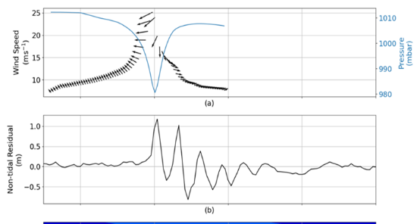
Example of the resurgence in The Great Atlantic Hurricane of 1944
Storm surge was 1.17 m at New York Harbor (NYH).
The resurgence has the highest peak of 1.25 m (trough to peak).
It repeats and dissipates after about 1.5 days.
Using historical tide gauge data and wavelet analysis (not shown), we find that resurgences had caused flooding at NYH during hurricanes and winter storms in 1869, 2013, 2017, and Aug-2020, Dec-2020 (2).
Resurgence
Storm surge

Slide 4
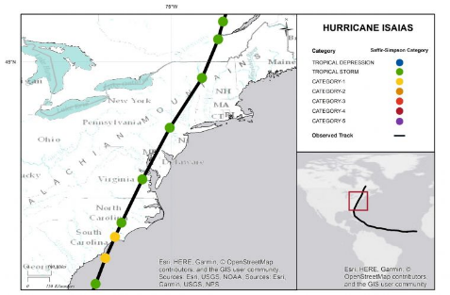
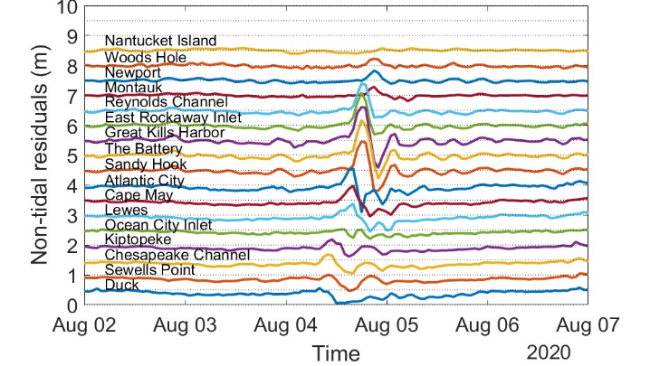
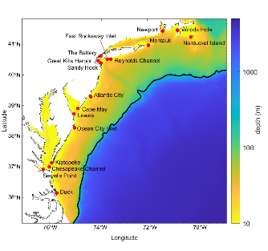
Observation analyses: Historical tropical cyclones
Method: We analyzed tide gauge data during tropical cyclones from 1860-2022.
Example: Hurricane Isaias in 2020
Storm surge
Resurgence
Source: NOAA/NHC

Slide 5
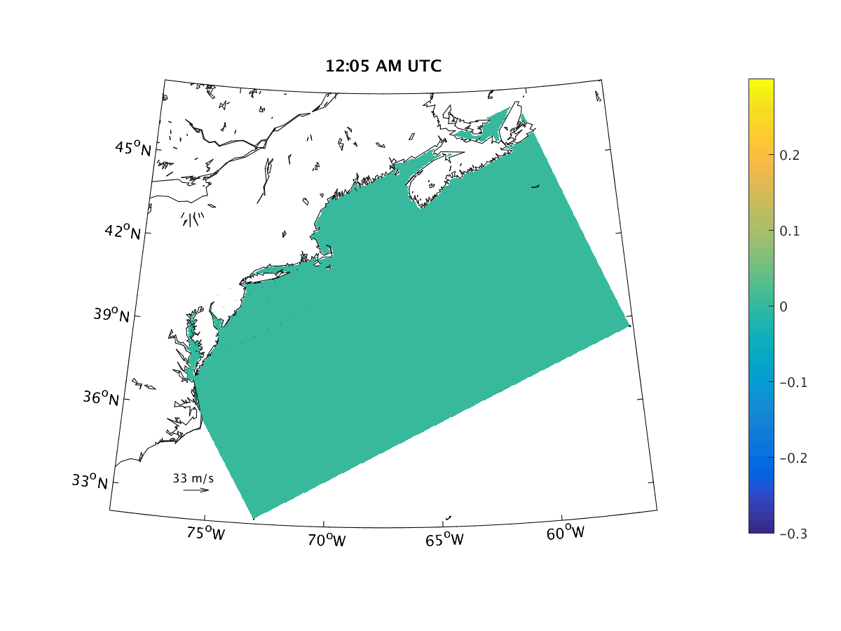
Modeling with Idealized Wind
The sECOM¹-SNAP² model is applied with idealized wind forcing.
SNAP domain with a rectangular 4 x 6 km resolution, 300 x 300 grid
Constant T and S.
No tides, only wind forcing.
Five day long simulation
A one-day southeast 20 m s⁻¹ wind event is simulated, then wind is abruptly reduced to zero over 30 minutes.
¹ The three-dimensional Stevens Institute Estuarine and Coastal Ocean Hydrodynamic Model (sECOM).
² The Stevens Northwest Atlantic Predictions (SNAP) model
Water levels (m)

Slide 6
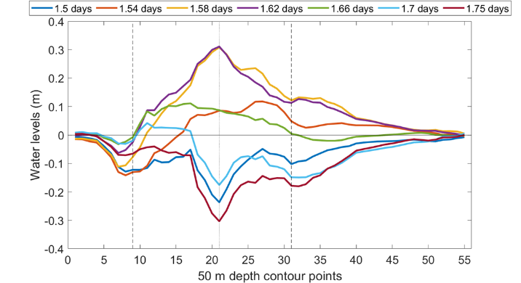
Results
Cross-shore transect
Water level pattern along the cross-shore and alongshore transects
Alongshore transect
Area of onshore wind

Slide 7
Conclusions
Analysis of regional water levels indicates that New York Bight (NYB) is a hotspot for “resurgences”.
Idealized wind event modelling demonstrates that the mechanism of the NYB resurgence is a shelf-wide standing wave or a shelf seiche.
The magnitude of resurgence is similar to storm surges and causes flooding.

Slide 8
Further study
Using a model of the Gulf and Atlantic U.S. East Coast, run further idealized wind experiments to study the importance of shelf seiches elsewhere.
Idealized shelf-slope-abyss modelling of factors controlling shelf seiches.

Slide 9
THANK YOU

